Slide 1
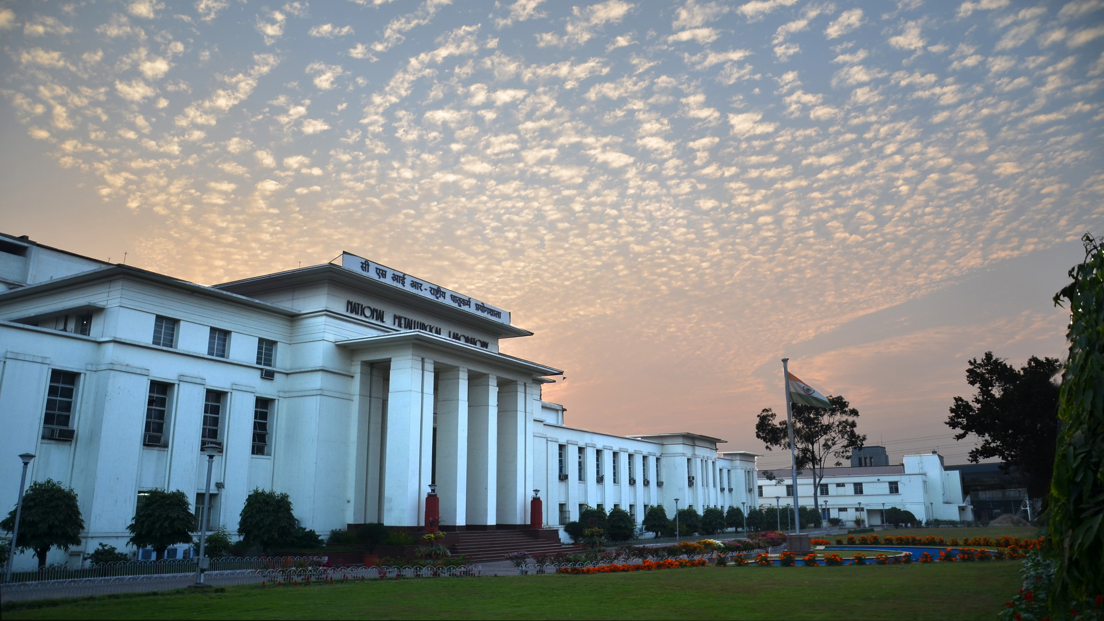
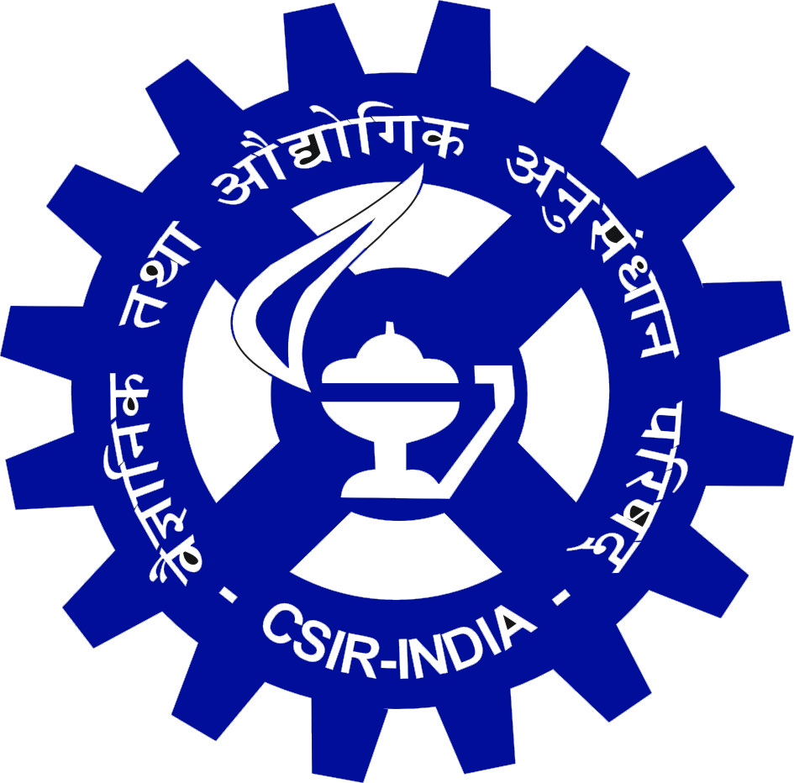
Performance (2016-2021) & Vision 2030
CSIR- National Metallurgical Laboratory

Slide 2
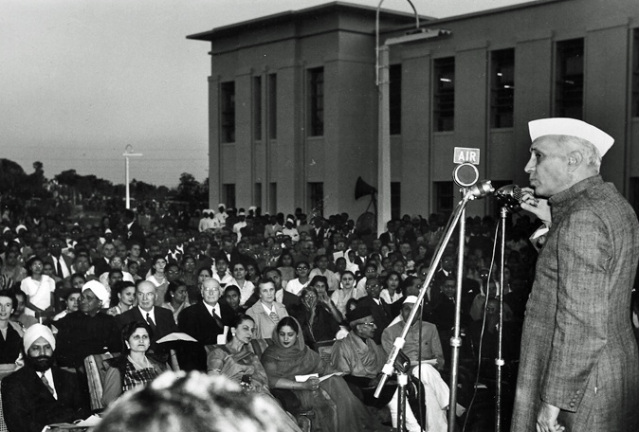
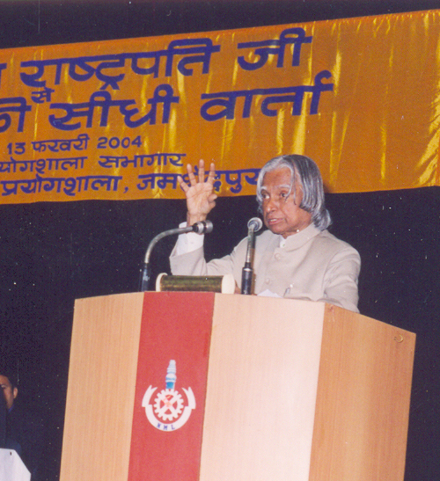
Brief History
Nov 21. 1946 : Foundation stone laid by Hon. C. Rajagopalachari
Nov 26, 1950 : Inauguration by Pandit Nehru
          : First Oxygen steelmaking in India
          1963 : Pilot plant in Mineral processing
          1972-1987 : Technology for Mg production
          1972 : Construction of Creep Facilities
          1975-76 : First Commercial sponge iron plant
          1990 : Component Integrity evaluation programme with World Bank funding
          2004 : Visit of Hon. APJ Abdul Kalam, president of India

Slide 3
Structure & Organization
President - CSIR
Vice President - CSIR
DG - CSIR
Research Council
CSIR-NML
5 R&D Divisions
1 Centre (in Chennai)
3 R&D Support Divisions
3 Ministerial Divisions

Slide 4
R&D Divisions
Covering cradle to grave and rebirth of metals & materials
Mineral Processing : Beneficiating ores of metals & non-metals to economically extractable forms
Metals Extraction : Convert beneficiated primary ores into metals or & Recycling metallic salts. Recycle and valorize secondary ores including industrial wastes
Materials Engineering: Characterize and evaluate metals. Post processing and downstream value addition to metals. Design Alloys
Advanced Materials: Develop new materials and coating and devices
Analytical & Applied : Chemical Analytical assessments for all processes. Chemistry Develops CRMs
NML – Madras Centre: Column Flotation; metals & materials evaluations

Slide 5
R&D Support Divisions
Research Planning: Industrial liaison, Technology forecasting, IP assessment & Business Development & maintenance, Research Planning
Knowledge Resources: Archive and disseminate knowledge and information. & Information Technology Provide IT architecture and support
Engineering: Provide infrastructural support. Plan and design and supervise creation of pilot plants
Administration: Provide backend non-technical support

Slide 6
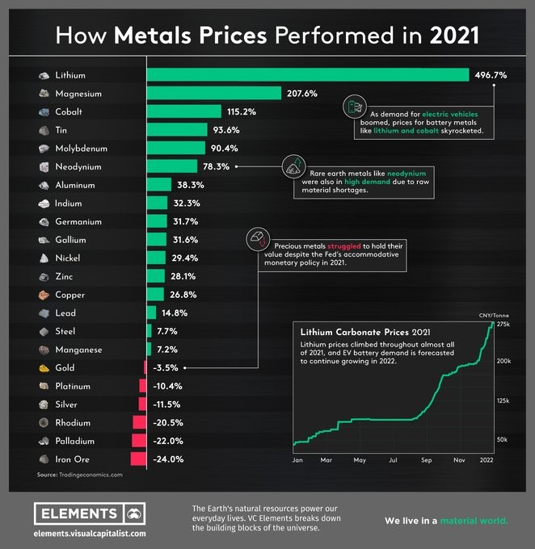
Li
Mg
Co
Sn
Mo
Nd
Al
In
Ge
Ga
Ni
Zn
Cu
Pb
Steel
Mn
Trends in Metals

Slide 7
National Mission Programmes

Slide 8
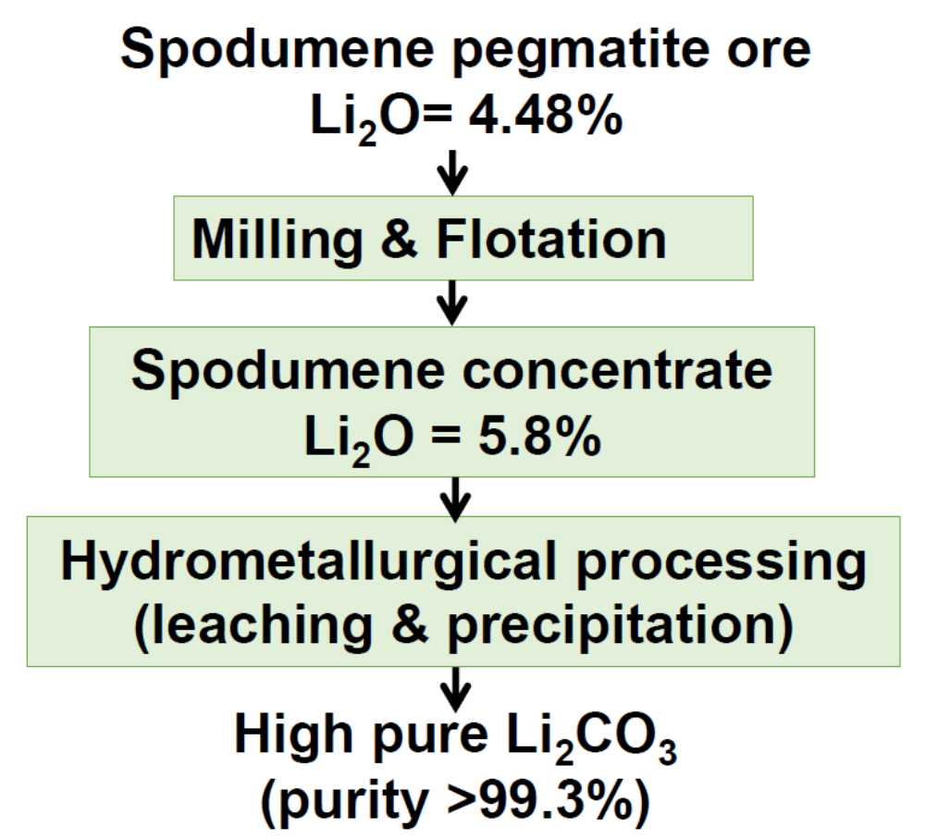
Production of Lithium from Ores
Apr 2020 – Mar 2022
A Work Package in the CSIR Mission Project on Bulk Chemicals. WP leader CSIR-IMMT
Scenario
Global resources:
(i) Brine (>60% of global production) (ii) Pegmatite hardrock (spodumene, petalite) (~40%)
Lithium occurrences in India:
Lepidolite (Jharkhand-Bihar mica belt )
Spodumene (Karnataka, Mandya dist)
No mining in India at present & No commercial Li-technology available & is a critical mineral

Slide 9
Li extraction from Li ion Batteries
Apr 2020 – Mar 2022
A Work Package in the CSIR Mission Project on Bulk Chemicals. WP leader CSIR-NML
Salient Features of NML process
No impurity in any product
Aluminium, Copper Powder: 99%
Iron Phosphate 99.6% recovered
85% recovery of acid
Residual carbon converted to High Pure Graphite
Legacy in LiB recycling
First Research paper published in India on battery recycling in 2011
First project in India on battery recycling in 2010-11 (Renault-Nissan)
First to develop a flowsheet for recovering COBALT (Transferred to 4 Industries)
Mn
Oxide, Carbonate, Sulfate, Chloride
Outlook
Presently TRL 5 soon to be upgraded to TRL 7
2 Patents Filed
EOI for Tech. transfer received from 2 industries
Co
Oxalate, Sulfate, Oxide, Chloride
Products Obtained
Ni
Sulfate, Oxide, Chloride, Carbonate
Li
Carbonate, Hydroxide, Phosphate

Slide 10
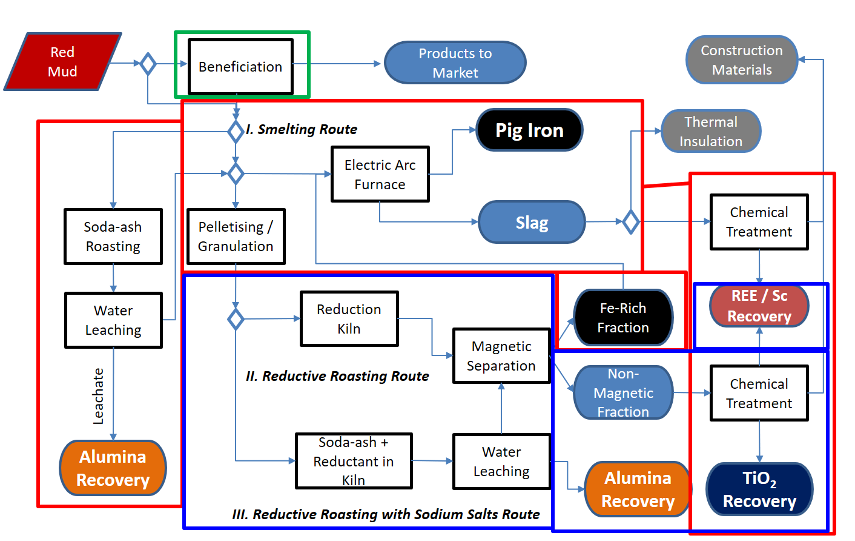
Holistic Utilization of Red Mud
An initiative by Niti Ayog
Oct 2021-Sept 2024
Project Partners
CSIR-NML (Nodal)
CSIR-IMMT
JNARDDC
NALCO
HINDALCO
VEDANTA
CSR-NML (Nodal)
CSIR-IMMT
JNARDDC

Slide 11
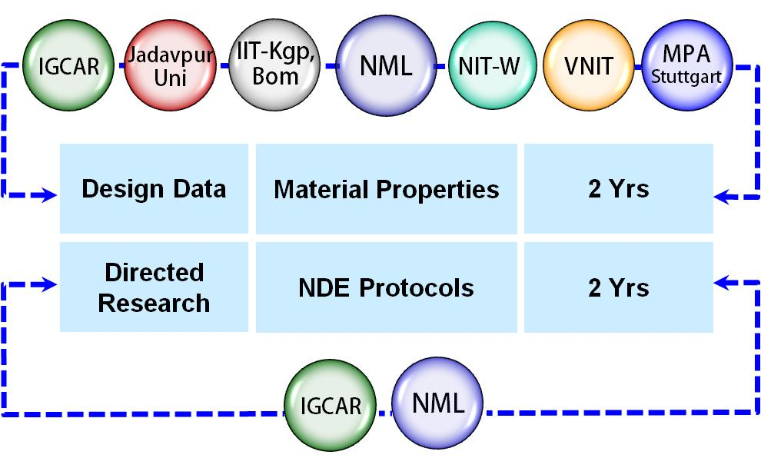
Evaluation of Candidates for Advanced Ultra Supercritical Power plants
Mar 2018-Sept 2021
Partnering Organisations
Component | Material
Water wall tubes | Gr.23 Steel
SH/RH tubes | Gr.91 Steel
Final stage SH | 304HCu
Hot zone SH/RH | Alloy 617M
IP/HP turbine | Alloy 617M + 625
Turbine rotor | 10Cr + Alloy 617M
Creep deformation: Alloy 617M and Alloy 625
❖ Creep Crack Growth : 304HCu and 10Cr-617M DMW
⬥ Fracture & FCGR : 304HCu and 10Cr-617M DMW
 Fireside Corrosion: 304HCu and Alloy 617M
 NDE Tools: Alloy 617M and Alloy 625
Very Severe Operating Conditions : 710⁰C, 300 MPa

Slide 12
Pioneering Research

Slide 13
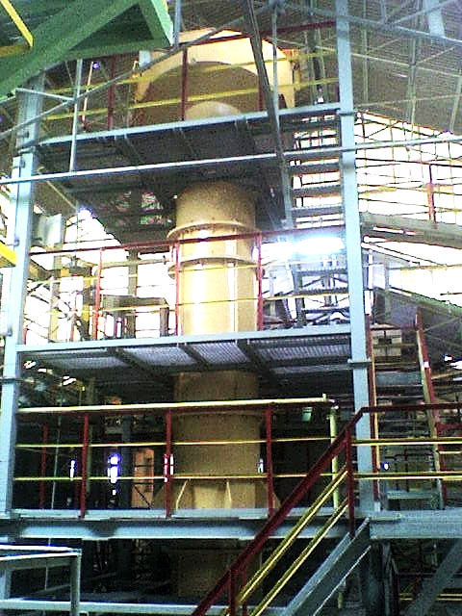
Column Flotation Technology
2007 - continuing
Timelines
1987 : Ideation
1988-1992: Lab scale developments
1992-1996: Prototype development
1996: Mobile pilot plant for on-site demonstration
1996- till date : on-site demo to 12 different clients
2007: First ToT to MSEL Bengaluru
Mineral | Client | Capacity
Limestone | Calpro, Tamil Nadu | 100 tpd, 2007
Sillimanite | IREL, Orissa | 150 tpd, 2006
Baryte | ABCL, AP | 700 tpd, 2014
Baryte | Oren, Tamil Nadu | 1000 tpd, 2018
Sillimanite | KMML, Kerala | 120 tpd, 2019
Coal | Tata Steel, Bhelatand | 200 tpd, 2022
CSIR-NML Achievements
14 columns supplied till date to different customers
Adjudicated best technology of 5 year period by CSIR
Commercial scale flotation column (150 tpd), M/s IREL, Chavara, Kerala

Slide 14
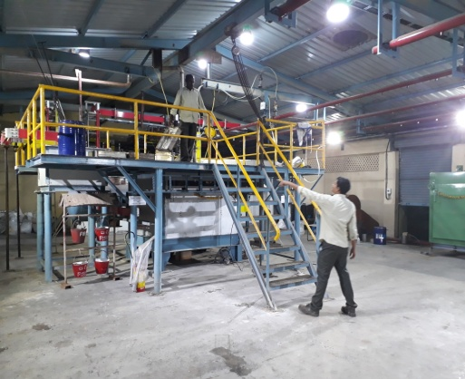
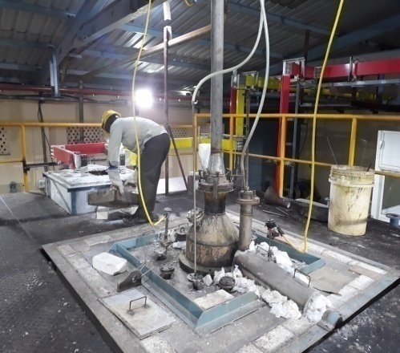
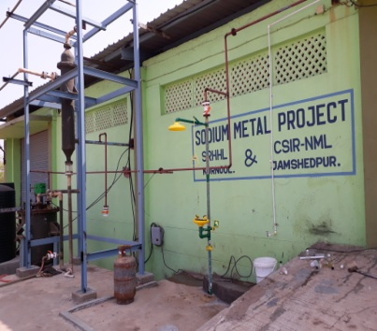
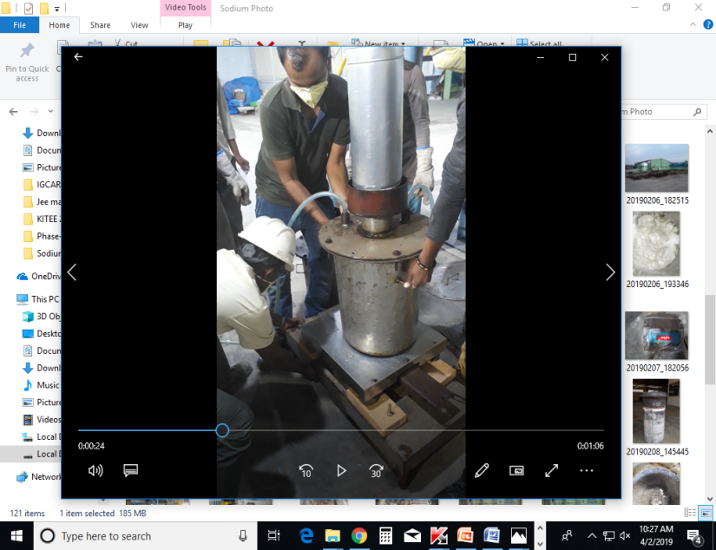
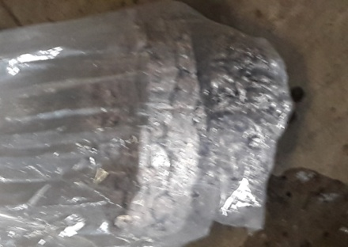
Indigenous Technology for Production of Sodium Metal
Sep 2017-Aug 2021
Only established technology for Sodium production in the country
Development History
Initial bench scale development sponsored by Heavy Water Board
Bench scale development at NML on 500A Cell
Scale- up of 3000A close cell at SRHHL, Kurnool
Purity of sodium metal 99.8%
Process efficiency 80%
Sodium Pilot Plant
3000A cell
Sodium Collection & Storage
Chlorine gas Scrubber
3000A close cell operation at M/s SRHHL, Kurnool

Slide 15
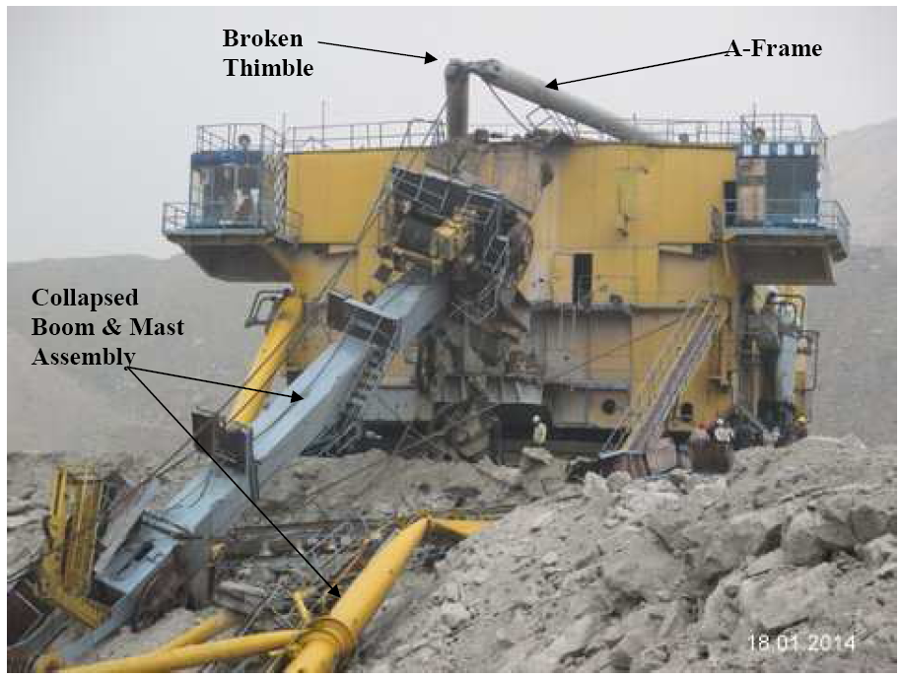
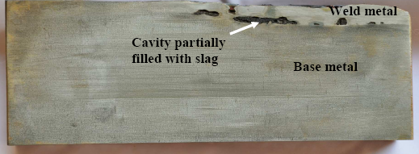
Metallurgical Failure Analyses
Legacy
First International Symposium on Failure Analysis :1953
First Failure Investigation :1954
(Mumbai-Calcutta Rail Accident)
No. of Investigations : >250
No. Publications : >100
Forte of CSIR-NML
2016 – 2021
Investigations : 22
Revenue : Rs. 333 L
Publications : 13

Slide 16
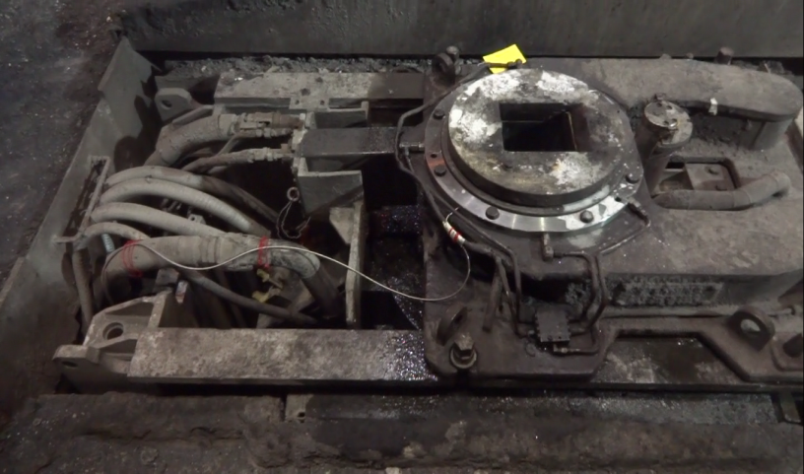
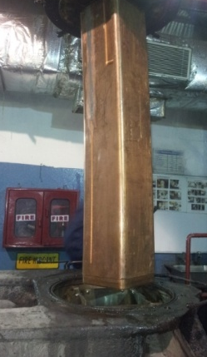
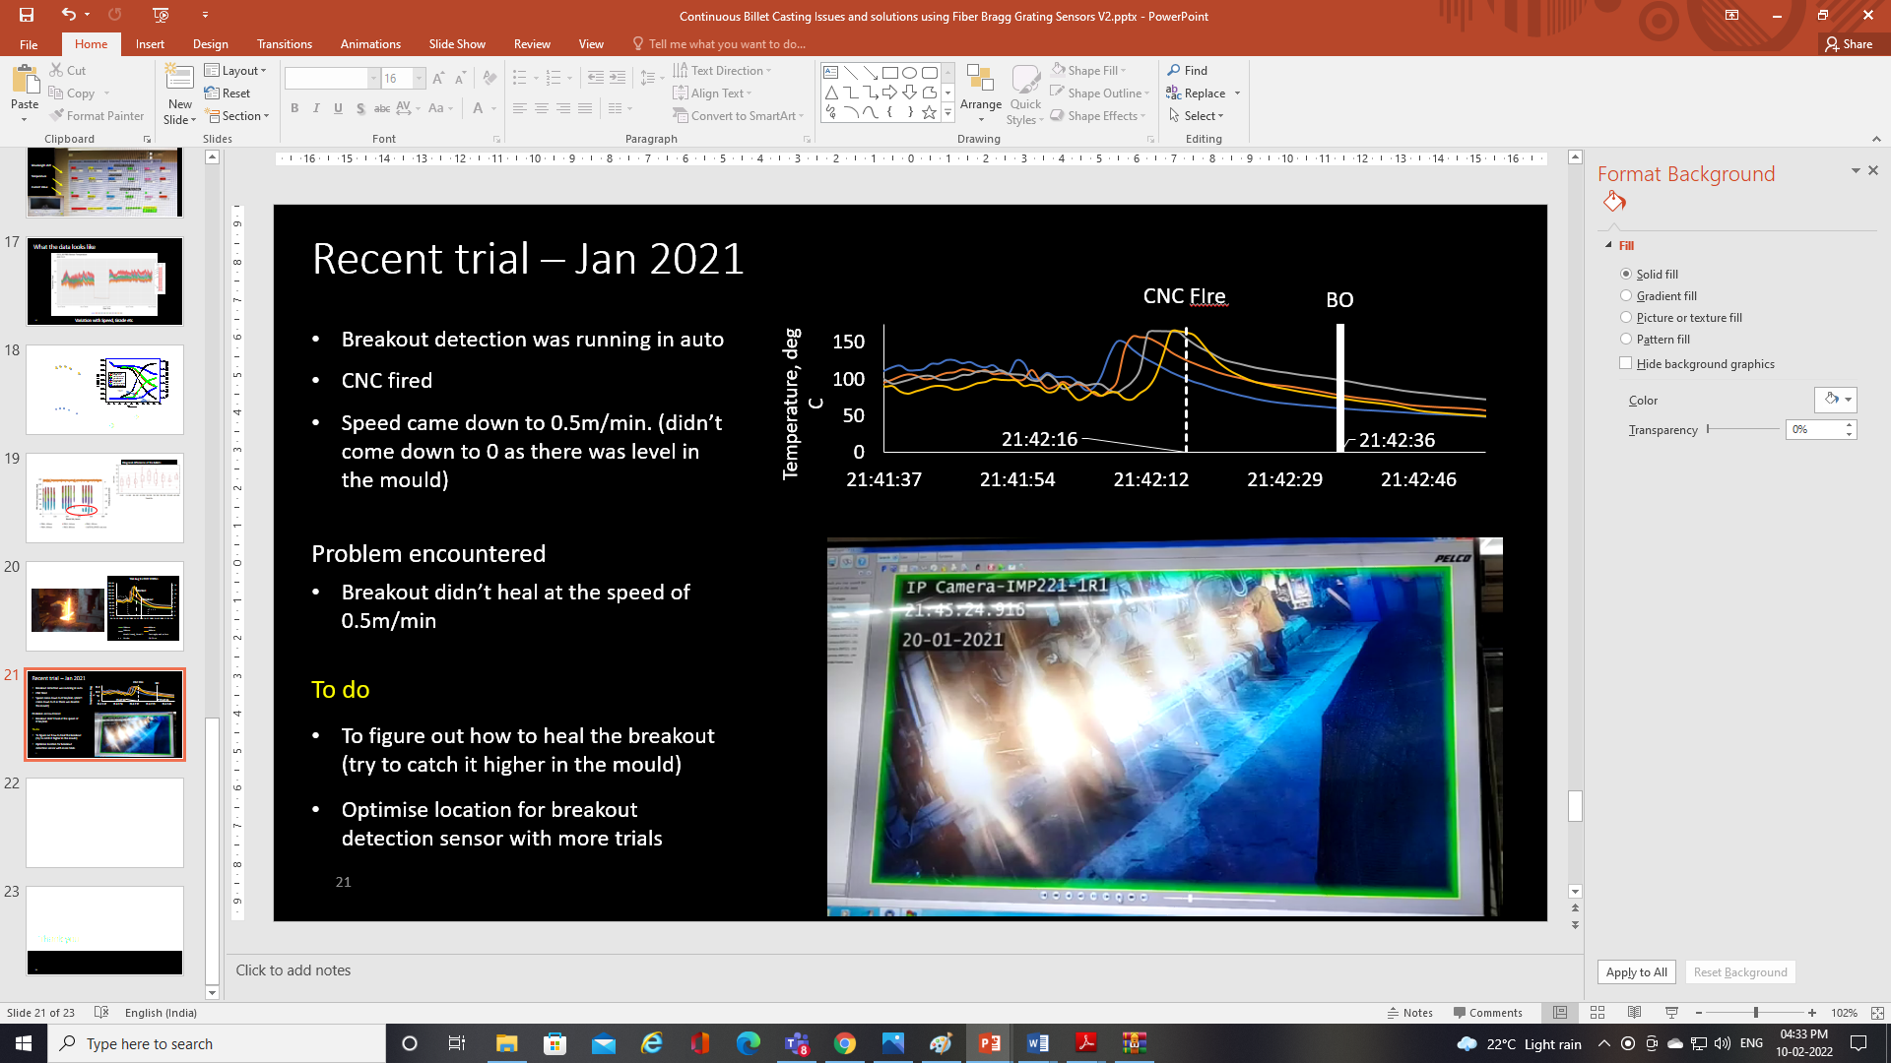
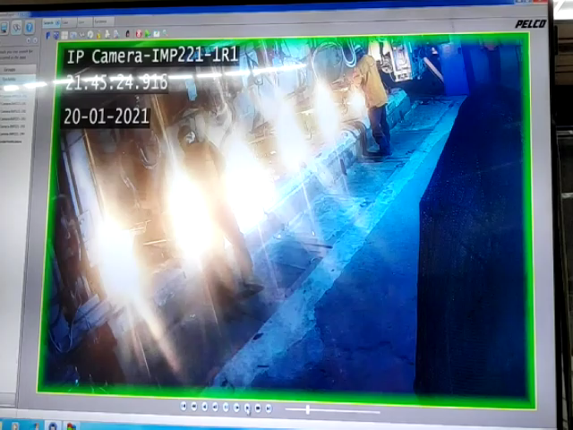
Health Monitoring of Billet Caster in Steel Industry
Nov 2017-Apr 2019
First time in the World online realtime breakout detection in billet caster
CSIR-NML & CSIR-CGCRI joint research in collaboration with Tata Steel
FOBOP
FBG sensors embedded mould for temp. mapping
3 instrumented moulds have been installed at the billet casters of Tata Steel
Work order from Tata Steel for all 6 strands is in process
IoT enablement
At CC3, Tata Steel

Slide 17
National Priority Programmes

Slide 18
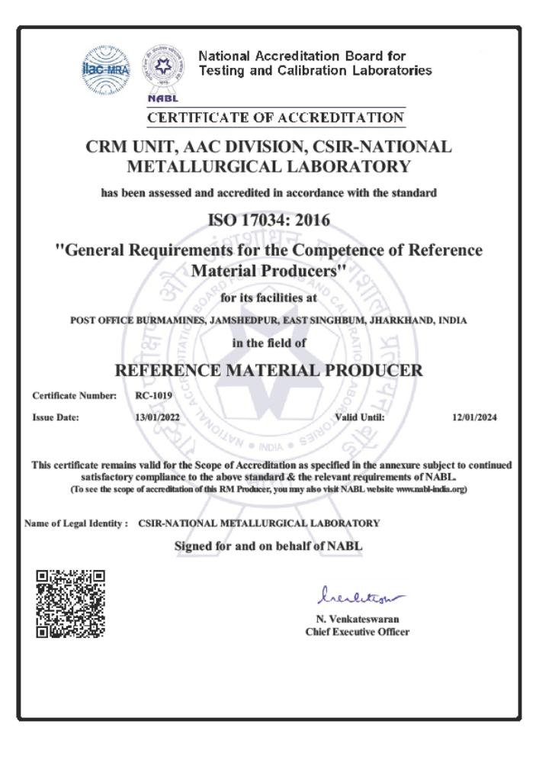
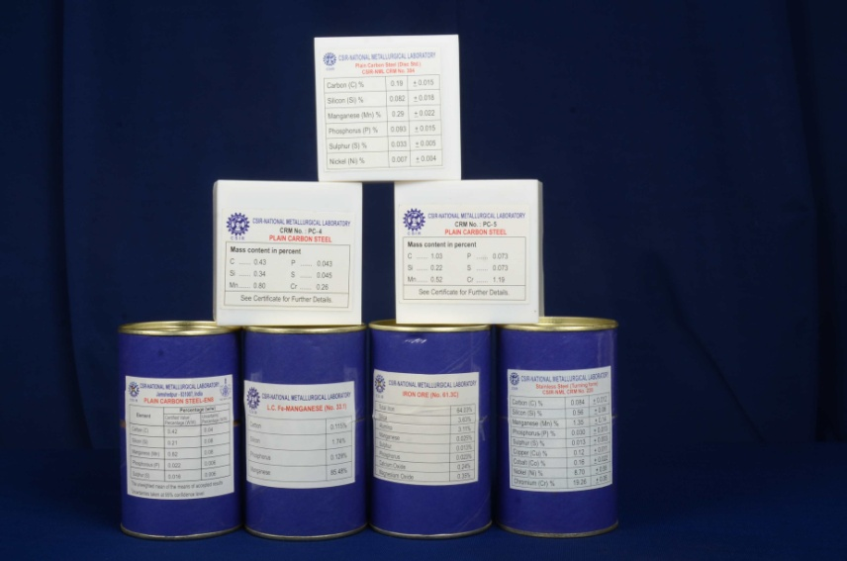
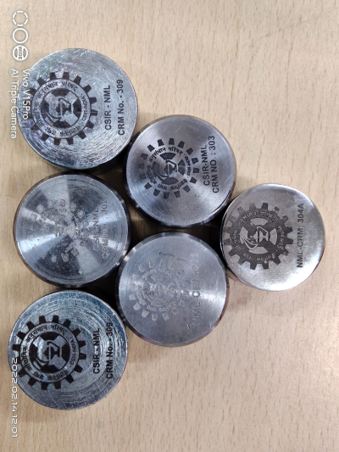
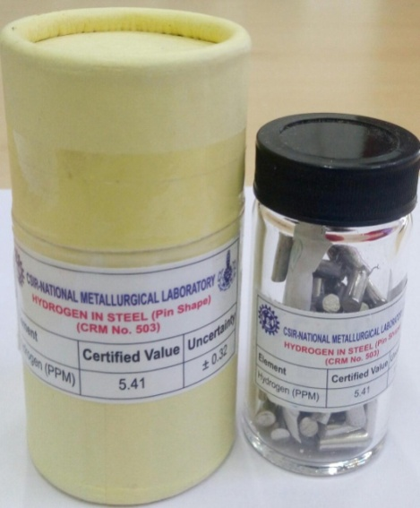
Certified Reference Material
Metallurgical Certified Reference Materials (CRMs) : 39 in place
Possibly have one of the largest range of CRMs in indigenous production
Diversifying to mechanical standards (charpy)
Market links in place
NABL Accredited as per ISO/IEC 17034: 2016

Slide 19
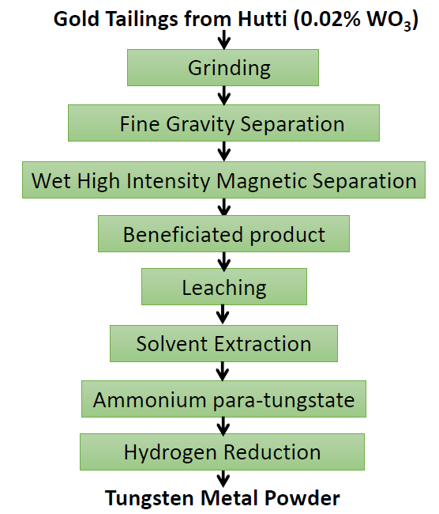
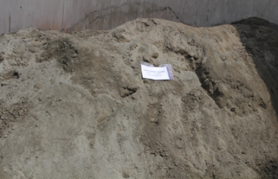
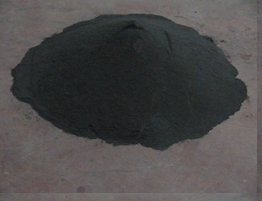
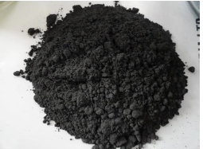
Beneficiation of W ores (Scheelite)
Dec 2016- Apr 2019
Source : Tailings of Kolar/Hutti Gold Mines
Gold Tailing Sample
Beneficiated Pre-concentrate
Tungsten Metal Powder
Sponsor : DMRL
Indian Scenario
Domestic demand, 150 MT/month – imported
~1.5% WO₃ can be economically processed, Indian reserves, very low-grade ores (WO₃ : 0.1% or less)
Deposits: estimated :87.4 million tonnes
Gold ores of Kolar/Hutti - Scheelite.
Processing Challenges- Low tenor and fine dissemination
WO₃ | 0.02%
WO₃ | 2%

Slide 20
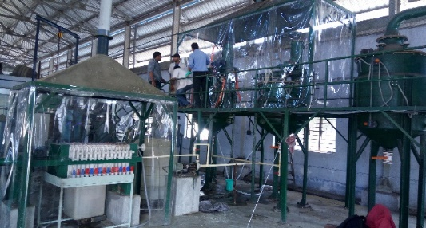
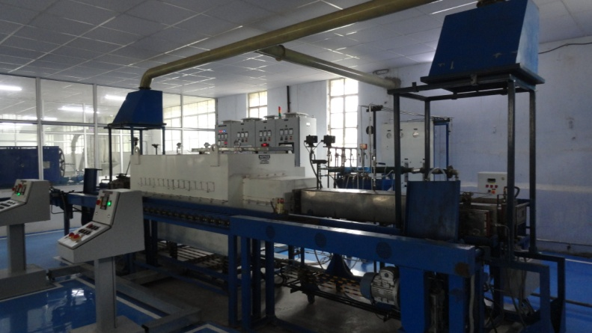
High Purity W-Powder by Recycling of W-Heavy Alloy Scrap
Sponsor : DMRL
Unique Process Advantages
98% W recovery along with recovery of all valuable metals (Ni, Co, etc.)
Close loop practice with no solid/liquid effluents
Processing cost ~ INR 450/Kg, as against INR 700/kg by present practice.
The produced powder meets the stringent spec for re-use by defence sectors
Indian Defence consumes ~ 700 MT/Y W-powder for manufacturing of penetrators of which 10% is scraped. No indigenous recycling technology is available
Scaling-up
100 MT/Y W-powder Production Technology Demonstration Plant is Underway Jointly by DRDO & MIDHANI, based on CSIR-NML technology

Slide 21
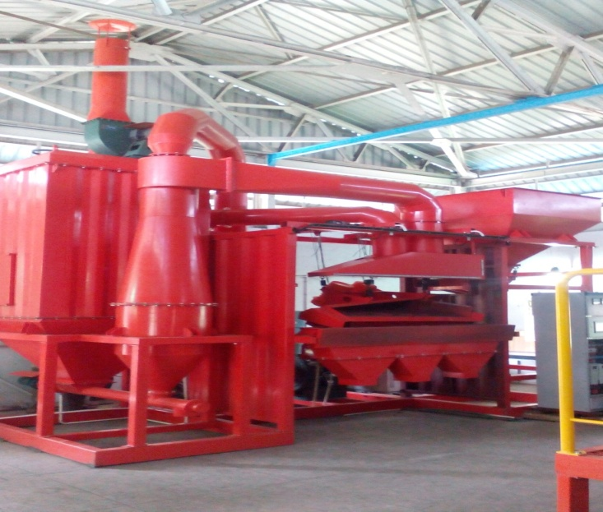
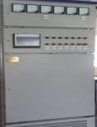
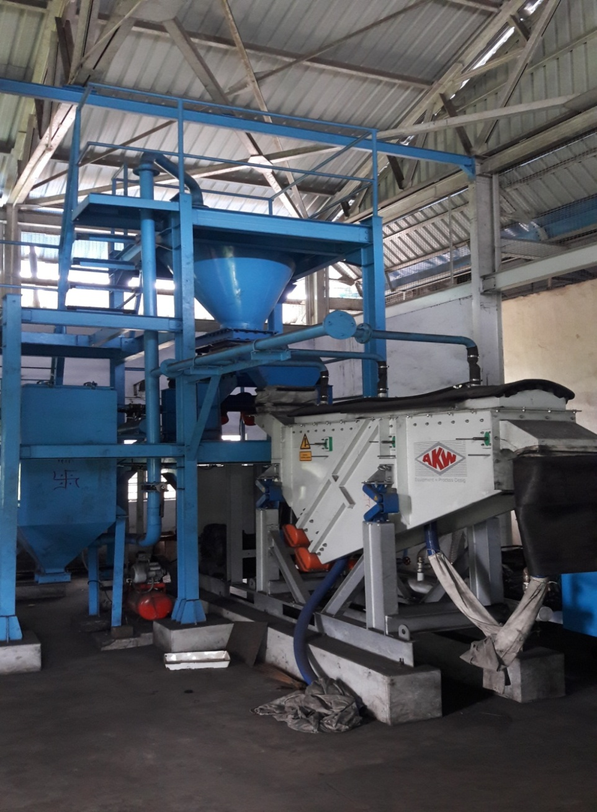
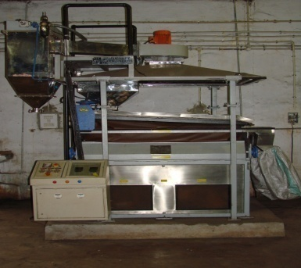
Technology for dry processing of Indian Coals
Advantages of dry beneficiation
Clean product with higher heat value
Conserve water
Simple & compact and cost effective
Requires less floor area
Prevents generation of slime water
Environmental friendly
Facilities of Dry Beneficiation at CSIR-NML
Coarse coal (-50mm) separator
CSIR-NML Achievements
Initiated in 2012 (CSIR network programme)
Several projects supported by Industries today (Tata Steel, Coal India, CMPDIL)
Discussion with CIL on commercialization through a demo plant of 100tph capacity at Mahanadi Coalfield
Medium coal (-5mm) separator
Fine coal (-1mm) separator

Slide 22
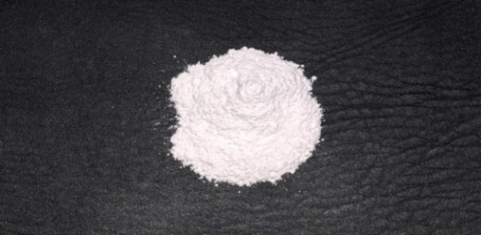
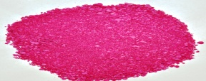
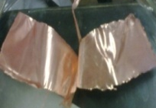
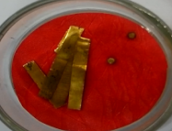
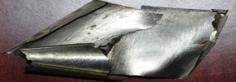
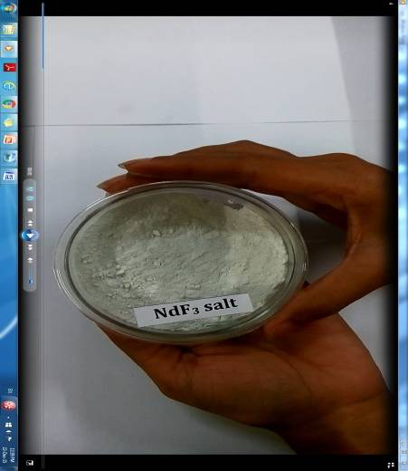
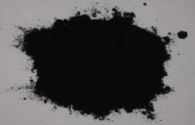
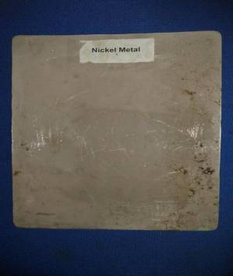
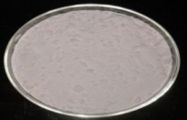
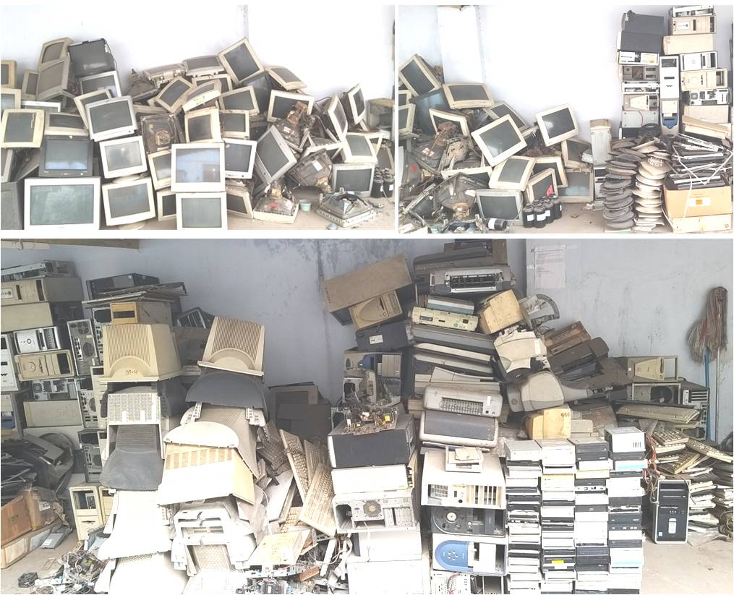
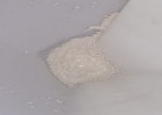
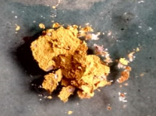
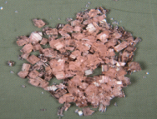
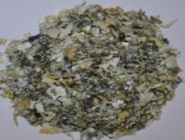
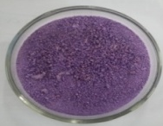
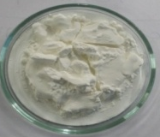
Urban Ore Recycling
Seeded by CSIR funds, inaugurated on 20th April, 2019
Urban ores : discarded PCs/laptops, mobiles, batteries, magnets
Metals Extracted: Precious metals, Ni, Co, Li, Nd, Sm, Cu, Zn, Cd, Pb, Sn, other RE metals
Lithium Salt
Cobalt Salt
Copper Sheet
Gold Metal
Cobalt Sheet
Neodymium Salt
Manganese Dioxide
Nickel Sheet
Manganese Sulfate
Major Achievements
10 technologies transferred
1 technology adjudicated best in CSIR in Physical Sciences
Silver Chloride
Pd Salt
Nd Salt
Plastics
Cobalt Chloride
Samarium Oxalate
Rare earth metals salt
Fe Pigment

Slide 23
Remaining Life Assesments of Critical Components
heater tube
process pipes
process vessel
reformer tubes
storage tanks
header
drums
steam pipes
blades
casings
turbine blade
combustor
boiler side
turbine side
petrochemical
gas turbine
Conduct Destructive tests as per codes
2016-2021
Total Investigations : 17
Revenue Generated : ~Rs. 260 L
Use Empirical relations in vogue
Compare with parametric life curve

Slide 24



Structural Health Monitoring : Device Developments
MagStar: A device for residual stress and microstructural damage evaluation in Ferritic Steel; Technology transferred. [JSW, BHU, NTPC, BARC]
MagSys: Solution for Health Assessment of Reactors of Petrochemicals; Technology Transferred
MagStric: Magnetostriction (MsS) Guided wave based sensing device for health assessment of pipelines using in-house developed amorphous ribbon Technology Transferred
MagStar
MagStric
MagSys

Slide 25
High Impact Industrial Research

Slide 26






Production of DRI using mines & steel plant wastes and non-coking coal
Key Achievements
Waste to Value Added Product
Techno-economic evaluation of the reveals that the developed process is much cheaper than the existing DRI making process
Approximate cost benefit of Rs.5000 per ton of DRI produced
Patent Filed and technology transferred
Mill Scale
LD Sludge
Tunnel Kiln
DRI produced

Slide 27



Ferromanganese by silicothermic smelting of Mn ore
Reduction roasting
Mn Ore
Key Process Features
Carbothermic pre-reduction in rotary kiln
Main reductant in EAF: SiMn
Roasted
Mn Ore
SiMn
Advantages
Fast process
Mn recovery >70% (≤60% in industry)
Energy consumption: 500 kWh/ton (2000 kWh/t in industry)
Process readiness: TRL-6
Lime
Slag
Slag (30%Mn) suitable for recycling in SiMn production
Upscaling Plans
In collaboration with Chandrapur Ferroalloy Plant (SAIL)
Project approved for sponsorship by MoS
Smelting
LC FeMn alloy

Slide 28

Alternate (Gas Based) Reduction Process for Low Grade Mn Ore
Important Findings & Outputs
By-pass valve
High calorific coal (>10,000 kcal/kg) essential for viability of Producer’s gas as an alternate reductant
LPG was found to be a better reductant with maximum reduction efficiency of 93% at 800 ºC
LPG reduction process was scaled up to 20 kg/batch; preliminary cost estimation indicated LPG reduction is cheaper than coal/coke base reduction process
Patent filed jointly with MOIL
Rotameter
Horizontal tube furnace
Water bath
N₂ gas
LPG gas
Sponsor : MOIL
Novelty : Using producer gas as a reductant

Slide 29

Valorization of Industrial Wastes
National Leader in Industrial Wastes Valorizations
At least 20 projects carried out in 2016-21
Red oxide pigment from waste chloride pickle liquor
Process transferred to
Tata Pigments
Rang Sarjan Chemicals
NRDC National Innovation Award of the Year 2020
Complete Value realization from Copper Slag
Single step treatment with no solid/liquid effluent, producing high purity Si0₂ and Ferric sulphate
Process demonstrated and transferred to Sterlite Copper
Vanadium from spent catalysts
Valorizing discarded catalysts used in contact process
Produce high purity V₂O5 by acid leaching and ammonical precipitation
Joint Patent with Hindusthan Zinc

Slide 30
Valorization of Industrial Wastes
CSIR-NML a pioneer in Mechanical & Mechano-chemical activation in India
A pioneer in applying geopolymerization in India
Slags/red mud/fly ash
Copper and steel slags
Granulated Blast Furnace slag
Paving block /bricks
Cementitious slag and Metal recovery
Fly ash
Blended Cements
Wear resistant ceramics
Refractory wastes
Cenosphere
Sponsors/Licensees
Tata Power
Tata Steel
Hindalco
Venspra Labs.
DST
Sterlite
Porous ceramics
Quick repairing material
Wall panels

Slide 31
Advanced Steels Development
Automotive grade steels
Development of third-generation advanced high strength steels
Nb +Ti Microalloyed Hot Rolled Steels
Process development schedules to achieve higher r-bar value as well as HER and flangeability n existing automotive grades of steel
Partners: SAIL, TATA Steel, JCAPCL
Wear-abrasion resistant steels
Development of Quenched & Partitioned steel through Hot Strip Mill Route – successfully tested at 300 T capacity and processed in industrial rolling mill (Tata Steel)
Development of thicker section (thickness > 6 mm) abrasion resistant grade steel with relatively higher coiling temperature - pilot scale (Tata Steel)
Wear Resistant Grinding media and Blow-bars for primary crushers – technology transferred and Implemented at plant (Shree Cement)

Slide 32


Realtime Process Monitoring : Device Developments
FlawGuard: Real-time defect detection sensing device for cold drawn wires. Device installed and commissioned at Tarapur Wire Mill. Technology transferred [Tata Steel]
Zincometer: A sensing device for real-time zinc weight measurement in GI lines: Suitable for both thin (52-100 GSM) & thick coating (250 -500 GSM) lines. Two sensors and a device installed at Tarapur Wire Mill [Tata Steel]
AI based critical zone assessment of Blowpipe using embedded FBG sensors to avoid catastrophic failure. [Tata Steel]
UFG: Ultrasonic Flow Gauge for the estimation of propellant flow rate in a spacecraft; Technology Transferred [ISRO]
Sensors
At TWM, Tata Steel
Device

Slide 33


Device Developments for process simulations
Flow assisted corrosion test rig
Annealing Simulator
To simulate annealing and other heat treatment processes used in steel industry for property prediction and process selection.
Developed in Collaboration with Tata Steel. Has been used for extensive sponsored research.
To study flow assisted corrosion with varying flow rate and dissolved oxygen. Technology (TRL-6) is ready for licensing.
Developed in collaboration with ONGC. Patented.

Slide 34

Hot dip process simulation of Automotive grade AHSS
Several hot dip processes simulated for commercial steels:
Spot free GI & GA coatings on AHSS (600-1000) using Fe interlayer (Patent with Tata Steel)
Al-Si-Mg-Cu-Sc coatings for hot stamping applications (Patent with Tata Steel)
process for adherent Zn-Al-Mg coatings without any bare spots on AHSS
Extensively used to carry out collaborative research with major steel players (Tata Steel, JSW, SAIL)

Slide 35
Niche Research & Services

Slide 36
Research Solutions for the Indian Defense
Interactions with Indian Navy
Interactions with Indian Air Force
Naval HQ, Delhi
INS Dockyard, Mumbai
INS Eksila, Visakhapatnam
INS Dockyard, Visakhapatnam
On board INS Vikramaditya
MoU signed between CSIR-NML and Indian Air Force on Dec 07, 2020
Failure analysis of Quill Shaft of MiG-21 Bison Aircraft (HAL, Sep-Nov’21)
Material analysis of 562D Harley Buckle used in parachute (Ordnance Parachute Factory – Kanpur)
Root cause analysis of sheared bolt of AVRO AC H-2373 Aircraft (IAF Station-Thiruvanatapuram)
Failure Analysis of Engine Exhaust Unit Retaining Bolts (IAF Station-Vadodara)
Root cause of cracking over hydraulic pipe line (IAF Station-Thiruvanatapuram)
Indigenisation Programmes
RLA of Gas Turbine Engines
RLA of Boiler Tubes of VKD
Rejuvenation of Gas Collector
Training Programme

Slide 37







Research for Societal Benefits
Energy efficient, eco-friendly brass melting furnace for artisans
DPR for silver artisan cluster
Melting
Casting of ingots
Melting in developed furnace
Ingot re-heating
Rolling of ingots
Trained ~ 450 artisans/entrepreneurs at NML
Demonstration given to ~ 700 artisan outside NML; Installed furnaces at 7 different places
Transferred technologies to:
(i) Khadi & Village Industries Board, W. Bengal
(ii) Yugantar Bharati, Ranchi, Jharkhand
Prepared DPR for 5 silver clusters of West Bengal, under sponsorship of the MSME ministry of WB

Slide 38


Knowledge Dissemination to Society
CSIR Integrated Skill Initiative
Corporate Training
Professional Training
Societal Training
Summer and Winter Training
National Apprentice Training
Training under the DST-Women Technology Park
Teachers’ training under CSIR Jigyasha 2.0
Journal of Metallurgy and Materials Science
A technical journal published by CSIR-NML
Starting Date : 1959
Previous Name: NML Technical Journal
Website launched in 2021
Open source since 2020

Slide 39
Initiatives for MSMEs & Entrepreneurs
NML-Intellectual Property Facilitation Centre (NML-IPFC)
Caters to all IPR related queries and issues of MSMEs
IP Awareness Training/ Programme | 16
MSME trained/facilitated | 1600
IP advisory Services | 25
IP Search and Analytics Services | 20
Patent Filings | 7
Trademark Registration | 20
GI Filings | 1*
Copyright Registration | 3
Design Registration | 7
MSME
IP Clinics
Techno Support
NML-IPFC
Services Offered to MSMEs
IP Search and Analytics
IP Valuation
Drafting IP claim
IP Maintenance
Liaising with legal
IP Legal Firms

Slide 40
Parametric Performance

Slide 41
Patents Filed
Patents & Technologies
Technologies Transferred
Technologies Developed

Slide 42
No. of SCI Publications
Publications
Average Citation per Paper
Impact Factor of Publications

Slide 43
Financial Health : External Cash Flow (ECF)

Slide 44
Financial Health : Laboratory Reserve (LR)

Slide 45
NML’s USPs
4 active Scientists acknowledged in the “Top 2% in the World” in their respective domains (List by Stanford University)
The largest active pilot plant in the country for minerals processing
Only Indian research organization with commercialization capabilities of column flotation
Internationally renowned for mechanical and mechano-chemical activation
First Geopolymer pilot plant of the country, leaders in geopolymerization applications
Only Indian organization with piloted sodium production technology
Urban Ore Recycling Centre, first of its type in country working on a close loop system
National Leaders in valorization of industrial wastes and secondary resources; in Metallurgical Failure analysis and structural health monitoring
Second largest Creep Laboratory in Asia (~190 test points)
NABL accreditated analytical facilities; Largest repertoire of CRMs for metallurgical industries
Pro-active, industrially savvy Business Planning, adjudicated Best in CSIR in “Business Development &Technology Marketing” three times in last 10 years

Slide 46
NML’s Best Practices
IP whitespace analyses mandatorily done before technology development
Provide performance guarantee if asked for by clients
To ensure mentorship, inclusion of junior level scientists with a minimum of 25% total project manpower made mandatory, in all sponsored projects
Equipment utilization by all including internals by online centralized booking
Online customer feedback system in place
Quantified parametric evaluation of annual performance of scientists
Frequent “technology pitching” organized
Creation of a “Friends of NML” group consisting of the most renowned materials scientists and industrial icons, for advise and guidance
QR coded file movements for time accountability

Slide 47
SWOT
Strength | Weakness
Qualified & renowned manpower Good Brand name Excellent infrastructure A few niche areas A few “best in country” facilities/expertise Excellent industrial connect | Locational disadvantage No normative advantages Procedural slowness (a CSIR global issue) Diverse Heterogenous Clientele Too much time spent on non-technical information supply (a CSIR global issue)
Opportunity | Threat
Global markets Statutory environmental norms Vacation of conventional metals research areas by many institutions | Competition from R&D Labs including global players (a CSIR global issue) Industrial slow down especially metals, automobile, and other sectors Weening away of the best scientists by other attractive career offers (a CSIR global issue)

Slide 48
Vision 2030
Vision Statement: To become an internationally benchmarked & self-sustained technology centre in minerals, metals & materials and meet the aspirations of the people of India
Mission Statement: To develop technologies that meet the need of the country, provide sustainable solutions to industry and add value to our society through dissemination of knowledge, skill building and developing entrepreneurship

Slide 49
Vision 2030
Projected Thrust Areas
# | Area | Potential Beneficiaries/ Sponsors
1 | Dry Beneficiation of coal and ores | Coal India, Varous Mining Cos
2 | Fine particle processing | Various industries
3 | Alloy Development for Structural/Automotive/Aerospace Applications | Steel Companies, DRDO, ISRO, Aluminium companies
4 | Extraction of strategic metals from primary and secondary resources including Urban ore recycling | Defense, Chemical Industries, MSMEs
5 | Functional and smart coatings | Appliance Industries
6 | Sensors and NDE for Industry 4.0 applications | Multiple Sectors

Slide 50
Vision 2030
Niche Areas: to be nurtured/ developed
# | Area | Potential Beneficiaries/ Sponsors
1 | Utilization of non coking coal in Coke making process | Coal India, CMPDIL
2 | Integrated Computational Materials Engineering (ICME) | TCS
3 | Powder Production for Additive Printing | Additive Manufacturing Units
4 | High Entropy Alloys; Energy Storage Materials | Energy Sector
5 | Corrosion Modelling and Prediction | Various
6 | Advanced separation & purification processes for REE, Strategic, precious metals, etc. | Defense, IREL
7 | Fused salt electrolysis | Non-ferrous industries
8 | Development of analytical protocols for measurements of trace & ultra-trace elements | GSI
9 | 2D Materials for various applications | Appliance industries
10 | Big data analytics for materials assessment | Various

Slide 51
Vision 2030
Traditional Strength Areas: to be sustained and built upon
# | Area | Established Beneficiaries
1 | Creep evaluation, RLA and failure investigations | Power industries, Air Force, Navy, Railways, Chemical & Fertilizer Industries, Atomic Energy, Automotive sector
2 | Structure-property correlations | Various
3 | Material design data generation | DRDO/ BARC/ IGCAR
4 | Enhancement of corrosion resistance | Railways, IEOT, Tata Steel, various
5 | Thermomechanical processing of Alloys | Steel Industries
6 | Formability assessment of Alloys | Steel & Aluminium Industries
7 | Hot Dip Coatings on Steels | Tata Steel, JSW
8 | E waste management | Various MSMEs
9 | Industrial Waste utilization | Steel/ Cement/ Power Industries
10 | Agglomeration of iron ore fine | Steel Industries
11 | Development of ferro-alloys | Ferro-alloy manufacturers
12 | Quality assessment and evaluation of coal | Coal India, NTPC, Other power industries
13 | Trace elements and rare earth element mapping of soil and sediment samples of India | GSI

Slide 52
Vision 2030
Technology developments: to be pursued
Utilization of Non Coking coal for Coke making
Dry beneficiation protocols proliferations
Clean coal production through oil agglomeration
Decarburization of Ferro-alloys
High purity EMM and EMD production
LC/MC ferromanganese from siliceous ore
Solar grade silicon metal production
Technologies for REE extraction from secondary resources
Extraction of valuables from end of the life batteries
Hybrid materials for fire resistant applications
Potash recovery from indigenous low grade resources
Cobalt and Nickel recovery from wastes and effluents
Platinum group metal recovery from secondaries
Scandium recovery from tin slag
Lean Ores Processing
Metals/ Alloys from primaries
Metals/ Alloys from secondaries and wastes

Slide 53
Vision 2030
Technology developments: to be pursued
Advanced High Strength and High Temperature Alloys
Electrical Steels
Powder production for Additive manufacturing
Mg based Bio-implants
Corrosion measuring devices
Self-healing Coatings
Zinc control system for Multi-strand wire GI line
Hard amorphous coating for mining components
Corrosion resistant solar reflecting Graphene paint
Liquid Zinc corrosion resistant coatings for Sink roll
Green technology for oxide scale removal of moving parts
Universal Hot dip coating process for Advanced High Strength Steels
Advanced Alloys
Corrosion and Wear resistant products & protocols

Slide 54
Vision 2030
Initiatives for the Society
A. NML Intellectual Property Facilitation Center
B. CSIR Skill Initiatives : Targets
Type | 2022-23 |  | 2023-24 |  | 2024-25
 | No. | Participant | No. | Participant | No. | Participant
PTP | 8 | 140 | 8 | 145 | 8 | 140
CTP | 5 | 65 | 5 | 65 | 5 | 65
NTP | 15 | 230 | 15 | 230 | 15 | 230
STP | 13 | 420 | 12 | 445 | 12 | 445
ITP
OTP | 5 | 170 | 5 | 170 | 5 | 170
Total | 46 | 1025 | 45 | 1055 | 45 | 1050
PTP : Professional Training
CTP: Corporate Training
NTP: NSDC approved training
ITP: International training
OTP : Other training
C. Skilling of metal artisans

Slide 55
Vision 2030
Business Planning
A. Collaborations to be developed
# | Research Area | Organization
1 | Materials & Alloys Development | Tata Steel, DRDO, BARC, ISRO
2 | Materials for advanced aero engine applications | DRDO, GTRE
3 | Red Mud utilization | NALCO, Vedanta, HINDALCO
4 | Urban ore | Various MSMEs, MEITY, Tata Chemicals, IREL
5 | Materials Evaluation | GAIL, IEOT, ONGC, ARCI, IOCL, NHPC
6 | Materials for sensors & device development | ISRO, Tata Steel, NTPC, ONGC
7 | Strategic Metals | DRDO, IREL
8 | Additive manufacturing | ARCI, DRDO
9 | Dry beneficiation | Coal India, CMPDIL, Tata Steel
10 | Li extraction | Various MSMEs,
11 | Trace element analysis | GSI

Slide 56
Vision 2030
Business Planning
B. Special Business Strategies
Revenue Projection 2022-2030
In Rs. Crores
Providing Performance Guarantees
Flexibility on testing and services charges based on competition and quantum
Including “commercialization” clause for NML technologies with incentives for commercialization
Develop Industry – CSIR collaborations for challenging areas (e.g. Tata Steel – CSIR challenge programme)
Handholding MSMEs in relevant areas
Obtain NABL accreditation for most of the important testing and scientific services
Expansion of international client base
Exploit normative protocols
 | Type | Commercial Rupees | Govt. Grants
ECF | Industrial Research | 230 | --
 | Grant-in Aid Research | -- | 100
 | Tech. transfers | 15 | --
 | Testing | 25 | --
Non-ECF | CSIR funded | -- | 100
 | Total | 270 | 200

Slide 57
Vision 2030
Human Resource Planning
Expertise required
Recruitment plan (2022-25)
Computational/multi-scale modelling
Metal Powder Production
Advanced Steelmaking
Carbon capture technologies
Stress analysis/ Fracture mechanics
Advance Joining/Forming
Electrometallurgy
Advanced separation processes
Applications of AI/ ML
Coal characterization and beneficiation
Lean ore processing
Category | 2022-23 | 2023-24 | 2024-25
Scientists | 18 | - | 20
Group III | 7 | 5
Group II | 20 | - | 20
Group I | - | - | -
Admini-strative* | 10 | - | 10
* At CSIR-NML level excluding those recruited by CSIR directly

Slide 58

Thank you

