Slide 1


Current Activities at CSIR-NML on Steel

Slide 2
Silt Erosion Resistant Steel for Turbine Hydrogenerator
High Strength High Formable Steels for Automobiles
Technology Development for CRGO Steels
Steel Research
API X80 Steel Development
Steels for Ultra Supercritical Boilers
Cementite Dissolution in Cold Drawn Pearlitic Steel
Low Temperature Sensitization & Intergranular Corrosion

Slide 3

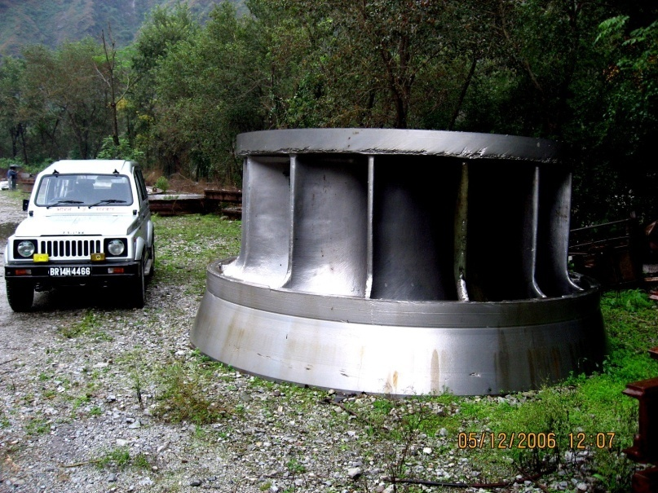
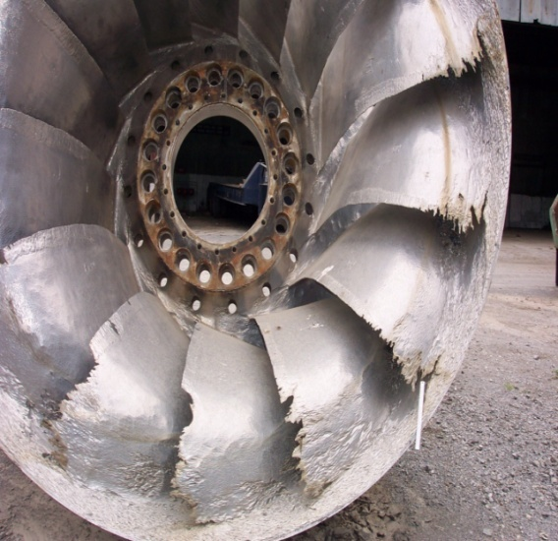
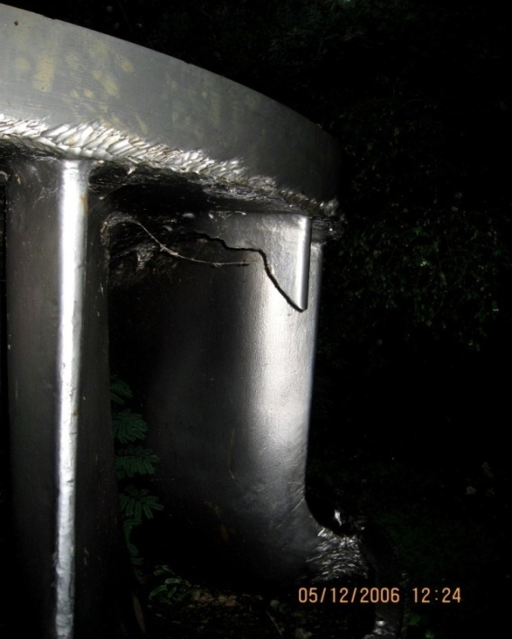
Silt Erosion Resistant Material
New CSIR for New India
for Turbine Hydrogenerator
Damaged RUNNER due to Silt
Francis Turbine
Shark Bite
Developed material to have :
Corrosion resistance similar to 13%Cr4%Ni
Good Castability
Good Weldability
Improved Impact toughness property for resistance to cavitation erosion by silts
Improved abrasion and erosion resistance

Slide 4
Process Flow Chart
New CSIR for New India
Alloy Melting
(Vacuum Arc Melting of 40Kg)
Casting
Check homogeneity by chemical analysis and NDT (UT)
Characterization
Microstructural, Mechanical property
(Optical, SEM, TEM) (Tensile, Impact)
Heat Treatment at air atmosphere
Microstructural, mechanical property
Wear Study
(Solid particle Impingement, Cavitation)
Making of set up
Characterization after Wear
Two Phase (Martensite + Austenite) Cr-Ni-Mn-Cu-Mo alloyed Steels developed for this application
Structure-property correlation
Scaling up to make prototype components

Slide 6
Properties
New CSIR for New India
Variation of tensile strength with tempering temperature
Variation of Impact toughness values with tempering temperature
13Cr-4Ni has tensile strength of 1000 MPa
13Cr-4Ni has impact toughness of 60-80J at room temperature
Material is now undergoing field trial; components have been fabricated and will be put in the plant for the coming monsoon

Slide 7
High Strength High Formable Steels
New CSIR for New India
  Design steel chemistry and processing parameters in order to get
    Yield Stress: 650 - 700 MPa
    Tensile Stress: 900-1000 MPa
    Uniform Elongation: 50% (Min.)
    Optimization of strength and formability
    Optimum balance between strength, fracture toughness and corrosion
Gaps Areas
Gap details
NML Work
Single phase TWIP was developed (UTS:700MPa; eu: 80%)
Two phase (ferrite + austenite)TWIP being developed takes care of Springback
Two phase TWIP cold rolled up to 90% at NML
TWIP
No commercial production (POSCO
and ARCELOR have their own grades)
TWIP being high strength has high springback during processing

Slide 8
Process Flow Chart
New CSIR for New India
Alloy Melting
(Vacuum Arc Melting of 40Kg)
Hot forging followed by hot rolling (normal air cooling)
Characterization
Microstructural, Mechanical property
(Optical, SEM, TEM) (Tensile, Impact)
Cold rolling (11 passes) up to 90% reduction in thickness
Microstructural Characterization
Annealing at air atmosphere of 90% cold rolled sheet
Microstructural, Mechanical property
(Optical, SEM, TEM) (Tensile)
Two Phase (Austenite + Ferrite) Mn-Cr-Al- alloyed Steels developed for this application
Structure-property correlation
High strain rate testing for crash resistance & corrosion testing

Slide 9
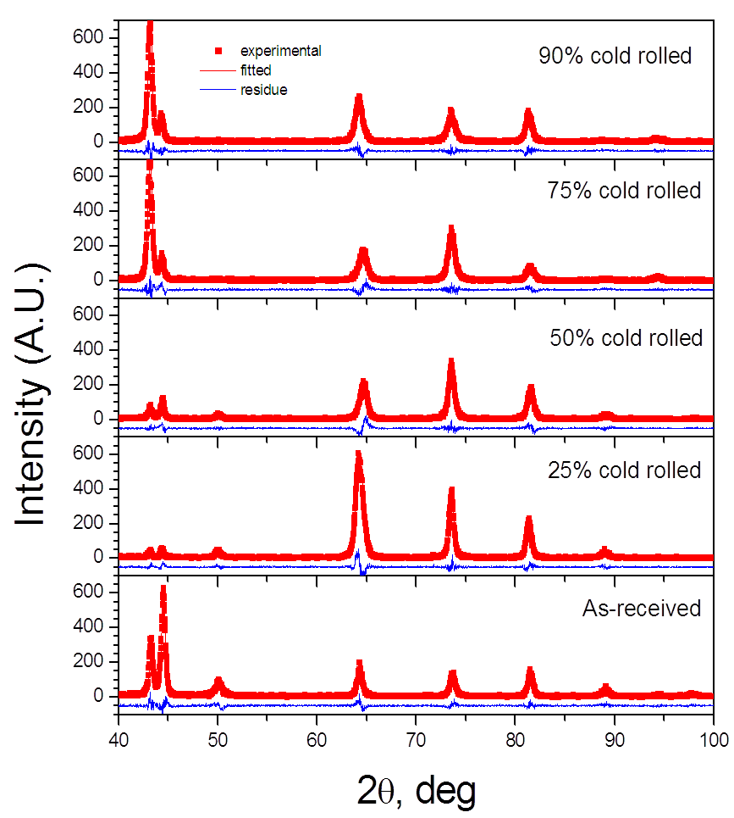
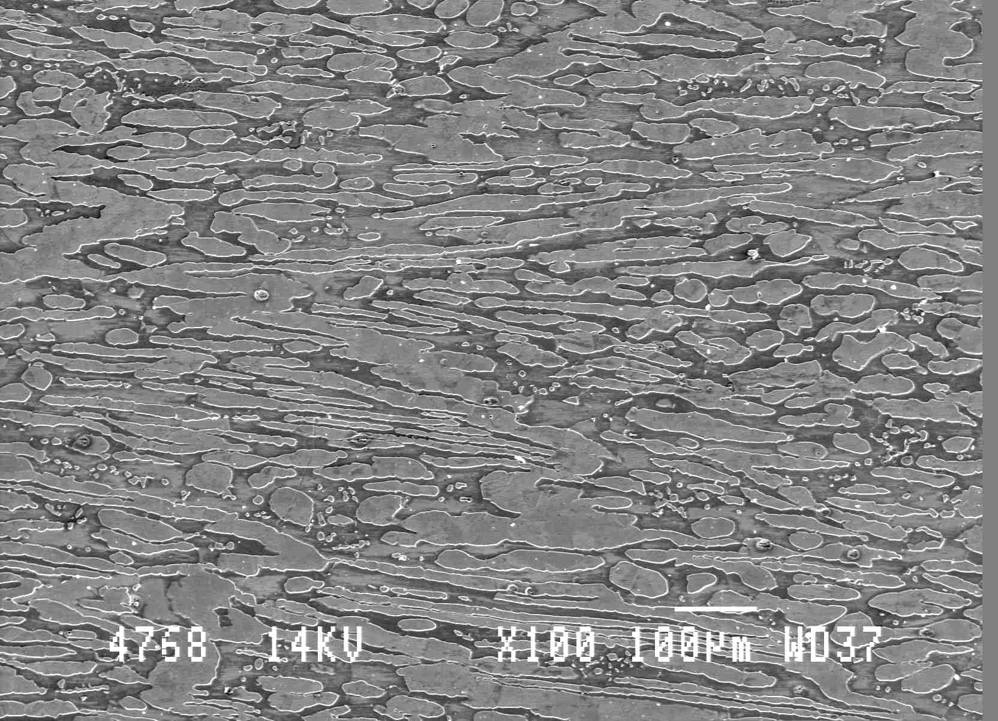
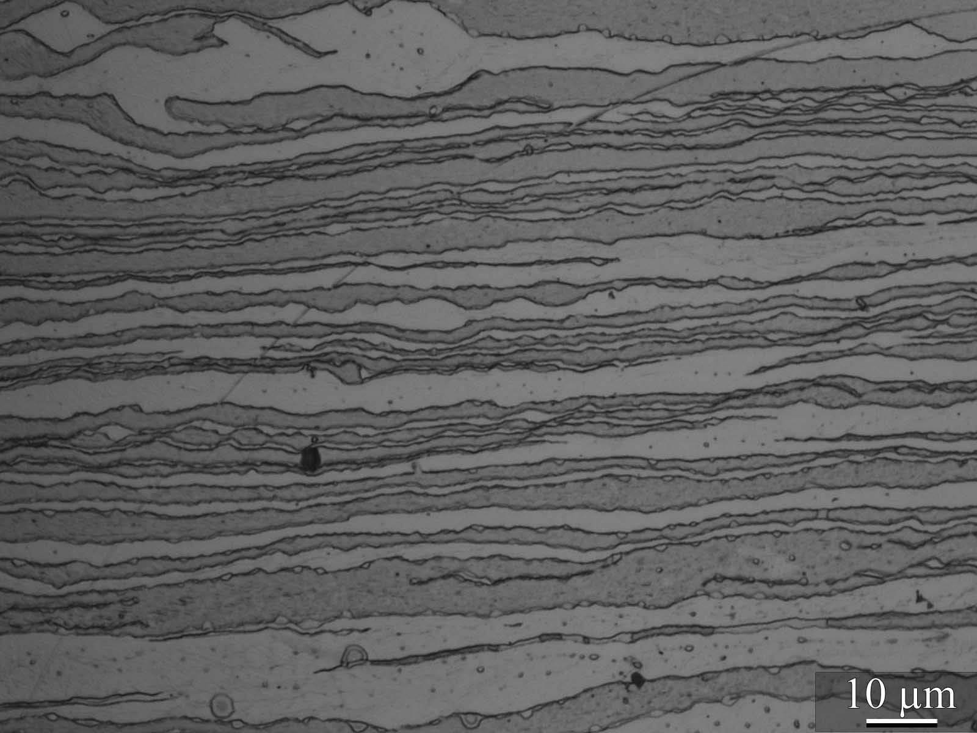
Process Flow Chart
New CSIR for New India
Hot forged and hot rolled microstructure
{111}_{g}
Only observed after 90% cold rolling
{110}_{a}
{200}_{a}
{220}_{g}
{311}_{g}
{200}_{g}
{211}_{a}
Necklace type structure: generally observed for dynamically recrystallized grains
Dynamic recrystallization is unlikely at room temperature
Chances of back transformation from ferrite to austenite is probable

Slide 10
Sample Details | (YS) (MPa) | (UTS) (MPa) | (n-value) | Uniform Elongation
750 ⁰C – 30 min. | 624 | 852 | 0.288 | 28
800 ⁰C – 30 min. | 634 | 888 | 0.297 | 30
1000
strain rate = 2.5*10⁻⁴ s⁻¹
900
800
700
600
Engineering stress, MPa
True Stress, MPa
500
750ºC-30min
800ºC-30min
400
300
200
100
0
0
0.05
0.1
0.15
0.2
0.25
0.3
0.35
0.4
Engineering strain
Unlike in the literature, shows no serration in the stress-strain plot at different strain rates
True Strain

Slide 11
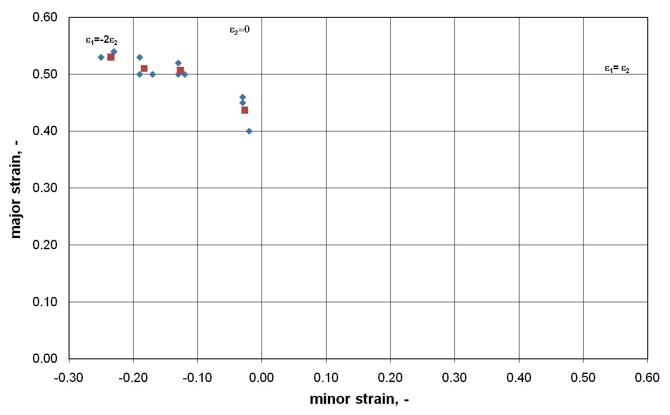
Forming limit diagram (FLD) has been determined from the annealed specimens along the rolling direction.
The FLD presented in the graph shows better forming properties compared to DP600

Slide 12
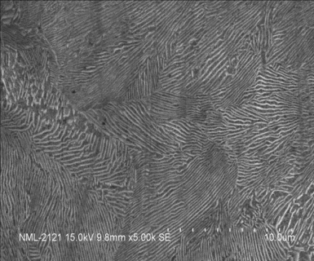
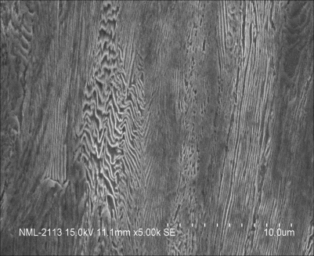
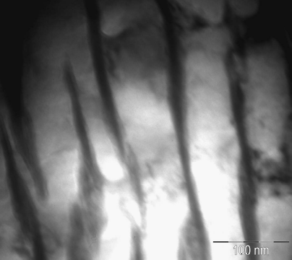
Cementite Dissolution in Cold
New CSIR for New India
Drawn Pearlitic Steel
Drawing strain:0.12
Drawing strain:1.4
Drawing strain:1.4
Equilibrium weight fraction of cementite in pearlite: 12wt%
Quantitative XRD shows < 5wt% cementite at strain 1.4;
Conclusion: more than 50% cementite got dissolved
Alternate ferrite and cementite lamella in pearlite
cementite lamella buckling
Fragmented cementite
lamella and its
dissolution
SEM micrograph
SEM micrograph
TEM micrograph
Drawing strain:1.4
Quantitative X-ray diffraction
< 5 wt% cementite

Slide 13
Cementite Dissolution in Cold
New CSIR for New India
Drawn Pearlitic Steel
Role of ferrite dislocations in the dissolution
Traditional Williamson-Hall plot
Modified Williamson-Hall plot
(Ungar-Borbley )
Non-monotonic increase of
FWHM with angle of diffraction
Confirmation: Strain anisotropy due
to dislocations in the ferrite matrix
Key results
Strain 0.12: 44%screw + 56%edge
Strain: 1.4: 60%screw + 40%edge
Note: ferrite lattice parameter remains unchanged even after the dissolution. Hence, screw dislocations perhaps predominantly pull the carbon atoms from the cementite causing its dissolution.
Total avearge dislocation density: 6 x 10¹⁴/m²
Total avearge dislocation density: 8 x 10¹⁵/m²
CSIR-NML Tata Steel collaboration

Slide 14
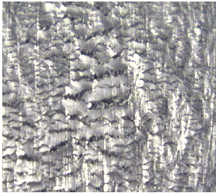
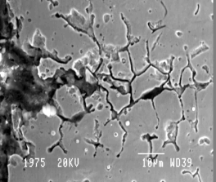
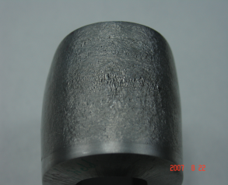
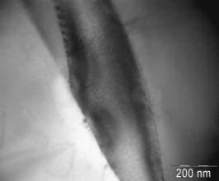
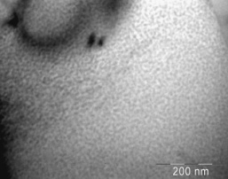
Sensitization & Intergranular
New CSIR for New India
Corrosion (IGC) of Stainless Steel
Role of deformation, GBE, and welding on susceptibility to LTS, classical sensitization, IGC, and IGSCC
Prediction of LTS for 100 years at 300ºC and Time-temperature-sensitization diagram
Deformation effects
Observations and outcome
450C/1300h
Weld
MC
γ
α
γ
α
Heat affected zone and base (304LN) are safe against IGC at 300ºC for 100 years operation
Weld zones are susceptible to failure due to phase separation and LTS
Deformation e.g. >2.5% reduction in thickness causes IGC in 304LN

Slide 15
BASE
HAZ
Temperature, deg C
Temperature, deg C
Time, h
Time, h
Note: TTS Base and HAZ line separates ‘step’ from ‘dual’ microstructure; assigned values are %DOS
Weld
Temperature, deg C
Note: TTS weld line separates fissured and non fissured regions
Time, h

Slide 16
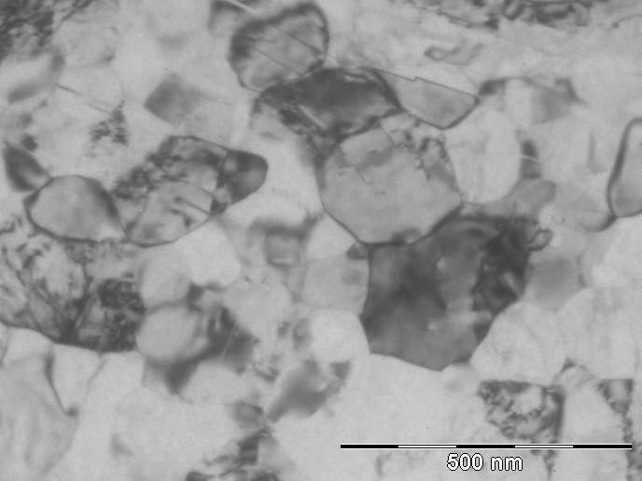
Designing of bulk nanostructure/ultrafine austenitic stainless steel
A novel Cyclic Strain Anneal process
for Bulk nano structure / ultra fine grain
Recrystallisation
Cold
Deformation
Solution Annealed
Matrix
Thermal Cycle
Ultrafine Grained Stainless Steel
Recrystallisation
Cold
Deformation
Solution Annealed
Matrix
Isothermal
Increase in YS 3 to 4 times
gs< 200 nm
Present methods
Severe Plastic Deformation
Accumulative Roll Bonding
Repetitive Corrugation
Limitations ?
Pub: Metall. Mater. Trans. A, 40, 2009, 3227
Mater Sci & Eng A 528, 2011, 2209

Slide 17
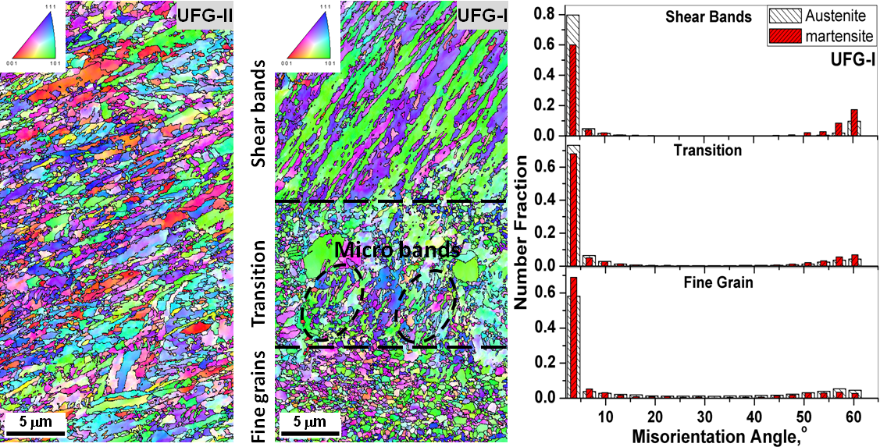
Ultra fine / nano structure Austenitic Stainless Steel -Deformation mechanism
Concerns
Considère Criterion
Plastic instability
Poor strain hardenability &
Strain rate sensitivity
Bimodal grain size
Change in deformation mechanism
UFG-I: Grain size
Below 500nm
Strain localization
UFG-II: Bimodal maxima at ~650nm and ~1400nm
Strain induced transformation of austenite to martensite
Pub:Scripta Mater, 66,2012, 634

Slide 18
API X80 Steel Development
New CSIR for New India
through Thin Slab Casting and Rolling (TSCR) – In collaboration with Tata Steel
Targeted properties
♦ Yield strength : 600-660 Mpa;♦ YS/UTS ratio : 0.85-0.88; ♦ Elongation : 20-25%
♦ Fracture Appearance Transition : -50 to -70 ºC ♦ Charpy Energy (-20 ºC): 150-250 J
Challenges
► Coarse austenite grain size
► Limitation in temperature, strain and strain rate
► Criticality of composition selection (issues with Ti and Nb carbonitrides)
For API grade steel

Slide 19
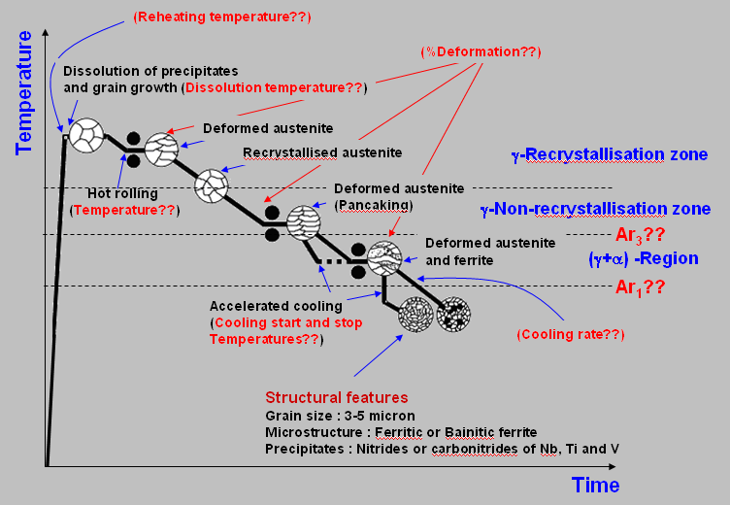
Typical Process for API Grade Steel
New CSIR for New India

Slide 20
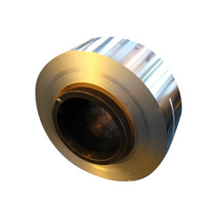
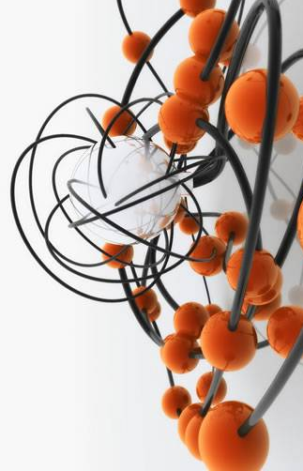
Technology Development for
New CSIR for New India
CRGO Electrical Steel Sheets
International Status : Very Few producers of HI-B CRGOs, no Indian producer
Partnership : CSIR-Tata Steel-Ministry of Steel
(one of the largest PPP programmes ever)
Indian Demand : ~ 1000 million USD worth
Justification/ Need :
It is not just developing another steel grade, but re-creation of a jealously guarded technology
Creation of a pilot scale integrated Flat Products development & processing facility – the only one of its kind in the country
Scale of operation: 3 – 5 Tonne per batch

Slide 21

Areas for Collaboration
New CSIR for New India
ICME: Processing-Structure-Property Correlation Models, Development of databases on composition-processing-microstructure-property correlation for steels
Design and development of high strength high formable steels for automotive applications
Design and development of pipeline steels.
Development of steels for application in USC boilers (30 MPa, 700ºC Steam Conditions)
Fundamental understanding of deformation characteristics in steels

Slide 22


