Slide 1

Processing of Secondaries
& Waste

Slide 2
Recovering metal values from secondaries
Converting waste into value added products
Ni from
Spent Catalyst
Nonferrous slag
e.g. Cu, Zn, SiMn
Ferrous slag e.g.
steel slag, GBFS
W from scrap
High purity Fe
from waste
Program on
fly ash utilization
Waste
Secondaries
Precious metals from E-waste
Program on geopolymer
Rare earth extraction
Red mud utilization
And many
more…
And many more…

Slide 3
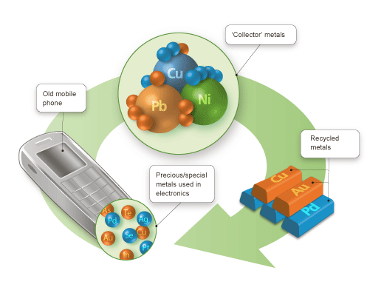
Recovering Metal Values from Secondaries

Slide 4
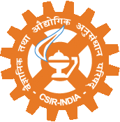
Rare Earth Extraction
New CSIR for New India
Current Indian Scenario
High presence of Monazite in Indian beach sand (resource: 10.2 million tons)
Production of REs from monazite obtained from beach sand: 2700 tons/year
Current production by Indian Rare Earths Ltd. (IREL) : 7700 tons/year (2012 )
Composite chloride of REs (IREL) by hydrometallurgical route
IREL, Alwaye produces Misch metal & individual REs by SX/IX: Oxides of Y, La, Ce, Nd & Pr
India is the second largest supplier of yttrium in the world
Some separation process of other REs -heavy REs developed in India
Scope & Prospects of further R&D
Embargo on supply of REs from China – Provides opportunity for India
Indian Monazite is rich in REs (La, Ce, Pr, Nd, Sm) with small Gd (1%) & Y (0.1%)
Besides monazite, small Bastnaesite and Xenotime (rich in Y and heavy REs) deposits located in India & needs to be harnessed
Waste / secondary resources - spent catalysts, waste magnets, wind turbines are rich sources of REs and no proven extraction technology exists.

Slide 5
Secondaries for Recycling RE &
New CSIR for New India
Rare Metals/ Energy Critical Elements
Only about 1% of the total RE’s is reused and obsolete components are only recycled
Sl. No | Secondary material/ source | Metal values | Processing approach
1. | Super alloys of Ni and others | Nb, Ta, Re, Ni etc | Leaching- metal separation & recovery by SX
2. | Spent Li batteries | Rare earths, Li, Co & other metals | Leaching –metal separation & recovery by SX/IX
3. | Electronic wastes/ scraps- PCBs | Rare metals, Rare earths, PGMs | Hydrometallurgical processing
4. | Bayers’ liquor of alumina plants | Ga & other rare metals | Hydrometallurgy-SX/ IX
5 | Anode slime of copper electrolytic plants | Se, Te, PGMs, Ni etc | Pyrometallurgy / Leaching- Precipitation / SX/ IX
6. | Fly ash of gasification plants | Ga, Ge | Hydrometallurgy
7. | End-of life magnets from electronic equipments | Rare earths- Gd, Sm, Pd, Nd | Hydrometallurgy
8. | Monitors & Screens / LCDs | In | Hydrometallurgy- precipitation/ IX
9. | Sludge of alumina plant | V, Ga | Hydrometallurgy
10 | Spent petroleum catalysts | Mo, Co, V, PGMs | Hydrometallurgy- leaching- metal separation & recovery

Slide 6
Activities under 12th Five Year Plan
New CSIR for New India
Primary/Secondary RE resources
Primary Resources (Indian Monazite)
Secondary Resources (Spent Catalyst)
Develop Novel Recovery process for Light REs (La, Ce, Pr, Nd, Sm) by SX using synergistic systems
Develop eco-friendly process (leaching-SX) to exploit spent catalyst for augmenting resource base of REs (La, Ce etc.) & base metals (Ni, Mo, Co)
Process package for separation and recovery of individual light REs from Indian resources
Process package for leaching & separation of REs and other metals from waste catalysts

Slide 7
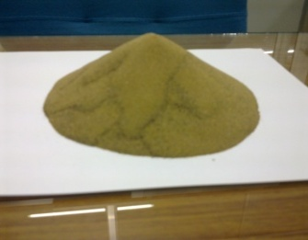

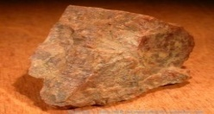
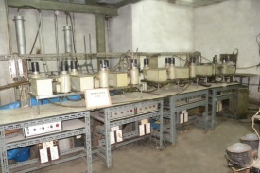
Indo- Korean Cooperation
New CSIR for New India
Rare earth separation and recovery from Korean Monazite/ REO’s.
De-phosphotisation
Acid Leaching
Leach Liquor
Lanthanum
Cerium
Neodymium
Praseodymium
Solvent Extraction

Slide 8

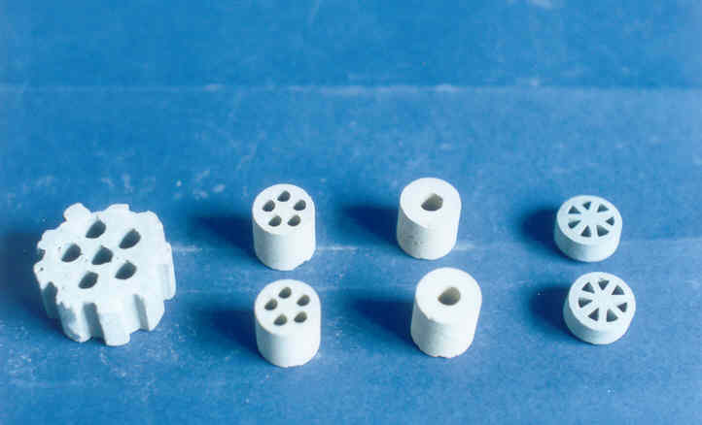
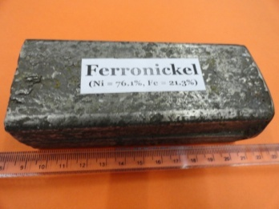

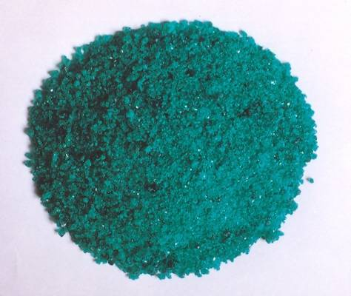
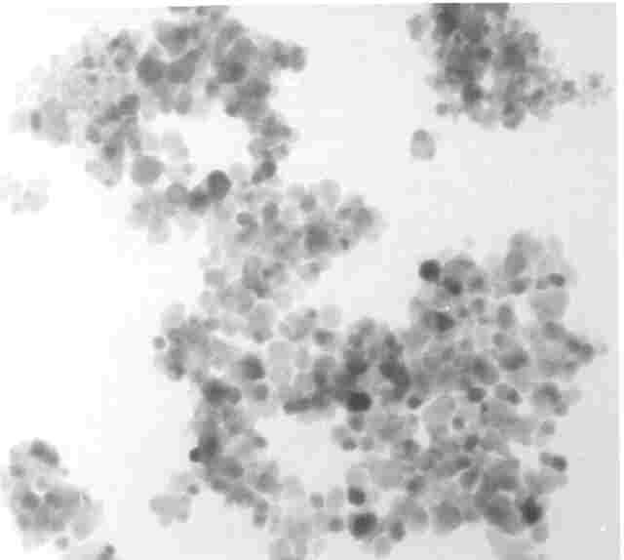
Nickel from Spent catalyst
New CSIR for New India
Direct dissolution of Nickel from spent catalyst is difficult even with high strength acid and higher temperature
Ni : 9 - 21%, Al₂O₃: 40 - 85%
A simple direct leaching method in presence of a promoter was developed with > 99% nickel recovery at low acid concentration
Ni : 20 - 75% Fe : 22 - 78%
High pure alumina
Nanosize
Ni-Zn ferrite
Nickel sulphate
NiZnFe₂O₄, 30 nm
Acid-3%, T -70 C

Slide 9
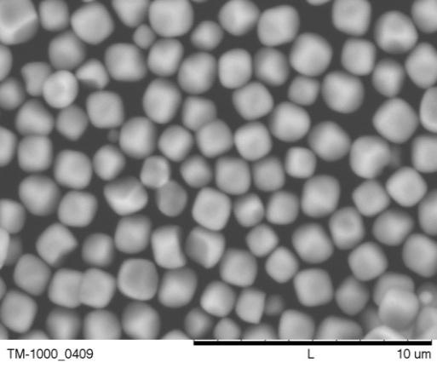
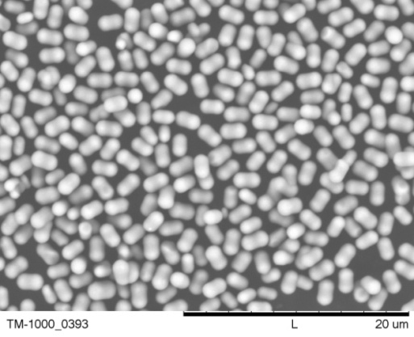
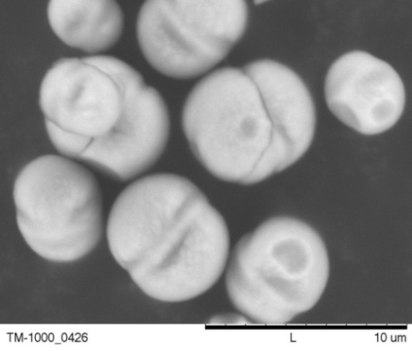
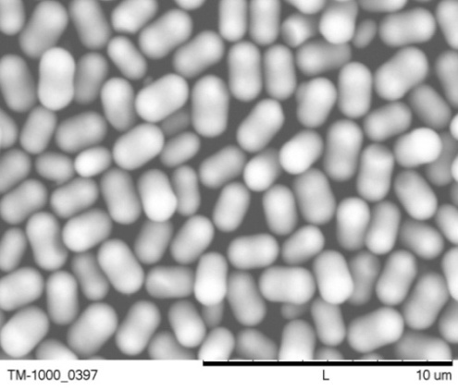
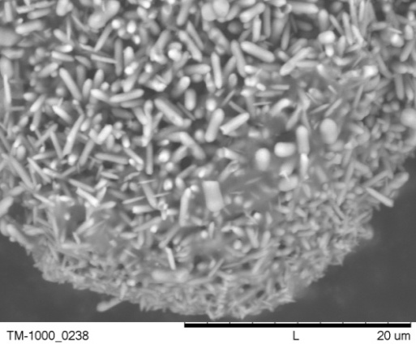
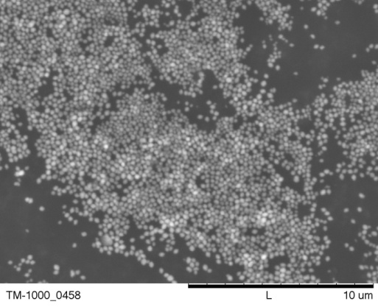
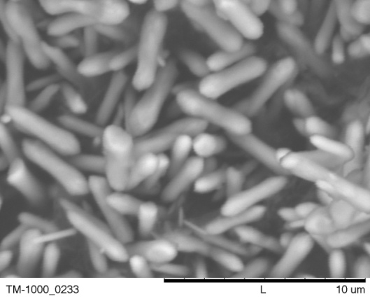
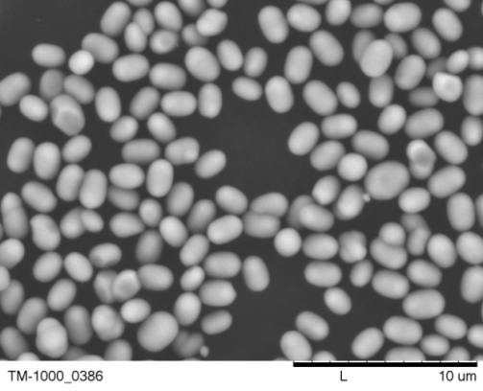
High Purity Iron Oxide from Waste
New CSIR for New India
Monodispersed & Uniform Size
Produce various shapes and sizes of hematite (200 – 4000 nm) from
Waste steel pickle liquor of Tata Steel
Titanium industry waste residue (Cochi)
Copper slag of Sterlite Industries
Crude iron oxide of Tata Steel
Manganese ferrous clay
Produce Mn-Zn ferrite from spent acid pickle liquor of steel industries

Slide 10
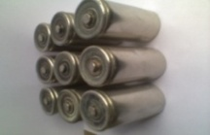
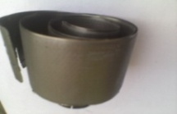
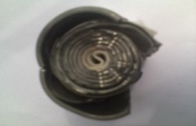
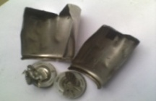
Spent Ni-Cd Battery Processing
New CSIR for New India
70% of world’s Cd is used in rechargeable batteries, Ni content is about 30%
Market share of mobile phones, Ni–Cd batteries 44.4%, lithium ion batteries 27.3%, NiMH batteries 28.0%
Battery Fraction
Ni-Cd Spent Battery
Electrode material
Paper & Plastics
- Electrode material - 68.5%
- Case Material - 22.1%
- Paper - 3.8%
- Plastics - 0.63%
- Alkali – KOH - 3.25
Ni | 41.7%
Cd | 24.3%
Co | 0.74%
Fe | 14.7%
Mechanical separation
Dissolution
S L
Alkali paste
Electrode material
External case
Hydroxide pptn
Hydrothermal conversion
Iron removal
Dissolution
Washing
Ni-Cd Ferrite
Interesting Development :
Complete utilisation of battery components with >99% recovery
Better separation of Co-Ni using a combination of solvent mixture
Direct dissolution & pptn process to produce Ni-Cd ferrite
Cd, Co, Ni Separatn - SX
Fe scrap
Paper/plastic
Electrolysis
Hydroxide pptn
Pure Metal
Metal Oxide

Slide 11
Pb Recovery from Zinc Plant Residue
New CSIR for New India
Zn : 7.9%
Pb : 8.5%
Fe : 2.25%
Cu : 1.15%
Moist : 10.5%
Zinc Plant Residue
Pb - 85 g, Zn - 79 g, Fe - 22.5 g, Cu-115 g
Zinc secondary processing units generate huge quantity of residue containing lead
Lead is highly toxic and dumping is illegal
Environmental Authorities threaten to close the unit unless the residue is properly treated
Developed an environmental friendly process to recover lead
The process generates a final residue containing <0.1% Pb
Balance water
Sulphuric Acid
Pre-treatment
For Zn & Cu recovery
Washing
S L
Brine Leaching I
Lead Chloride
Crystallization
)
Brine leaching II
S L
Lead Cement
)
Iron Powder
S L
Cementation
S L
)
Water
S L
Polishing
Washing
Iron Powder
Purification
To be used as make-up water
Solid to Land Fill
( Moist – 40%, Pb - 0.07%)
Waste
S L

Slide 12
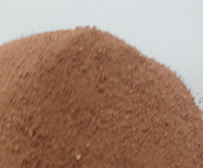
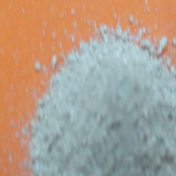
Metal Values from E-Waste
New CSIR for New India
Estimated generation in India - 10,00,000 MT in 2011
Precious metals 0.02%
Iron 20.47%
Lead 6.3%
Aluminum 14.17%
Copper 6.93%
Non-Metals 47.8%
Others 4.3%
E-waste
Beneficiation
E-Waste Conc
Pre-treatment
Will add up to 70, 000 MT of Cu and 200 MT of Precious Metals into the secondary stream.
Aeration Leaching
Pressure Leaching
Oxidation Leaching
Precious metal recovery
Base metal recovery
Gold Powder
Silver powder
Copper Powder
Lead Powder
Copper powder Silver powder
Process developed on kilogram scale

Slide 13
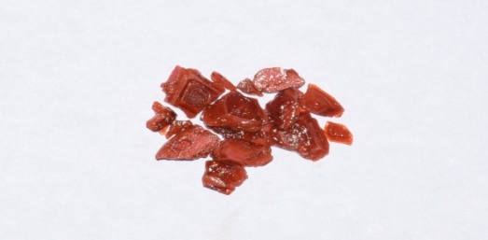
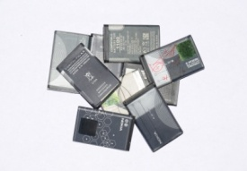
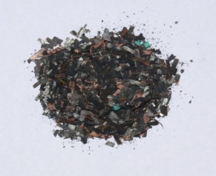
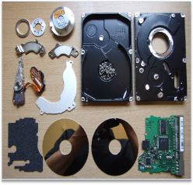
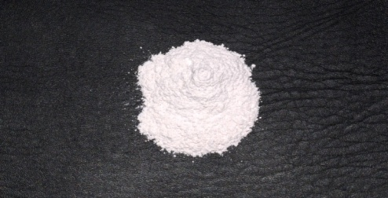
Metal Values from E-Waste
New CSIR for New India
Recycling of Li-ion batteries for recovery of cobalt and lithium
Evaporation
Stripped
Solution
Dismantling and
Separation
Leaching
Pulp density 100g/L, 2M H₂SO₄, Temp. 75 ºC
Leach Liquor
Solvent Extraction
15% Cyanex 272
Stripping H₂SO₄
Cobalt Salt
Waste Mobile
Batteries (LIBs)
Cathode
Material
Evaporation
Raffinate
Lithium Salt
Recovery of rare earth metal Nd from computer hard-disc
Magnet
Leach Liquor
Fe- Solution
Leaching of Magnet
Pulp density 100g/L,
2M H₂SO₄, Temp. 30 ºC, Time 30 Min.
Precipitation
NaOH
Na-Nd double salt
20% HF
Dismantled Hard-disc
NdF₃
(Value added Product)

Slide 14
Indo- Korean Cooperation
New CSIR for New India
A process for the removal of hazardous metal elements from leach liquor of electronic scraps following solvent extraction and recovery of valuables.
Sulfate Leach Solution
Cu, Zn, Cd, Ni
Regenerated Cyanex 302
Cu Extraction
pH= 1.91
Zn, Cd, Ni Sol.
Zn, Cd Extraction
pH=2.1
LIX84
HCl
Cu Stripping
H₂SO₄
Zn Stripping
Cd Stripping
H₂SO₄
Cu Sol..^{n}
Ni Sol..^{n}
Zn Sol..^{n}
Cd Sol..^{n}

Slide 15
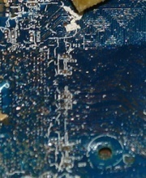
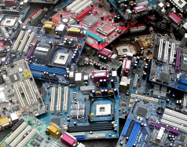
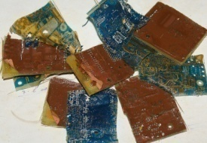
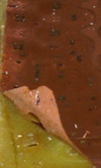
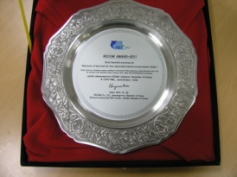
Indo- Korean Cooperation
New CSIR for New India
Recovery of Pb and Sn from the liberated resin of PCBs swelled by organic
Metal free Epoxy resin for safe utilisation
Organic Swelled PCBs
n-methyl-2-pyrrolidone
Heat, S/L separation
Selective
Leaching
Epoxy Resin (Pb, Sn)
HNO₃
HCl
PCBs
Lead Soln.
Tin Soln.
Metal Sheet (Cu)
Highlights:
Novel pre-treatment organic swelling & liberation of pure Cu metal sheet
Energy saving process in comparison to traditional mechanical pre-treatment for metal beneficiation
Organic can be separated after swelling of PCBs and reused
Commercial viability after some scale-up studies

Slide 16

Wealth from Waste

Slide 17
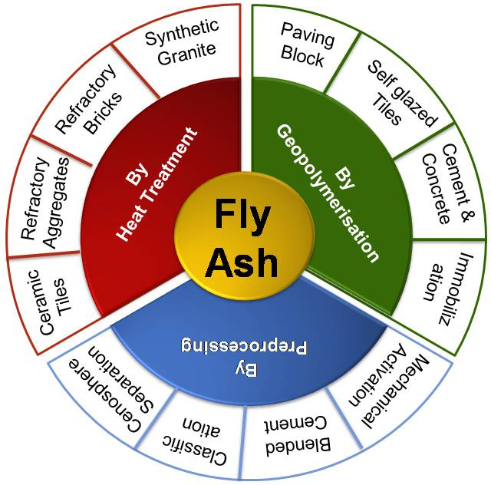
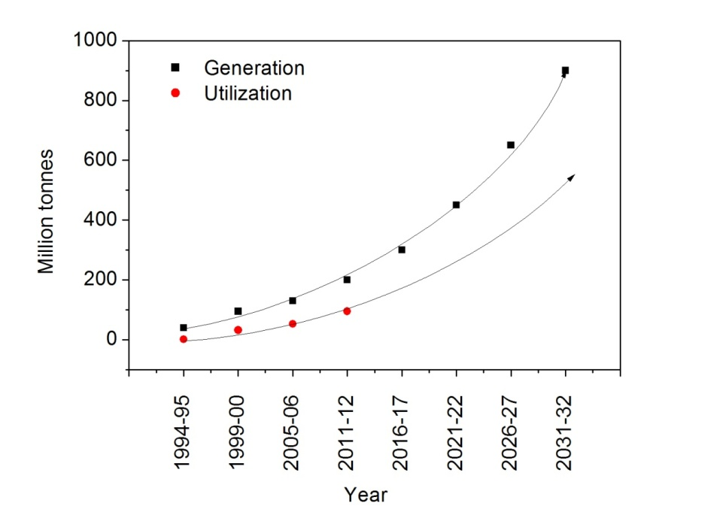
Fly Ash Research
New CSIR for New India
Summary of CSIR-NML’s activities
Fly ash utilization in India
Opportunities for new technology

Slide 18
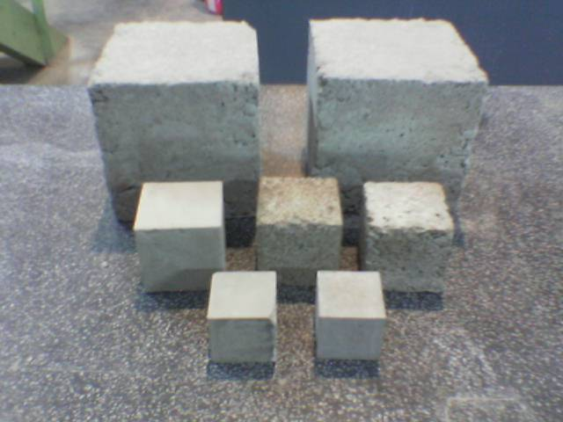
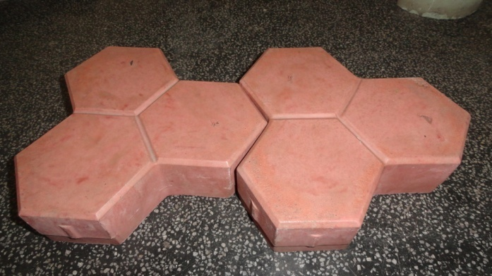
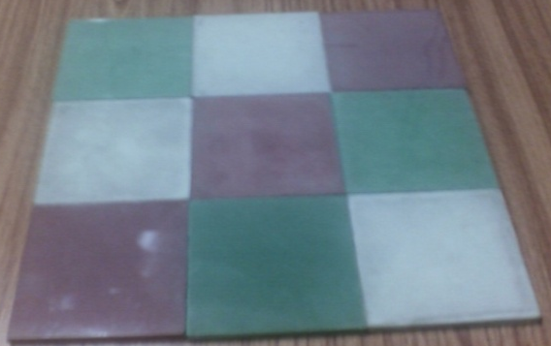
Geopolymer
New CSIR for New India
Process Developed
High strength concrete from fly ash
Paving blocks from fly ash, GBFS & red mud
Self glazed tiles from fly ash & GBFS
Up to 120 MPa strength
Improved durability
Better abrasion resistance
As per IS 15658:2006
No leaching
Ready to use in 7 days
Conform EN Specs
Produced at 100◦C
Different colours & designs

Slide 19
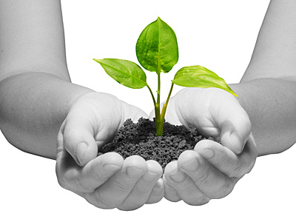
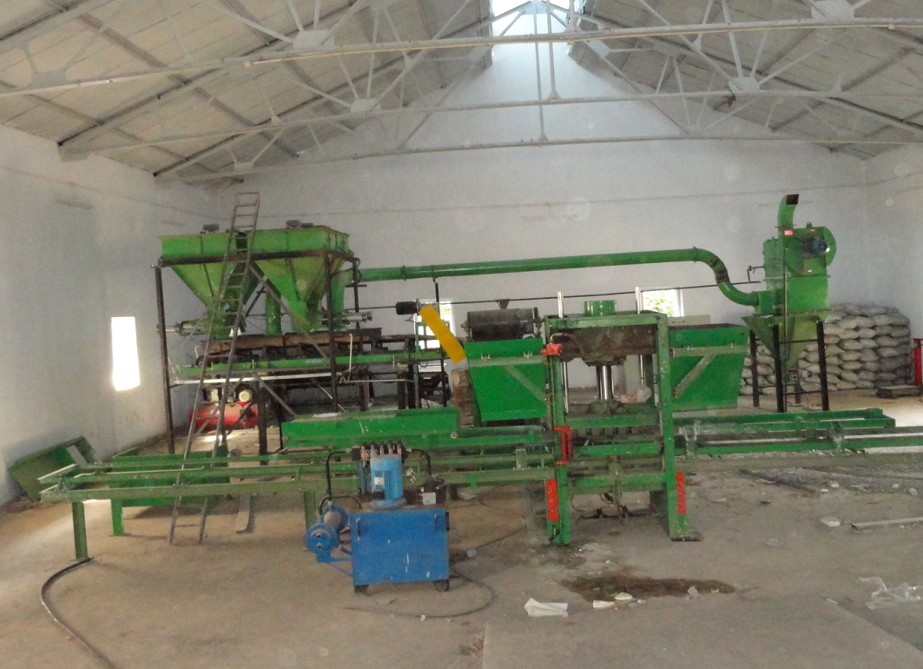
Lab to Pilot Scale
New CSIR for New India
Supported by Department of Science & Technology
Breakthrough
Paving Blocks from Steel Slag
(jointly with Tata Steel)
50-55% steel slag can be used along with fly ash and granulated blast furnace slag,
Meet all the obligatory specification as per IS 15658: 2006,
Complied with the USEPA limit for leaching of toxic metals and is environmentally safe,
Fully automatic, with ~4 ton/shift capacity
Modular construction, both bricks and paving blocks can be produced
A step forward in translating process into technology

Slide 20

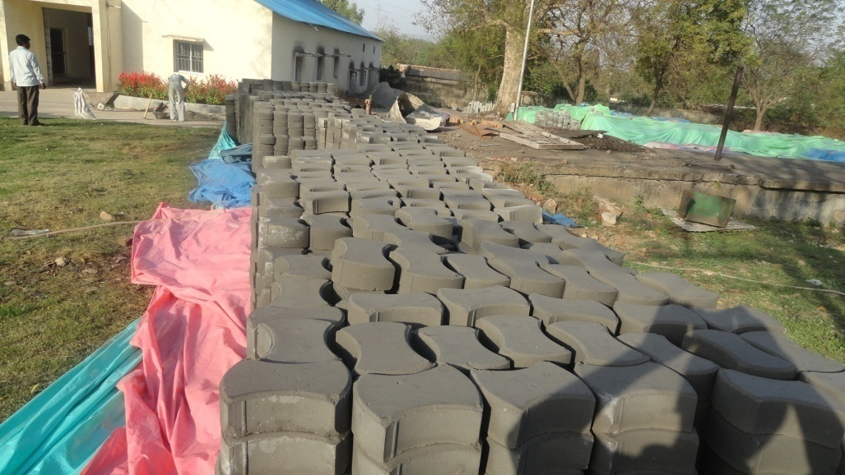
Technology Commercialised
New CSIR for New India
Technology transferred, plant operational from Nov 2011,
First commercialization of Geopolymer technology in India,
More than 500 tons of product has been produced,
Resulted into employment generation for 14 people,
Paving Blocks | Cement based | Steel slag based
Total CO₂ generation / ton | 180 -200 kg (from firing of cement) | 16 - 20kg (conversion of alkali carbonate into oxide)
Water requirement/ ton | 300 liters | 250 liters
Waste & by-products reuse/ ton | <75 kg | >900 kg
Embodied energy/ kg | 1.2 MJ | 0.8 MJ

Slide 21
Mechanochemistry
New CSIR for New India
Zircon
Illmenite
Red Mud
Research Focus
Aluminium
directions
Fly Ash
Fundamental research
Leaching of MA ores
Novel reactors
Building materials
Large size mills
BF Slag

Slide 22
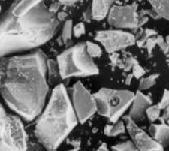
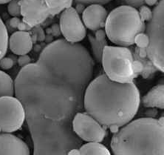
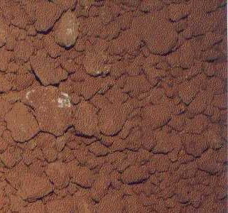
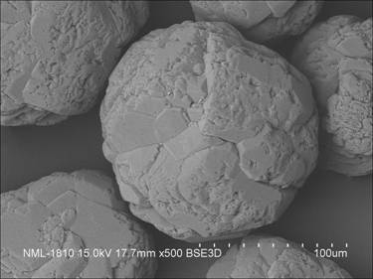
Significant Achievements
New CSIR for New India
Lab Scale Development of Promising Processes
SMILE – A Simultaneous Milling and Leaching Process for Bauxites
Improved blended cements, PSC (80-85% BF slag) and PPC (50-55% fly ash)
High strength (~ 120 MPa) fly ash Geopolymers
Fundamental Research
Mechanical Activation of bauxite, Al-oxyhydroxides, illmenite, zircon, chromite, calcite, BF slag, fly ash
Energetics of milling, role of milling energy and water, interaction of minerals during milling
Texture induced surface charge modification during milling
Mechanical activation of porous minerals (e.g. boehmite)
Kinetics and mechanisms of reactions of activated minerals
Simulation of weathering processes

Slide 23
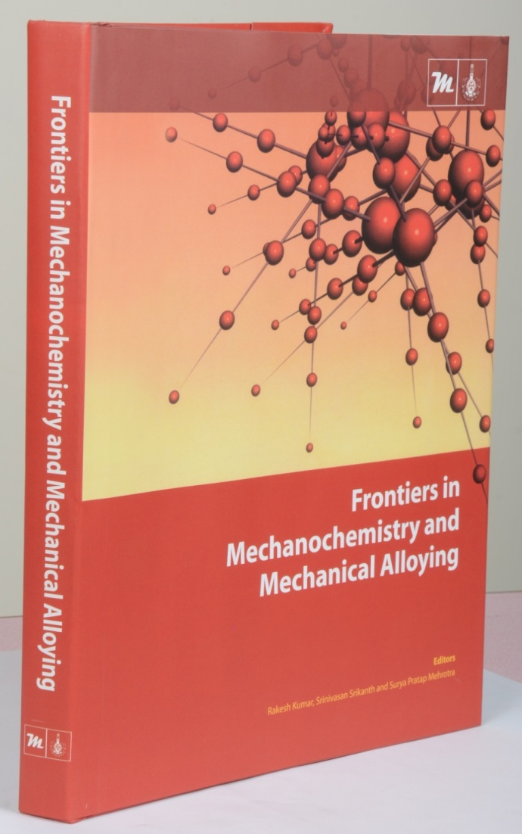
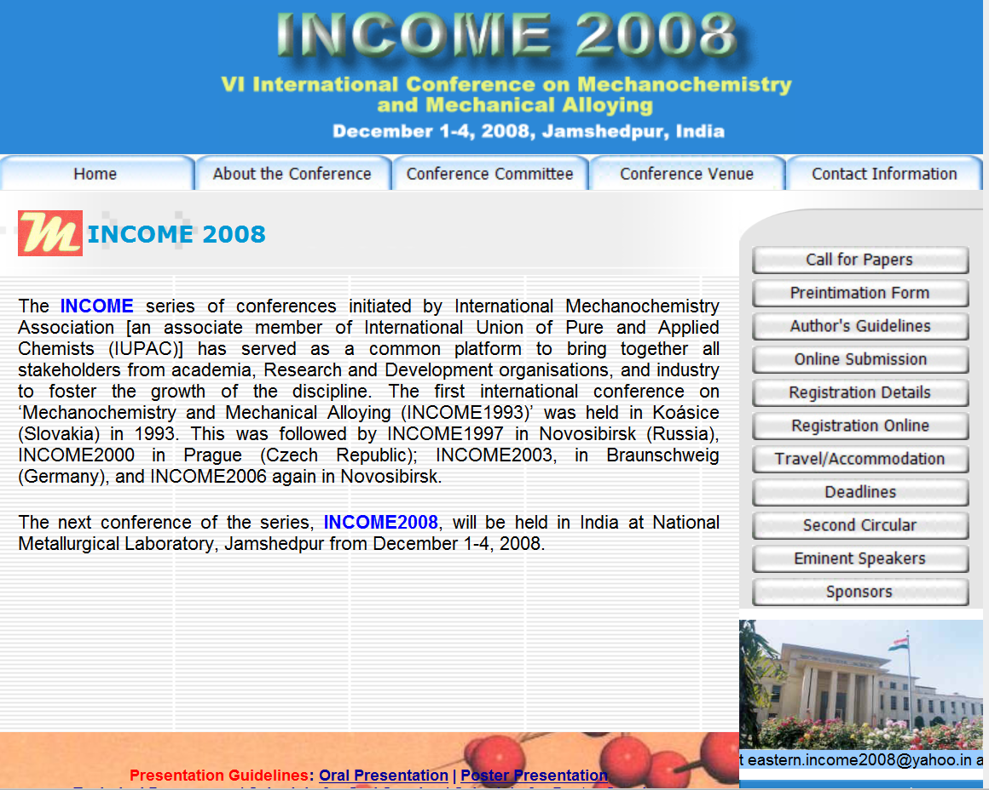
Income 2008
New CSIR for New India

Slide 24



