Slide 1
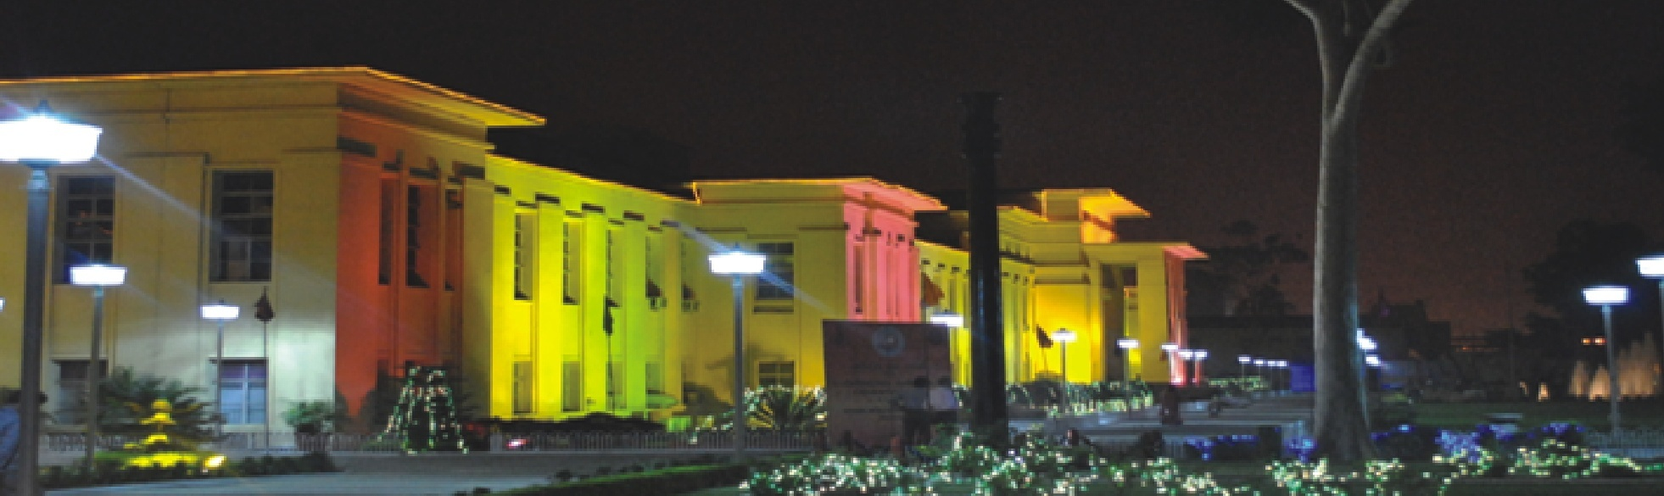
The Journey of
CSIR-National Metallurgical Laboratory

Slide 2
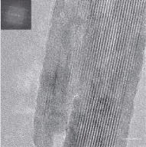
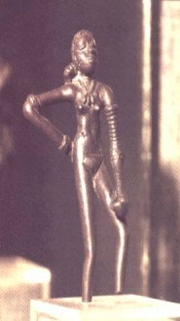
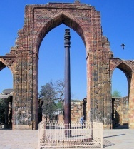
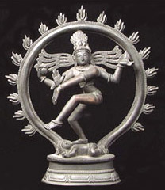
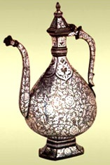
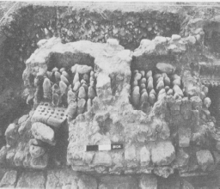
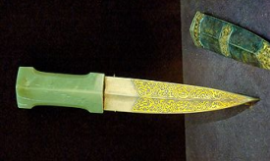
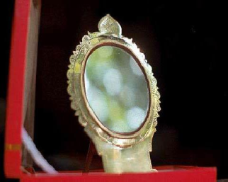
Chronology of Metallurgical Heritage in India
Discovery 1800 years ahead of commercialisation
Zinc smelting Zawar, Rajasthan
CarbonNanotube
First ever product out of an intermetallic
Aranmula Metal Mirror Kerala Cu – 30% Sn bronze
Source of Corrosion Resistance–Phosphorous in slag inclusions
Nataraja Statue
Pancha Dhatu Cu, Zn, Sn, Au, Ag
Bidriware
Cu-Zn alloy with silver inlay
Dancing Girl,
Bronze,
Indus Valley
Fe3C
Nanowire
2006 Discovery HRTEM image
Wootz Steel
Blade: Damascus steel Inlaid with gold; hilt: jade
Delhi
Iron Pillar
2500 BC
600 BC
300 BC
310 AD
900 AD
1400 AD
1800 AD
Yesterday
Lost Wax Process
Distillation Process
Powder Forging
Very slow cooling pptn. of brittle intermetallics
Lost Wax Process
Crucible Process
Ref: Late R Bala
Casting + CuSO₄ Coating + Inlaying with Silver
Today Gas Turbine Engine blades
Historical landmark metallurgy
(ASM 1989)
Ack: Dr. YR Mahajan & Prof. P. Rama Rao
Several ancient processes invented in India have found application in modern-day materials processing

Slide 3
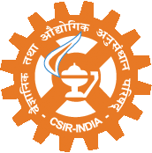
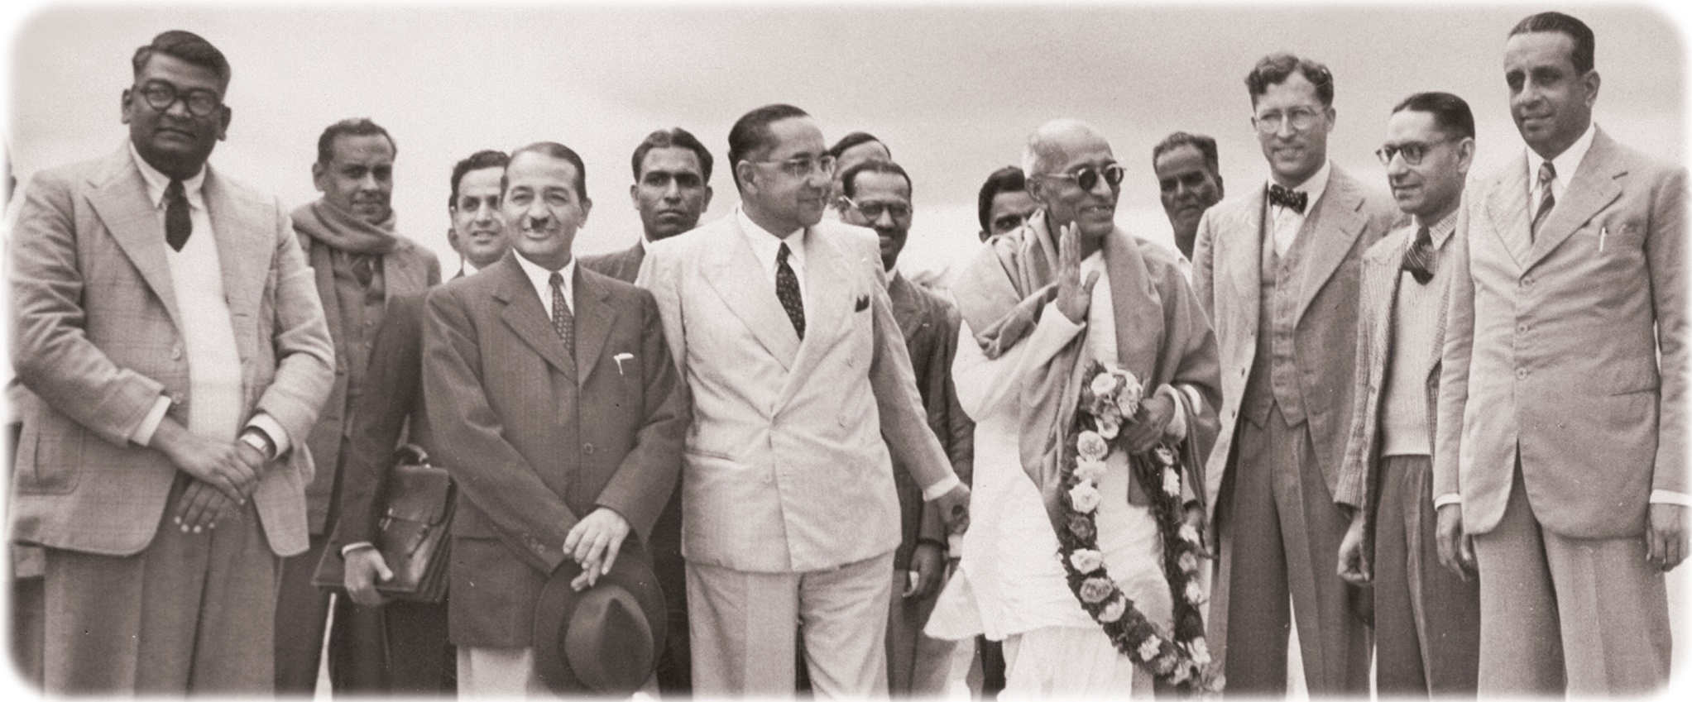
Laying the Foundation
New CSIR for New India
21 Nov., 1946
Foundation stone by Sri C. Rajagopalachari, Minister of Education & Arts in the Interim Government

Slide 4
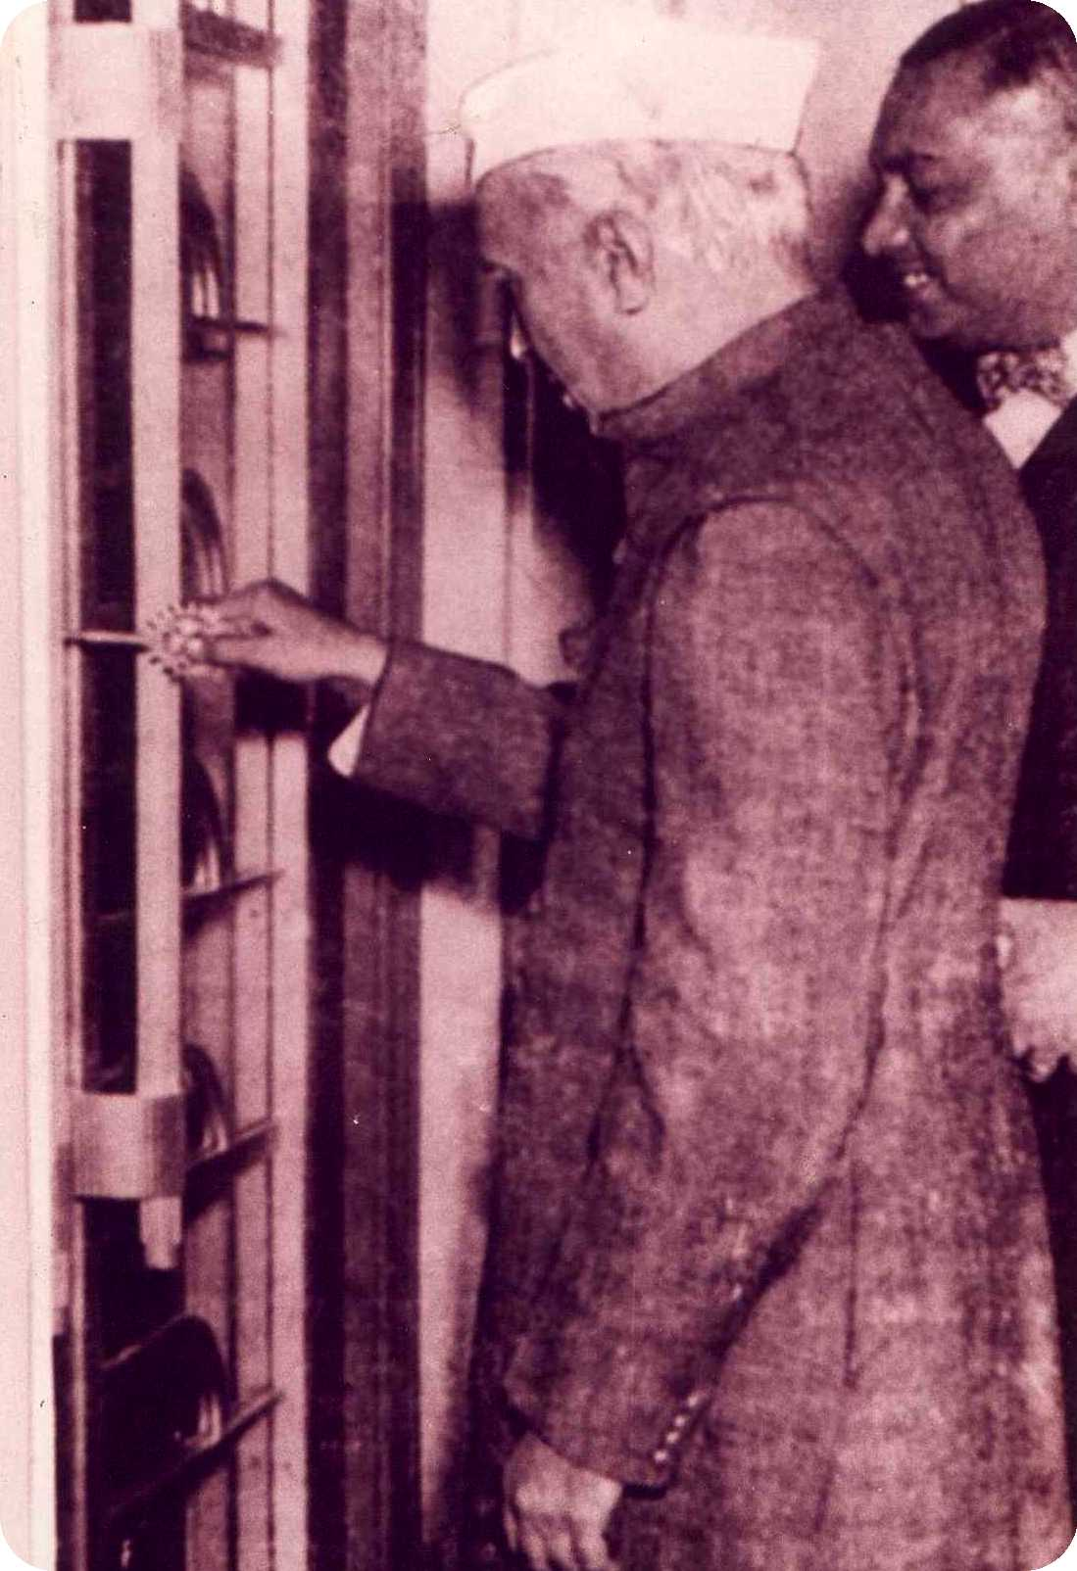
Opening the door of possibilities
New CSIR for New India
26 Nov, 1950
I think of the combination of this laboratory with the steel works of this city, of the marriage of science with industry for the progress of both…….
Pandit Jawaharlal Nehru during inauguration

Slide 5
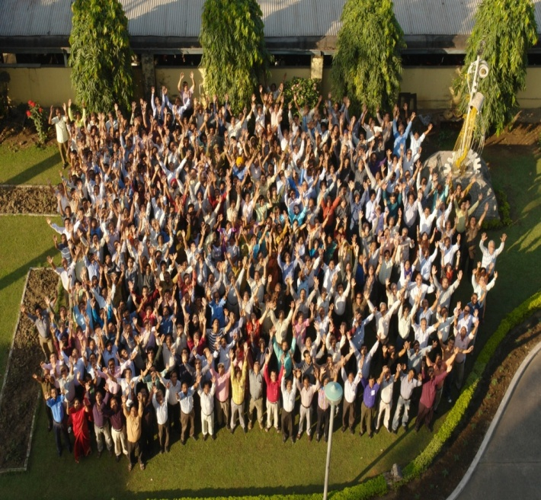
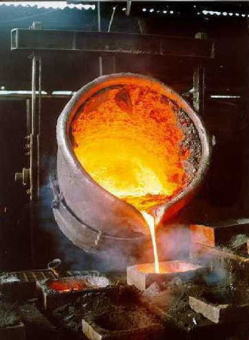
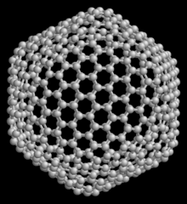
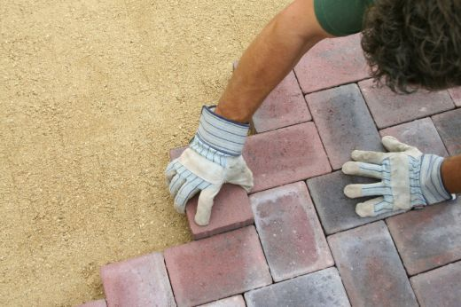
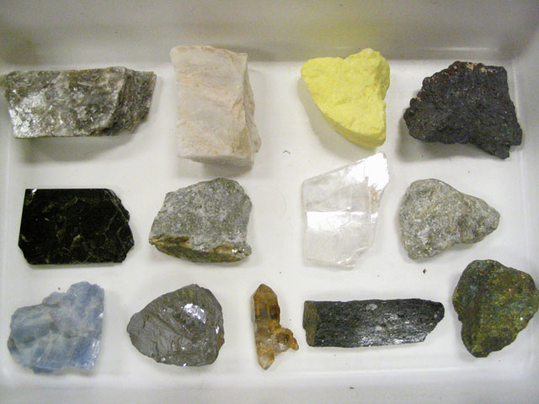

Mandate
New CSIR for New India
Metals
Materials
Human Resources
Minerals
Environment

Slide 6
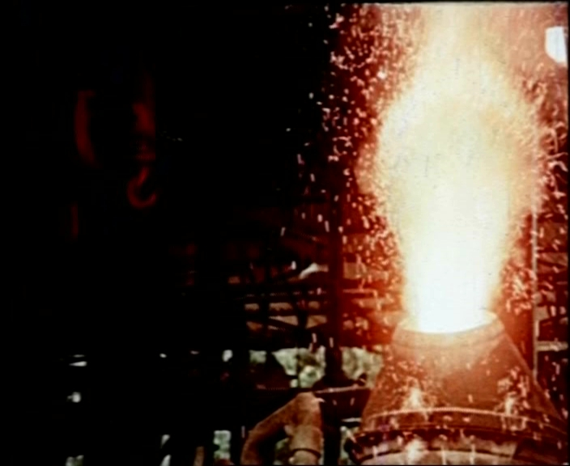
First Oxygen Steel Making in India
New CSIR for New India
1957
Top and side blown converters 0.1 to 0.5 tonnes

Slide 7
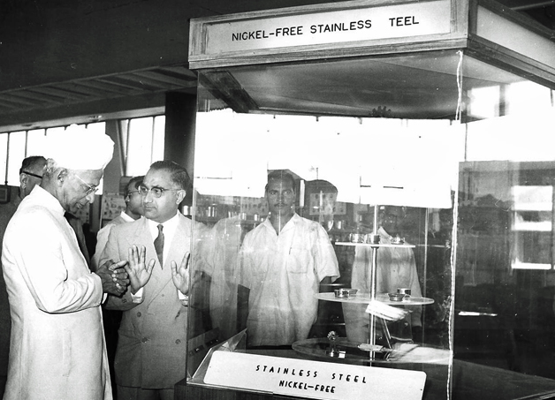
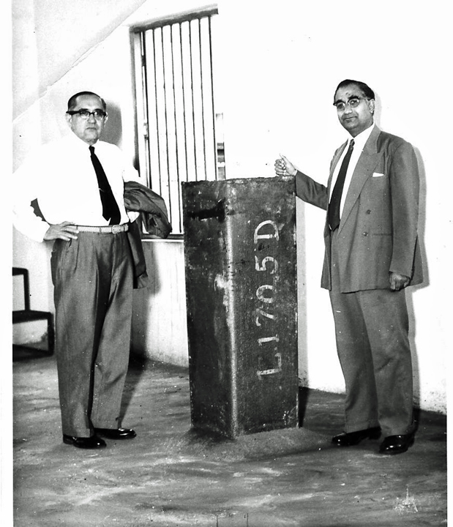
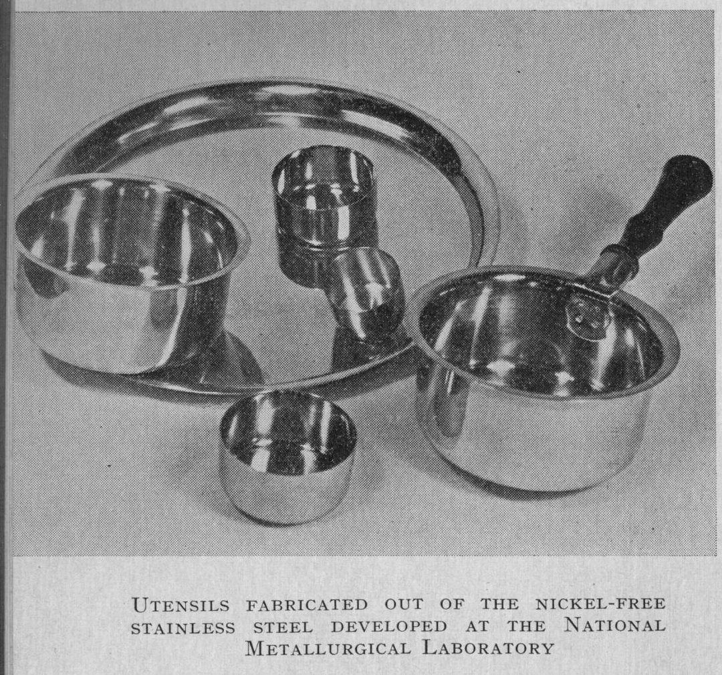
Ni-free Stainless Steel
New CSIR for New India
Heating Elements & Creep Resistant Steel
Since 1958 at tonnage scale......

Slide 8
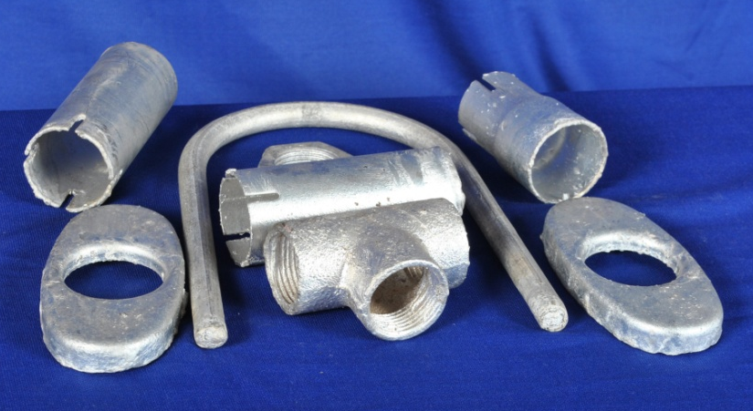
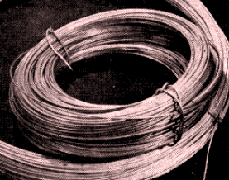
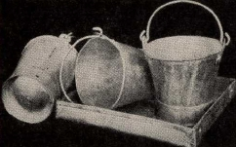
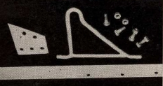
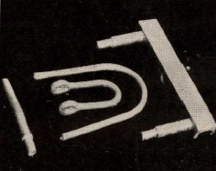
Aluminizing to Replace Galvanizing
New CSIR for New India
Pilot plant since 1959,
Beneficiaries: Posts & Telegraphs, Indian Railways, Automobile Industries, Bucket Manufacturers,

Slide 9
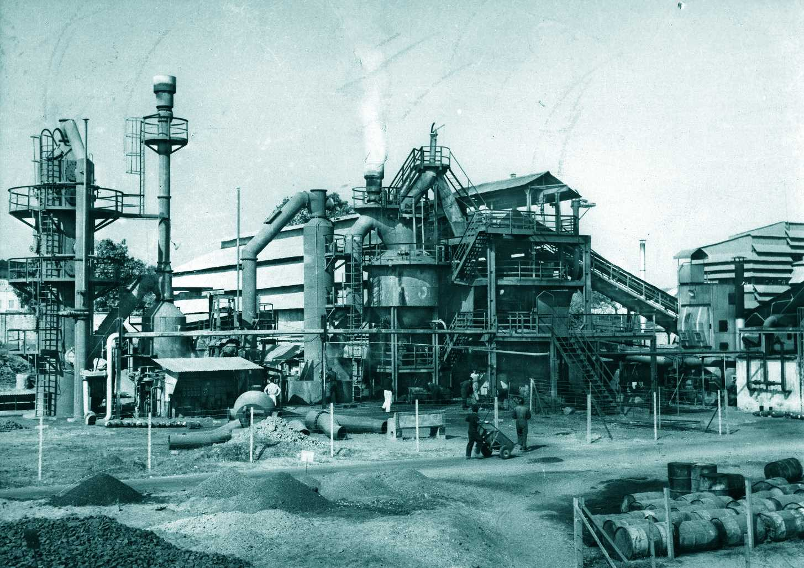
Low Shaft Furnace
New CSIR for New India
Core Activity in the 60’s
“For a country like India where there is a shortage of metallurgical coal and considerable deposits of lignite and other non-metallurgical coals exist, methods are to be developed for using these non-metallurgical coals for production of pig iron”
(Sardar Swaran Singh, Union Min. Steel & Mines
inaugurating the pilot plant in Feb 1959)

Slide 10
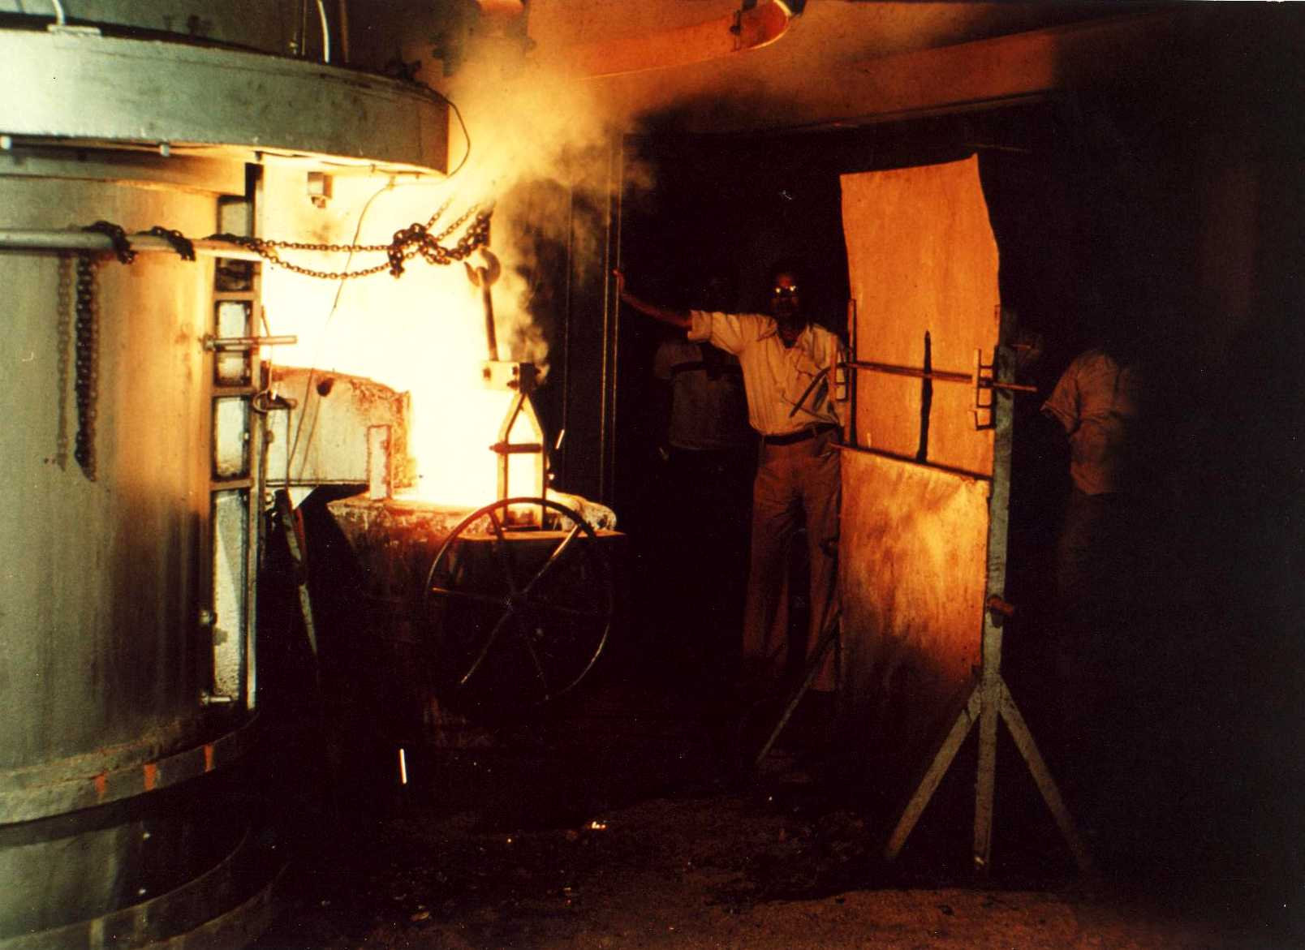
An Era of Ferro-Alloys
New CSIR for New India
500 kVA Submerged Arc Furnace-1962

Slide 11
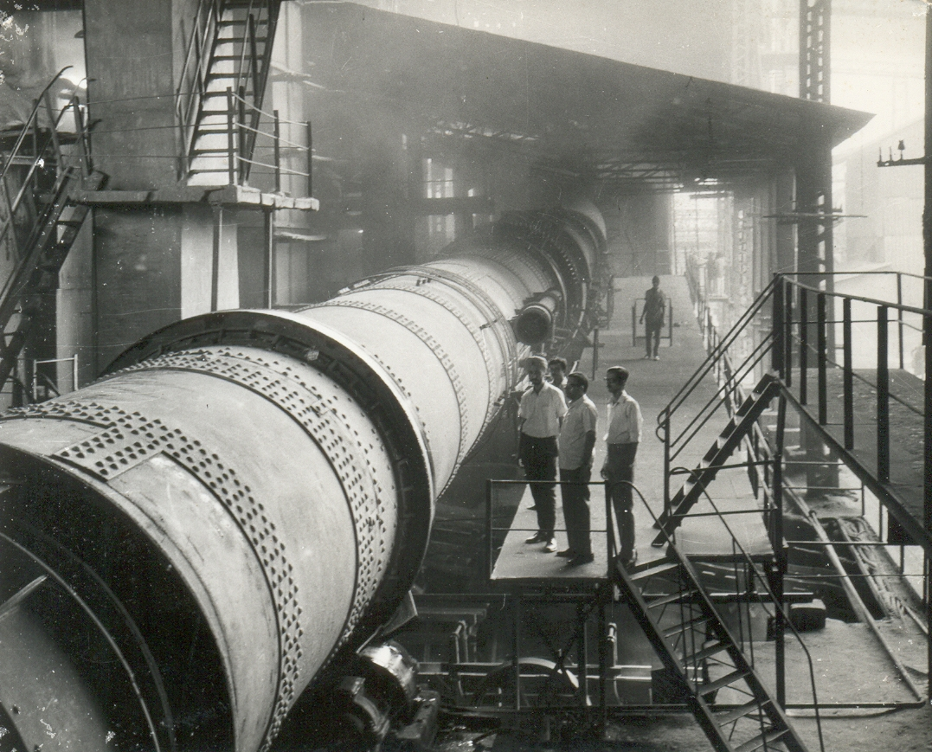
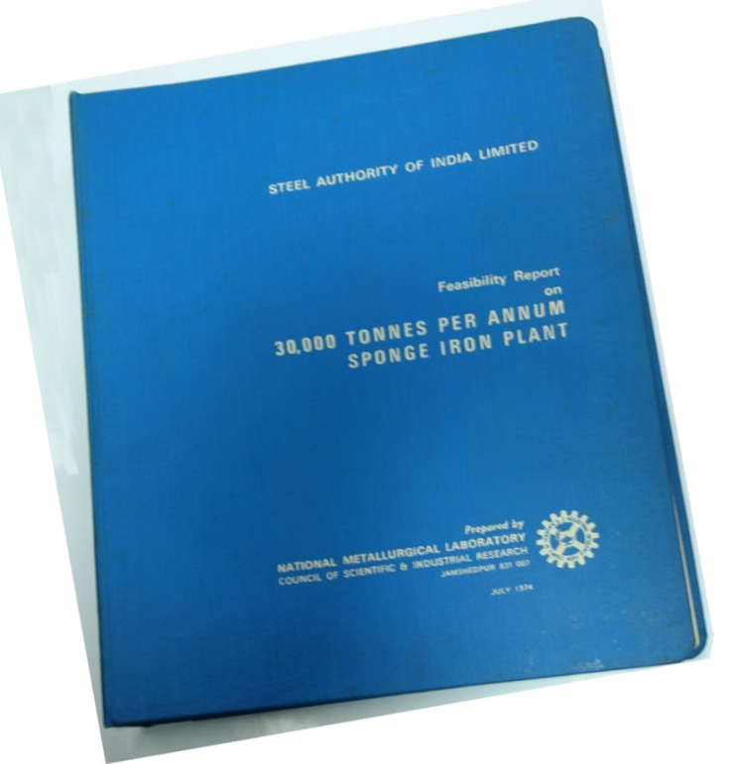
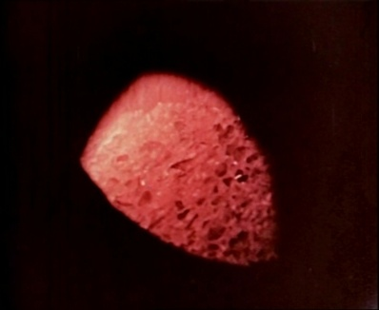
Sponge Iron by Rotary Kiln
New CSIR for New India
First pilot and commercial sponge iron in India
30000 t/day commercial sponge iron plant Andhra Cement (1975-76)

Slide 12
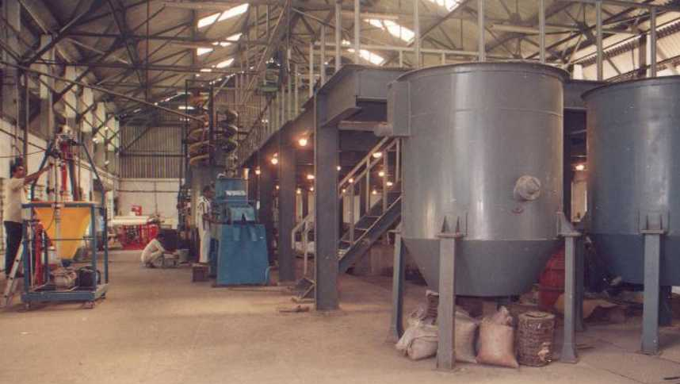
Mineral processing
New CSIR for New India
Integrated Pilot scale operations since 1963 …
Over 800 investigations on various minerals & ores
New pilot plant (1998)

Slide 13
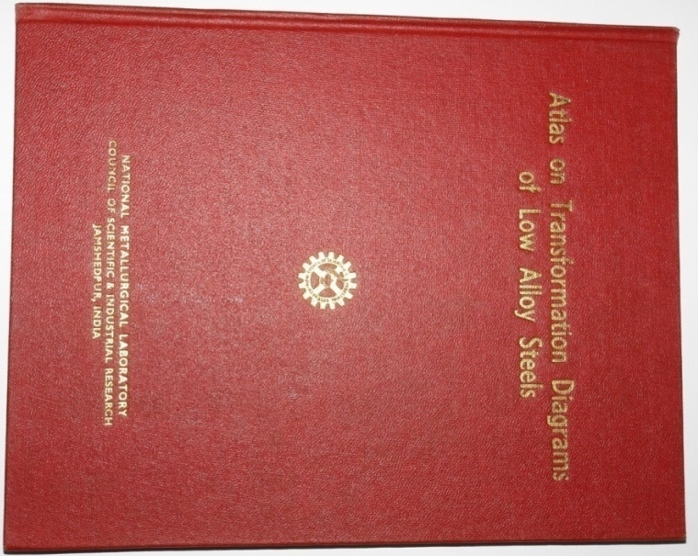
First Time Temp. Transformations
New CSIR for New India

Slide 14
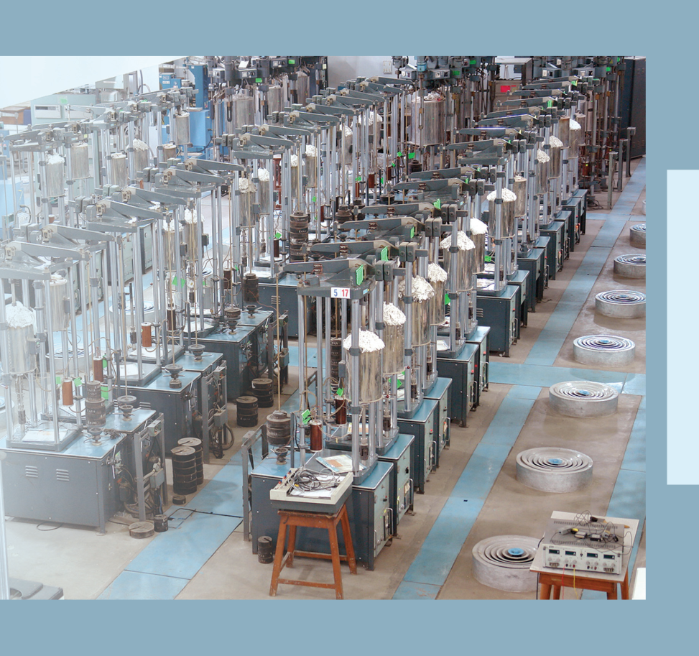
Rise of Creep Building
New CSIR for New India
1972
Asia’s largest creep testing facility

Slide 15
CIEP & Beyond
New CSIR for New India
1990
Damage Resistance data
Codes & Software
Quantitative Damage Index
Simulation & Modelling
Ageing Parameter
Non-destructive Surveillance
Documented information
In-service Critical Structural Components
Material Characterisation
Experimental Evaluation
Structural Integrity Assessment activities at NML (2010)

Slide 16
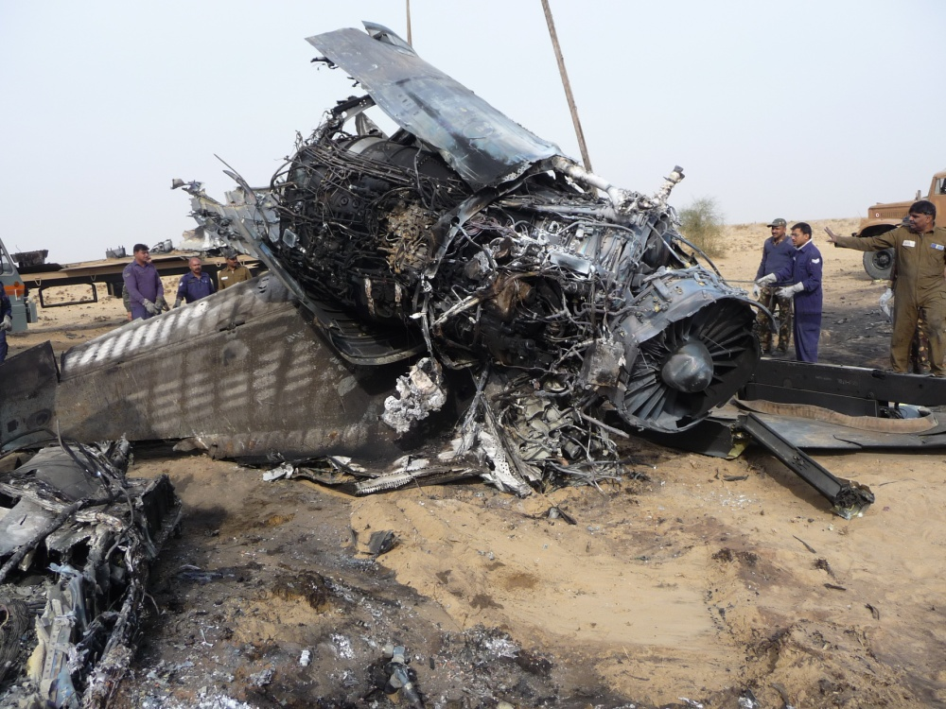
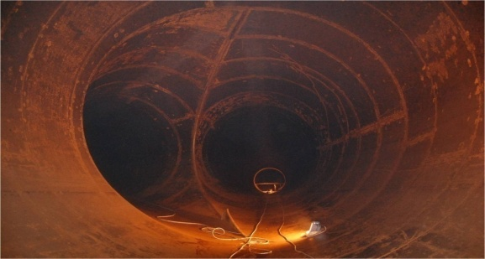
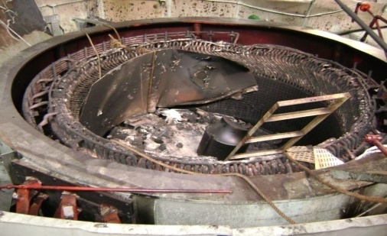
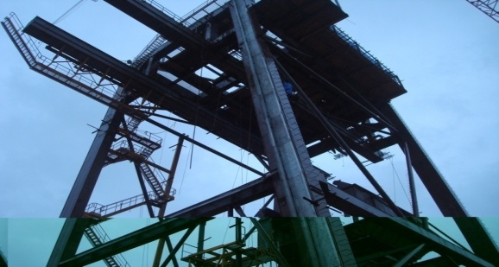
Failure Analysis
New CSIR for New India
Stress corrosion cracking of fuel pipe
Crashed SU-30MKI
Accident due to fatigue failure of sickle plate at Srisailam Hydel
Accident caused by fatigue failure of Pelton bucket at Sabarigiri Hydel
Failure ship unloader at Mangalore Port Trust

Slide 17
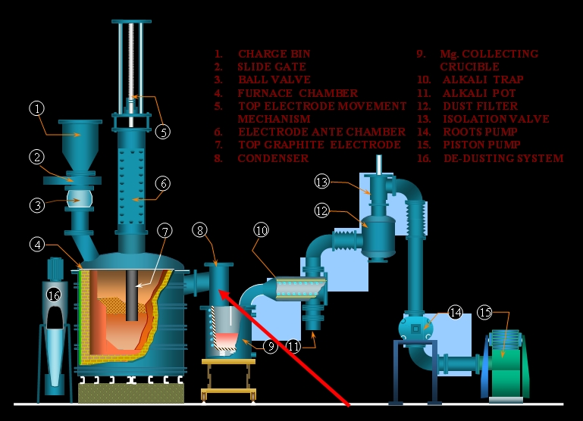
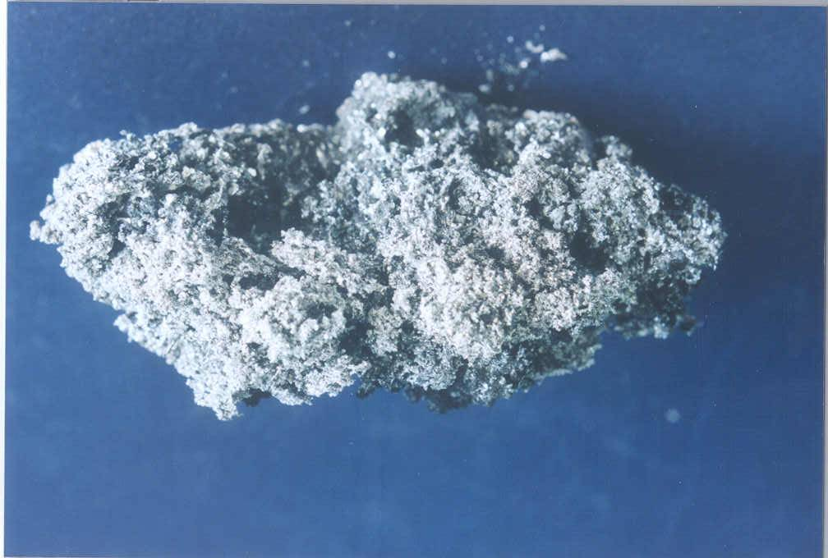
Technology for Mg Production
New CSIR for New India
From Pigeon process (1970-80s) to Electro-thermal extraction (current)
Focus on upscaling & continuous process
Use of low cost raw material
HIGHLIGHTS
Mg sponge produced at NML
Mg Pilot Plant designed and developed by NML

Slide 18
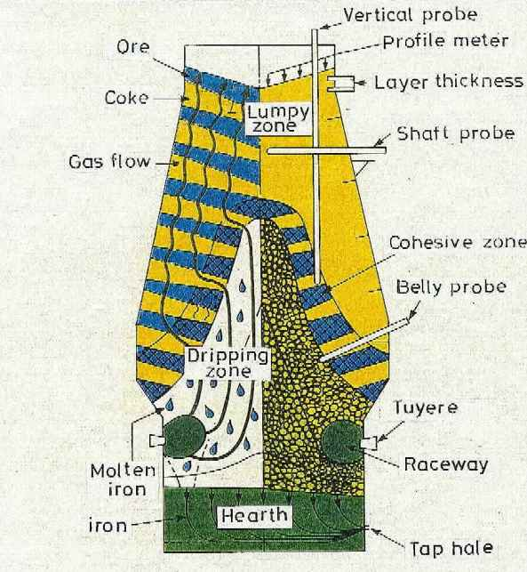
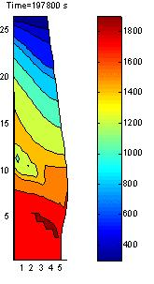
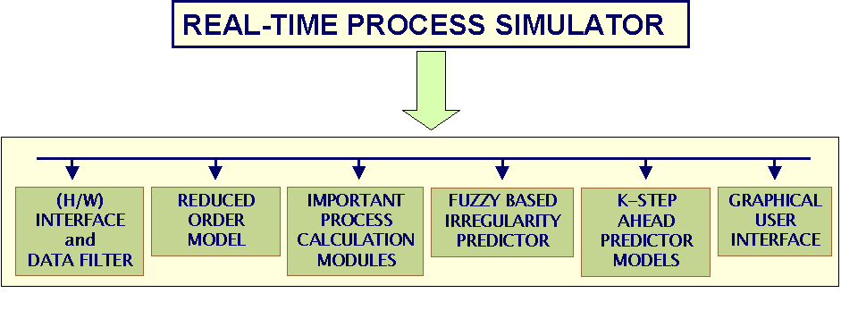
Increasing Productivity of BF
New CSIR for New India
through modeling
Learning the Harder Way
Mid/late 1970s
Quenching of Operating BF in Japan and layer by layer analysis
Blast Furnace
Now ..
Mathematical Modelling

Slide 19
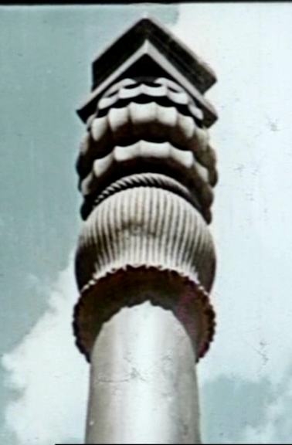
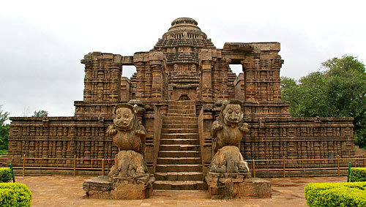
Preserving Heritage
New CSIR for New India
Unravelling the secrets of the iron beams at Delhi & Konark

Slide 20
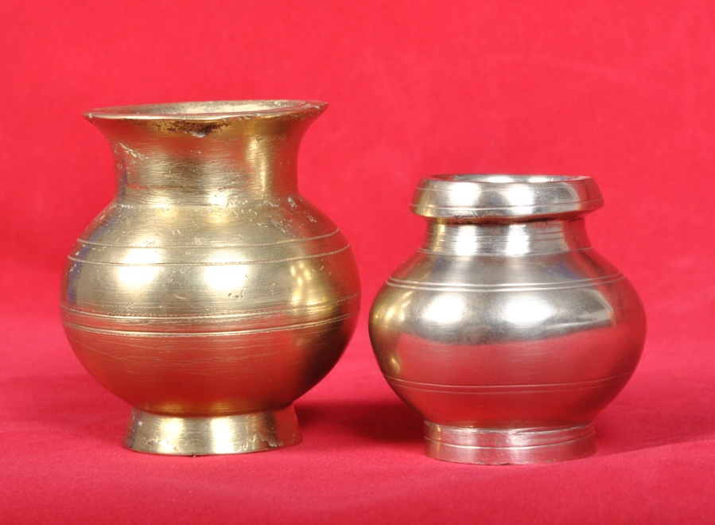
Enabling Artisanal Technology
New CSIR for New India

Slide 21
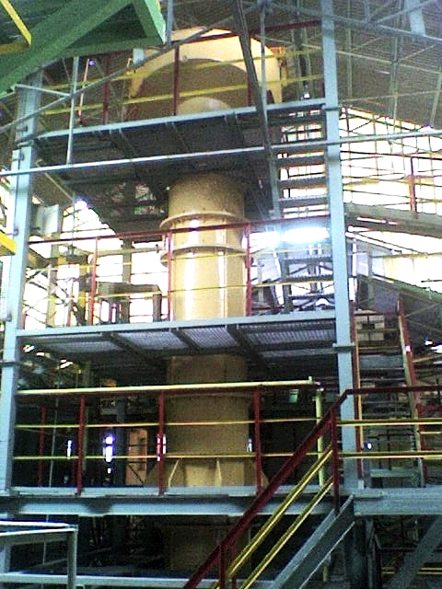
Column Flotation
New CSIR for New India
2004
Design of equipment and plant
Column to treat 6 TPH sillimanite at Indian Rare Earths Limited, Chavara, Kerala

Slide 22
Mechanochemistry Research@NML
Zircon
Illmenite
Red Mud
Research Focus
Aluminium
directions
Fly Ash
Fundamental research
Leaching of MA ores
Novel reactors
Building materials
Large size mills
BF Slag

Slide 23

Beyond 60 Years

Slide 24

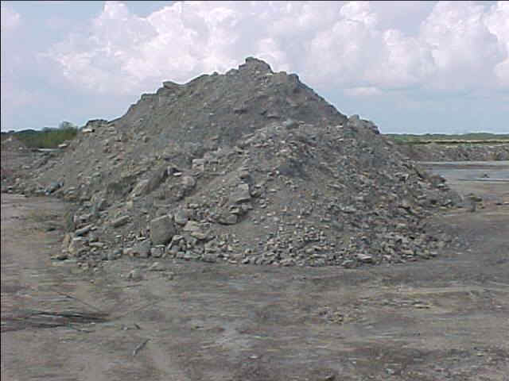
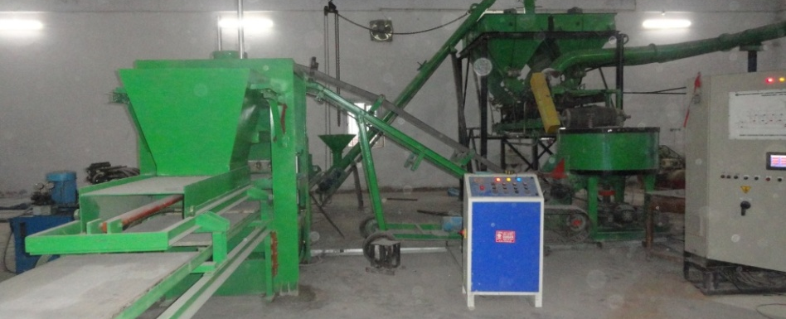

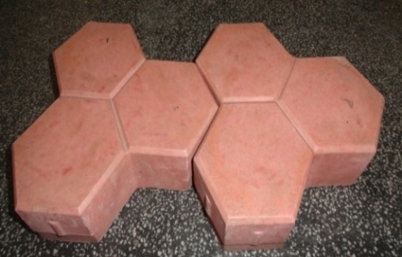

Waste to Wealth
New CSIR for New India
Technology for making paving blocks from waste transferred

Slide 25



Sodium Production
New CSIR for New India
Indigenous Technology
Up-scaling by Steps from the operation of a 50 A cell to a 20000 A cell
ARGON INLET

Slide 26





12th Five Year Plan
New CSIR for New India
Low cost technology for magnesium production
Dry beneficiation of coal
Extraction & Separation of Rare earths from secondaries
CRGO steel

Slide 27

12th Five Year Plan
New CSIR for New India
Utilization of lean grade iron ores & coal
Advanced coal characterization & integrated modelling
Extraction of rare earths
Integrated Computational Materials Engineering
Whole Cycle Analysis
Catering to the MSME metal clusters

Slide 28


Creating Future Leaders
New CSIR for New India
through Leadership Development Program

Slide 29



Igniting Young Minds
New CSIR for New India

Slide 30

International Collaborations
New CSIR for New India
Publications
Projects

Slide 31


SCI Publications
Cumulative Research Papers and Citations
during last 10 Years
New CSIR for New India

Slide 32
Cumulative Research Publications and Citations
during 1952 - 2011

Slide 33

Technology Transferred
New CSIR for New India

Slide 34

Technology Transferred
New CSIR for New India

Slide 35

Our Journey Continues...

Slide 36

In Quest for Quality
New CSIR for New India
& International leadership in minerals, metals & materials

Slide 37

Thank You
When I dream alone, it is just a dream. But when we dream together, it is the beginning of reality.
- Brazilian Proverb

