Slide 1
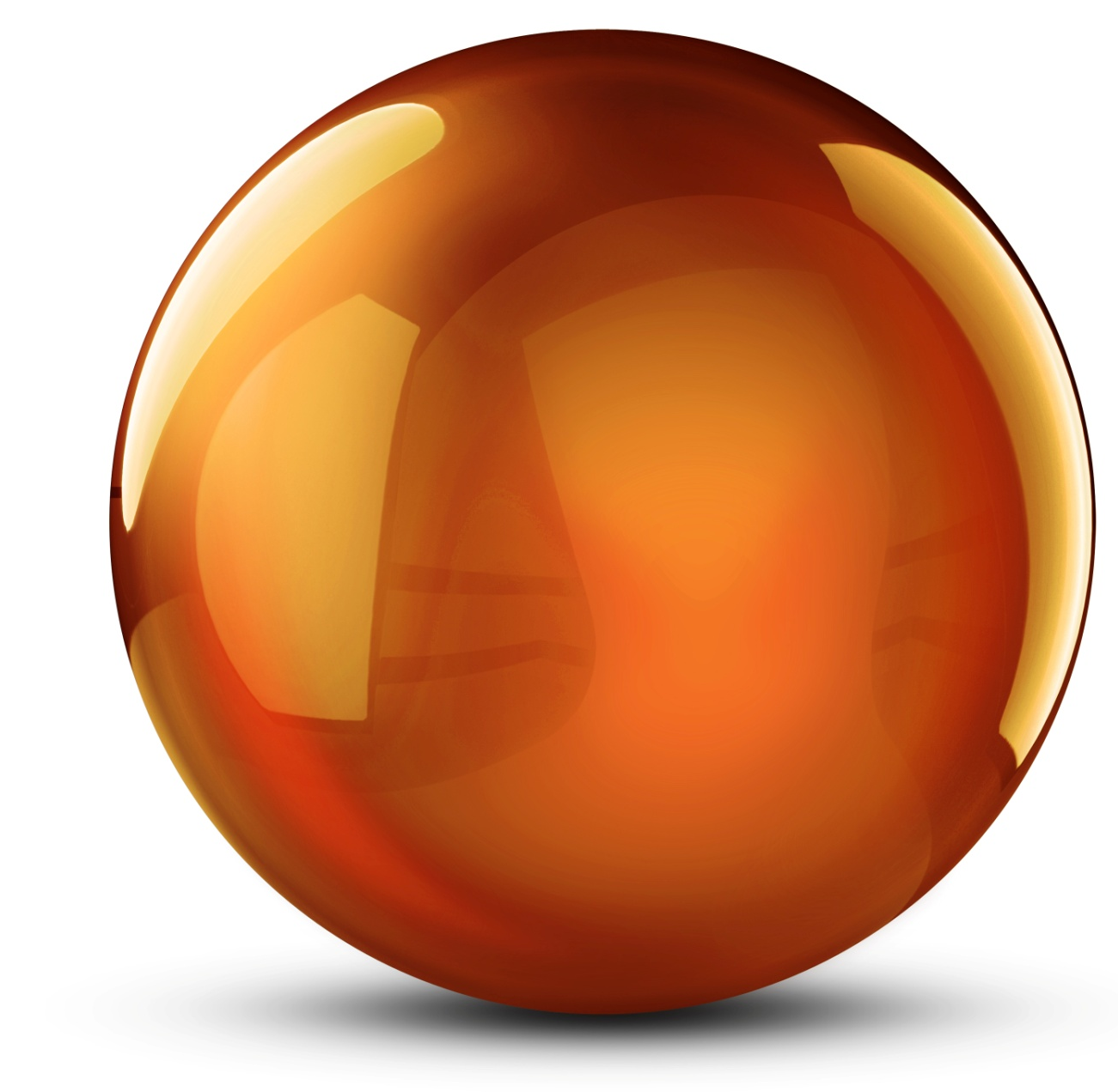
Materials Development Program
at CSIR-NML

Slide 2
Magnetic
Materials
Metallic
Glasses
Thin Films &
Coating
Structural
Materials
Biomaterials
Inhibitors

Slide 3

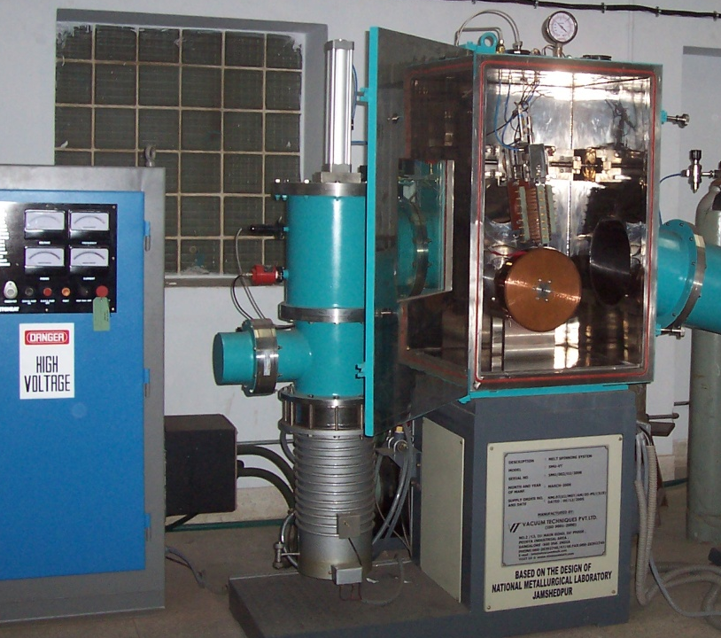
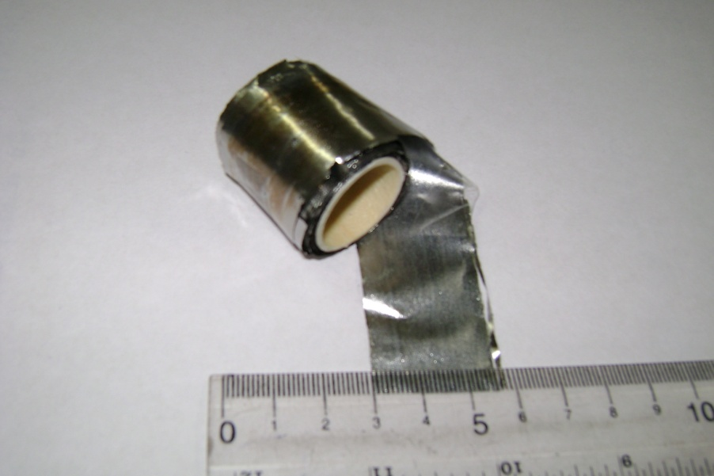
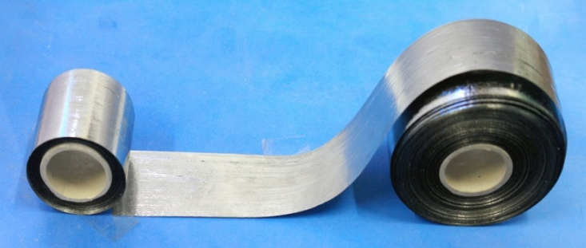
Magnetic Alloy for Sensors
New CSIR for New India
& Transformer Core
Magnetostrictive
Amorphous Alloys:
FeSiB, CoSiB
Melt Spinning technology for the production of wide (25mm) ribbons (About 1kg batch)
Ferromagnetic Shape memory Alloy (NiMnGa)
Nanostructured ultrasoft Magnetic alloys : FeNbCuSiB
High induction & High Curie temp.Alloys : CoFeSiB
Silicon Steels :Fe-6.5Si
Brazing alloys for space application
Fe6.5Si Steel
Brazing foils :
Cu-Ni-Mn , Ti-Zr-Cu-Ni
FeSiB alloy
Technology transferred to M/s Vacuum Techniques, Bangalore, India

Slide 4
Improvement of Magnetic Strength
New CSIR for New India
of Ferrite Permanent Magnet
Properties of Some Magnets
Ferrite is a low cost magnet,
but magnetic strength is low
Properties need to improve
for better performance
BH_{max}
kj/m³
Cost
ratio
Use
Ferrite 34 1 96 %
NdFeB 280 24 1 %
SmCo 150 32 0.5 %
AlNiCo 40 3 2.5 %
Ms, Mr and Hc data of doped SrFe₁₂O₁₉
Hc enhanced by La, & Co doping
5400 Oe to 7800 Oe
World Market for Applications of Mag.
Magnets fabricated and evaluated

Slide 5
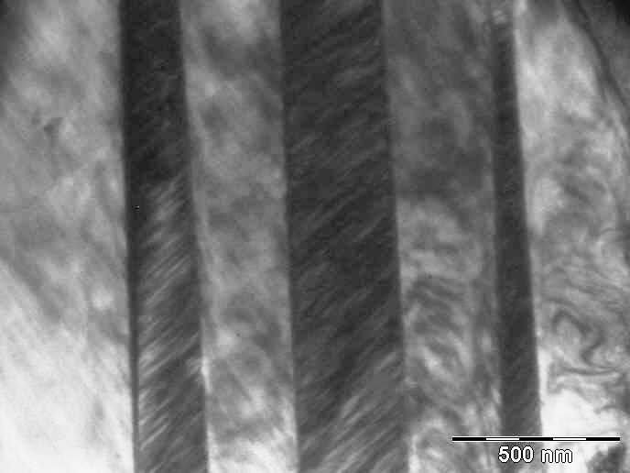
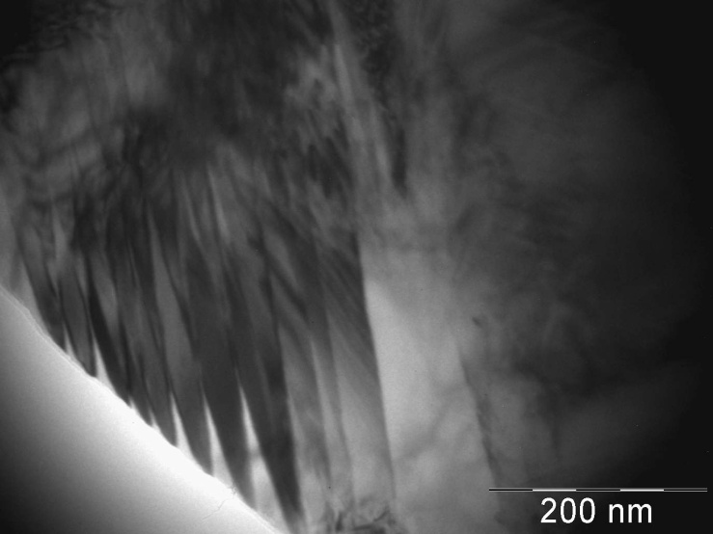
Ferromagnetic Shape Memory
New CSIR for New India
Alloys (FSMAs) by Rapid Solidification
As-Spun Ni₅₅Mn₂₂Ga₂₃
Mart. Start : M_{S}= 142ºC
Magnetic Field Induced Strain (MFIS) in annealed FSMA ribbons
Ni₅₅Mn₂₂Ga₂₂Al₁
Martensite Twins
As-Spun Ni₅₅Mn₂₂Ga₂₂Al₁
Mart. Start : M_{S} = 231ºC
Ni₅₅Mn₂₂Ga₂₃
Martensite Plates

Slide 6
Coatings
New CSIR for New India
Research Area (PVD, CVD, e-beam, Laser cladding, HVOF, Thermal Spray, Plasma Spray)
Hard & tough coatings for wear resistance applications
High temperature and oxidation resistant coatings
Coatings for corrosion resistance application
Recent Projects
Nanocomposite multicomponent coatings of TiSiBC system for wear resistance and less coefficient of friction applications (Ashok Leyland)
Multilayered hard and tough coatings of SiCN system
Cadmium replacement coatings for landing gears in aeroplane (Boeing International)
Anti corrosion, foul fuel sustainable coatings (Tata Steel)
Anticorrosion and anti bacterial coatings (Tata Steel)

Slide 7
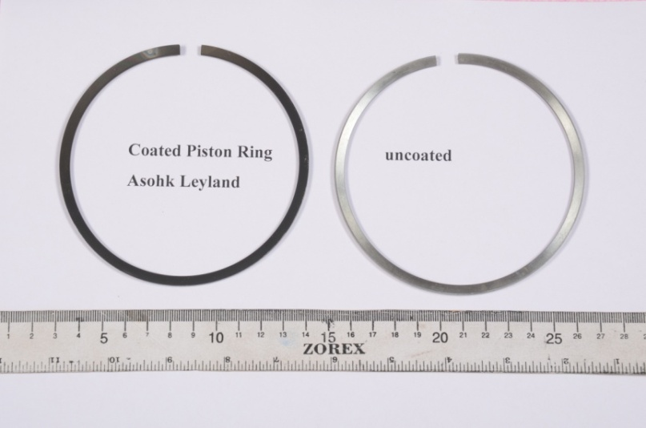
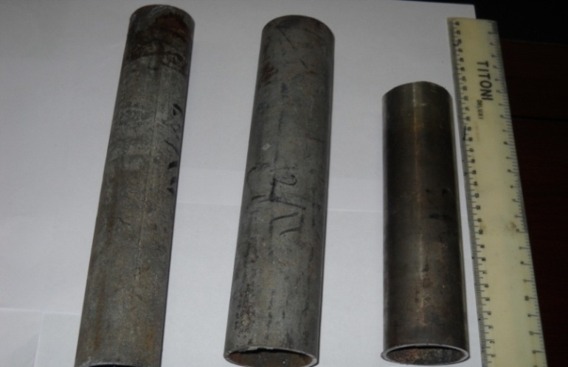
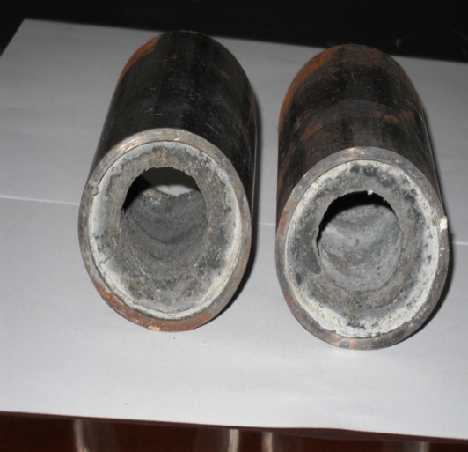
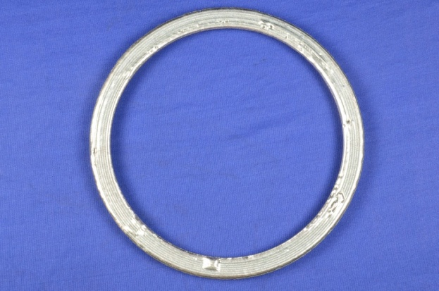
Coatings for various applications
New CSIR for New India
Al₂O₃-Fe coated pipe
Piston ring of truck engine Ashok leyland
Laser cladded hydroturbine guided vanes
Al₂O₃-TiB₂ coated pipe

Slide 8
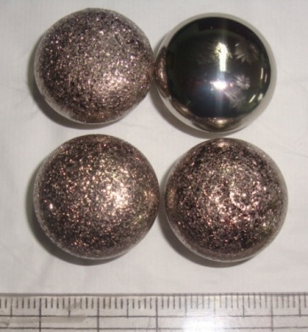
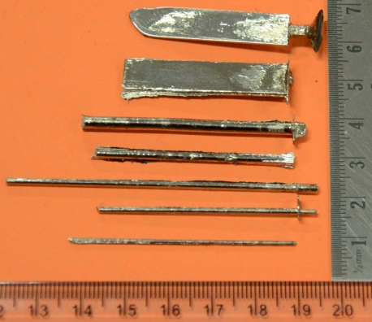
Development of Ductile Cu
New CSIR for New India
based Bulk Metallic Glasses
Alloys BMG’s
Composition of BMGs produced
Cu-Zr-Ti alloys with minor addition
of Nb, Ni, Sn
Size of BMGs produced
Rods: L ~70mm, φ up to 3mm
Plates: L ~70mm, B ~8mm, T ~up to 1.5mm
DSC Curves of Cu-BMGs
Compressive stress strain curves
Compressive strength ~ 2100 to 2700 MPa & Plastic strain up to 16% obtained. A few alloys didn’t break and showed plastic strain >20%.

Slide 9
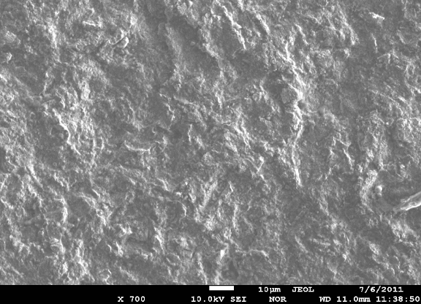
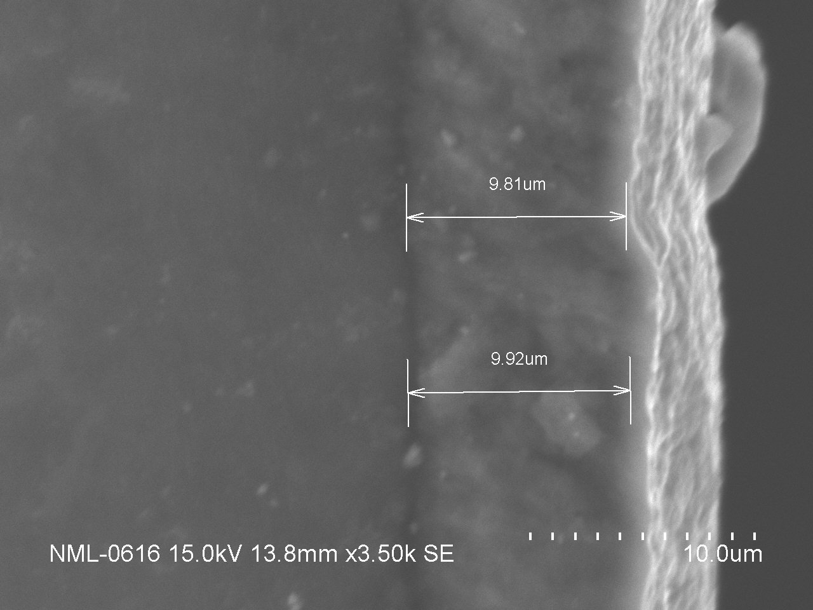
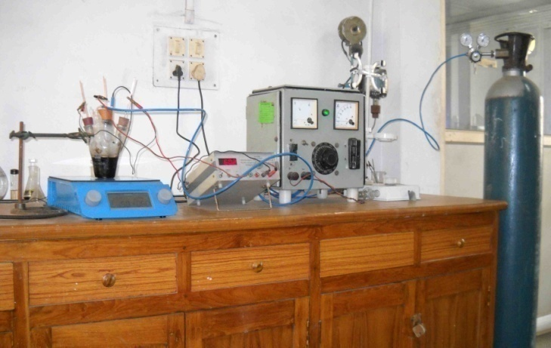
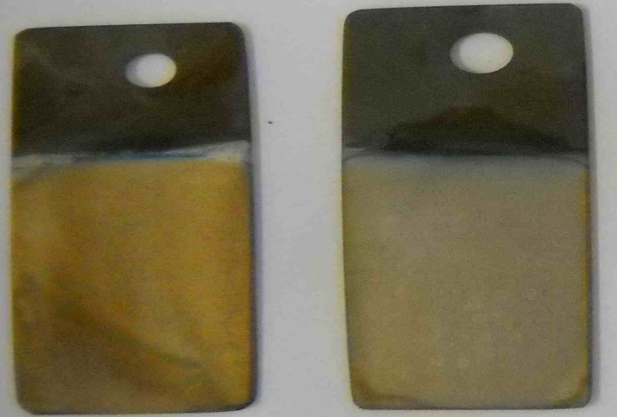
Al Coatings for Cd Replacement
New CSIR for New India
Al coating by PVD process showed dense microstructures and good adhered interface.
Control of oxygen inside deposition chamber is crucial
Photograph of Al coated steel substrate
Al coating by EC process using low cost ionic liquid showed good quality Al films.
Moisture control is crucial.
The process can be scaled up easily.
Electrochemical set up
Chrome passivated EC Al coat ings

Slide 10
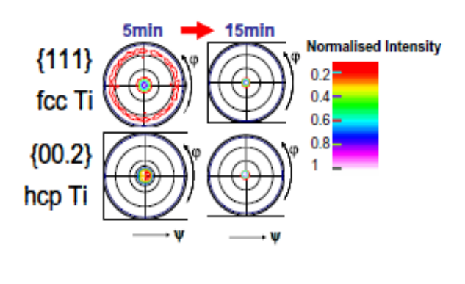
Hcp-fcc phase transformation
New CSIR for New India
of Ti thin film
Ti films on Si(100) substrate:(thickness: 140nm to 717nm)
X-ray diffraction: Phase analysis
Texture evolution
Diffraction stress analysis
140nm
717nm
Rotationally symmetric biaxial stress
Key observations
Fcc Ti: LP = 4.1638Å (this work)
LP = 4.11Å (ab initio calc.)PRB 65(2002)092106
Volume fraction of fcc Ti reduces with increasing film thickness.
Hence, hcp-fcc transformation is film thickness dependent
Texture evolution is driven by surface energy minimization
Compressive stress in hcp matrix decreases with increasing film thickness
Conclusion
At low film thickness, high compressive stress (≥ 2 GPa) in hcp matrix may generate Shockley-partial dislocations which glide on close packed plane (00.2)hcp/(111)fcc in order to change the stacking sequence from hcp to fcc & vice versa.
Fcc phase is stable below a critical film thickness
Chakraborty et al. Acta mater. (2011) 59(7) 2615-2623

Slide 11
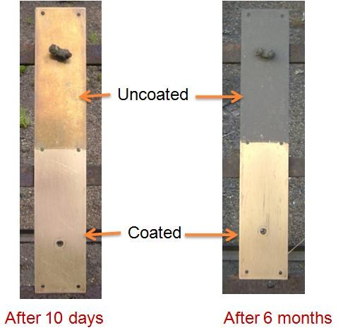
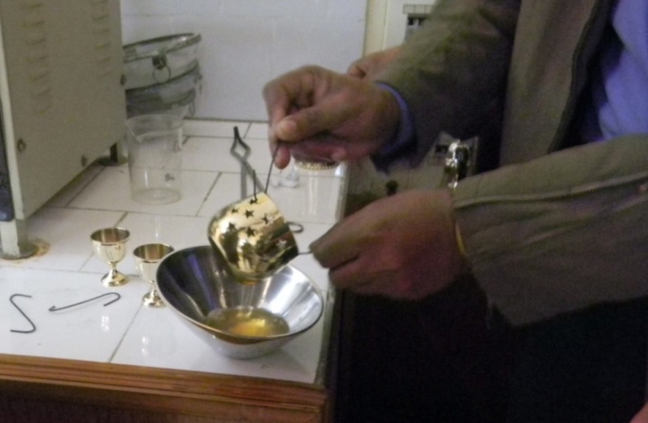
Anti-Tarnishing Lacquer for
New CSIR for New India
Copper & its Alloys
Advantages
Efficiency better than available lacquers
User friendly
  Can be used as dip coating, brush painting or spray coating
Cost effective
Outdoor Exposure test
Dip coating of Brass items

Slide 12
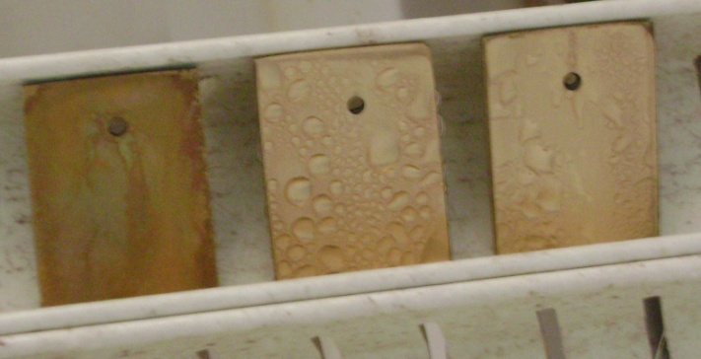
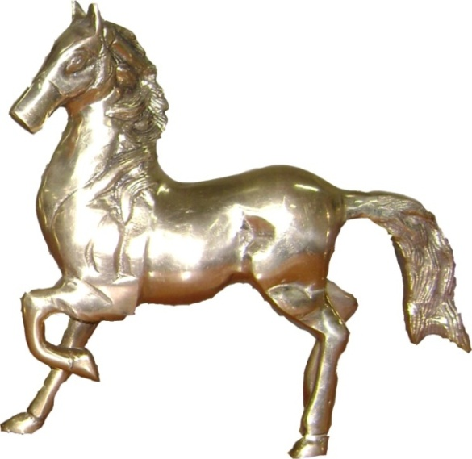
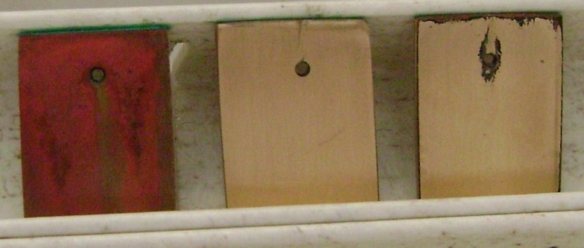
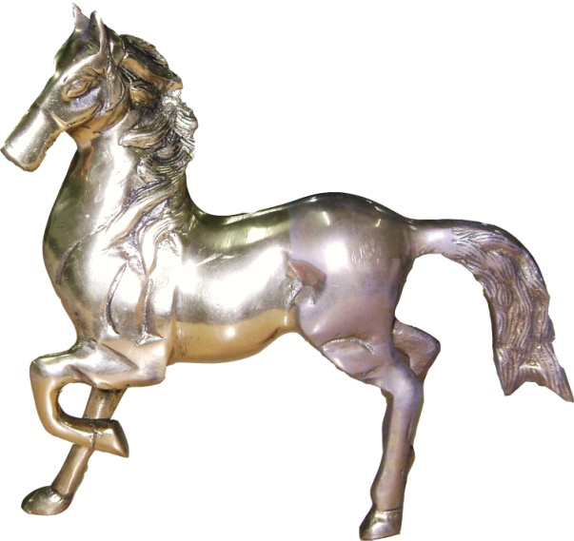
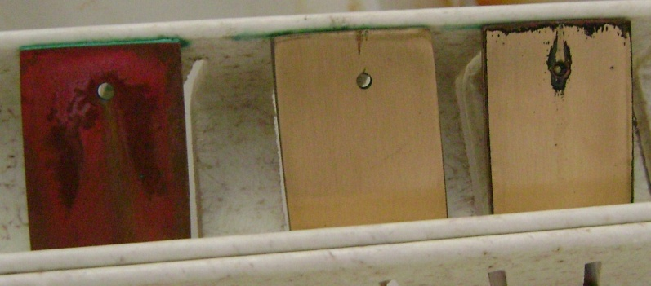
Accelerated Tarnish Test
New CSIR for New India
Salt spray test (ASTM-B-117)
“Flower of Sulfur Test” (ASTM B 809)
Blank
CSIR-NML
Saboo
24 Hours
0 hours
Blank
CSIR-NML
Saboo
10 days
Coated
Uncoated
72 hours
Blank
CSIR-NML
Saboo
20 days

Slide 13
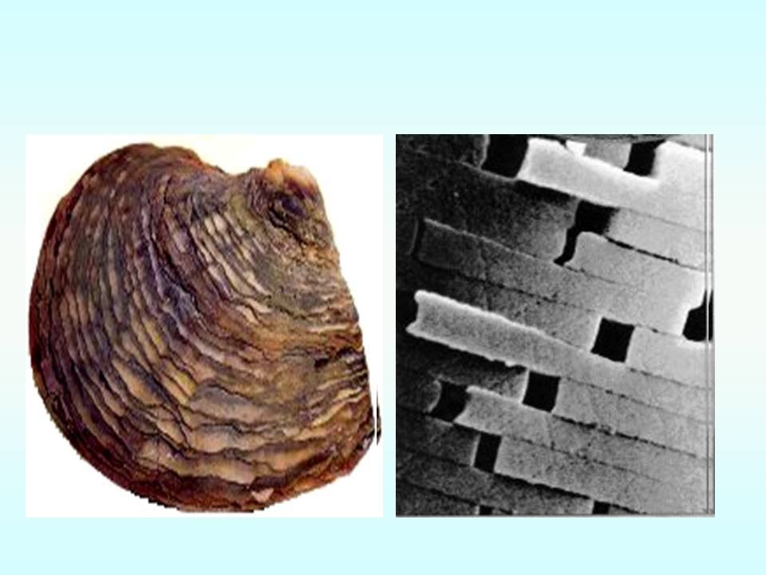
Biomaterials
New CSIR for New India
Inspiration from nature
WHY????
Ambient reaction conditions
Uniform morphology- site specific nucleation & growth
Reproducible Nanosize as matrix is defined
Monodispersity
Projects on two materials:
1. Nanosized hydroxyapatite & its various forms
2. Nanosized iron oxides and aqueous ferrofluids

Slide 14
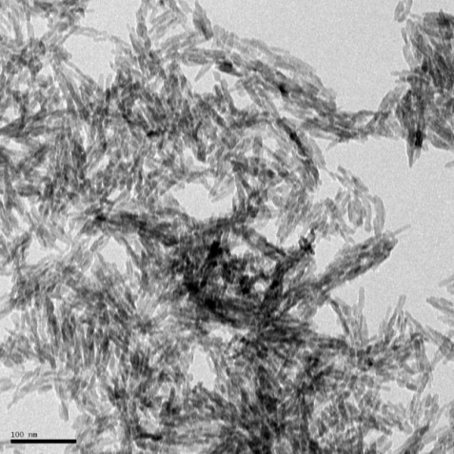
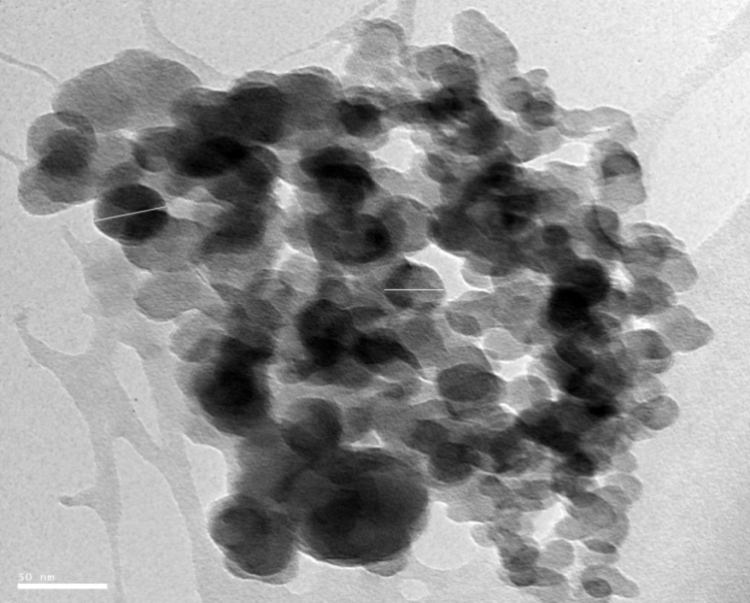
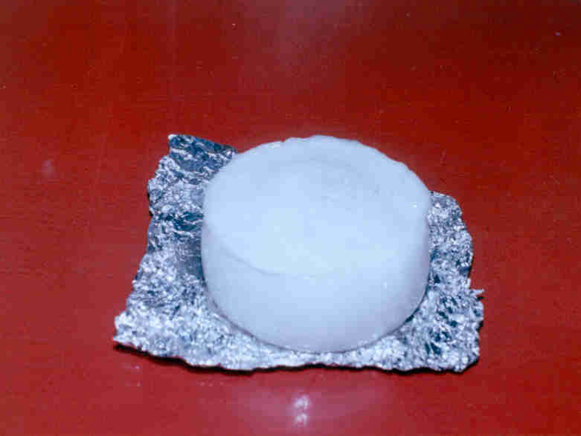
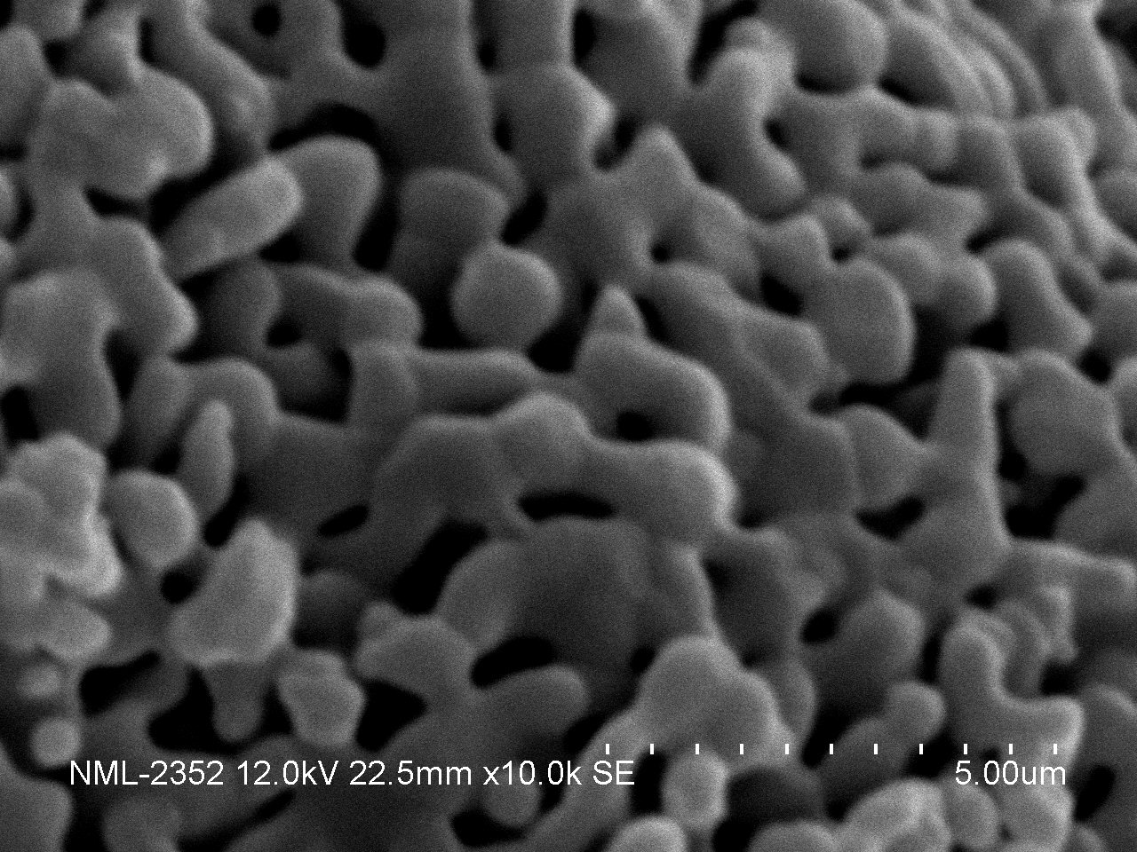
Control Achieved over Morphology
New CSIR for New India
HA Powder
HA& β-TCP Powder
HA & β TCP
3-D HA Block
Microstructure

Slide 15
Comparison with Commercial Brands
New CSIR for New India
Characteristics of Hydroxyapatite | Sigma Aldrich, US | Kemix, US | Ningbo, China | NML
Form | Powder | Powder | Powder | Powder
Particle size | <200 nm | 40nm | 40nm | 25-30nm
Surface area | 10-15 m²/g | - | - | 67.54
bulk density g/cm³ | 2‑6 | - | - | 3.02
Trace elements (ppm) | - | - | - | <0.01
Cost | Rs 7000 | 56$ | 55$ | Rs 2000
Characteristics of Injectable Hydroxyapatite | BONESUPPORT™ | NML
Injectability/ working time | ≥ 4 min (through 16G cannulae) | 7-10 min
Final setting time | ≤ 45 min | 30 min
Compressive strength | 10 - 50 MPa | > 33 MPa
Setting reaction temp | < 43°C | < 30ºC
Hemocompatibility, Cytotoxicity, Initial screening &Sensitivity test, Cell adhesion-both in vitro & in vivo, Carcinogenesis evaluated and qualified

Slide 16



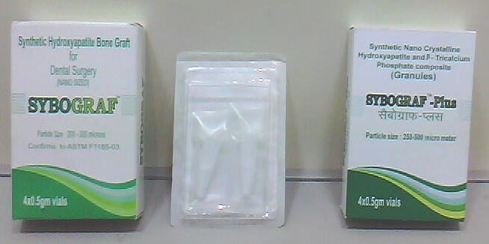
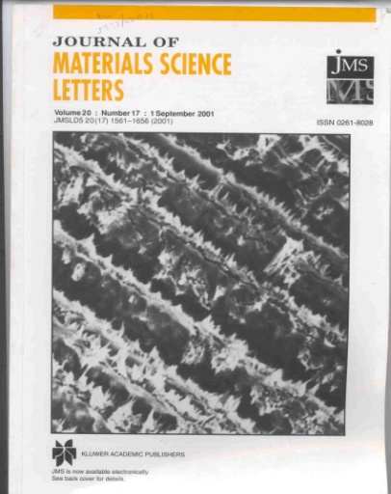
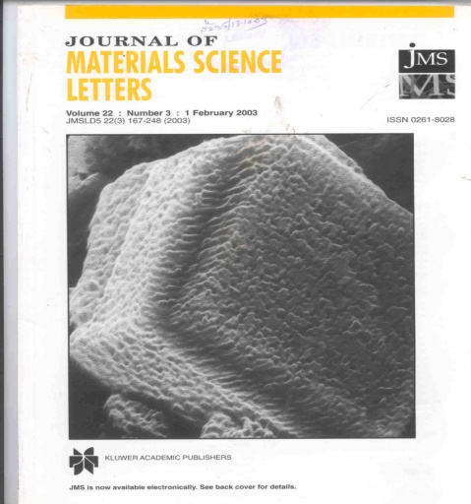
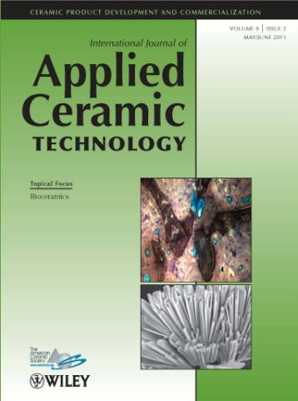
Success Story
New CSIR for New India
Industries with us
Products Commercialized:
Nanosized Hydroxyapatite (Increased mechanical strength)
Nano HA+ β-tricalcium phosphate (Strength & Solubility)
Cover pages of journals

Slide 17
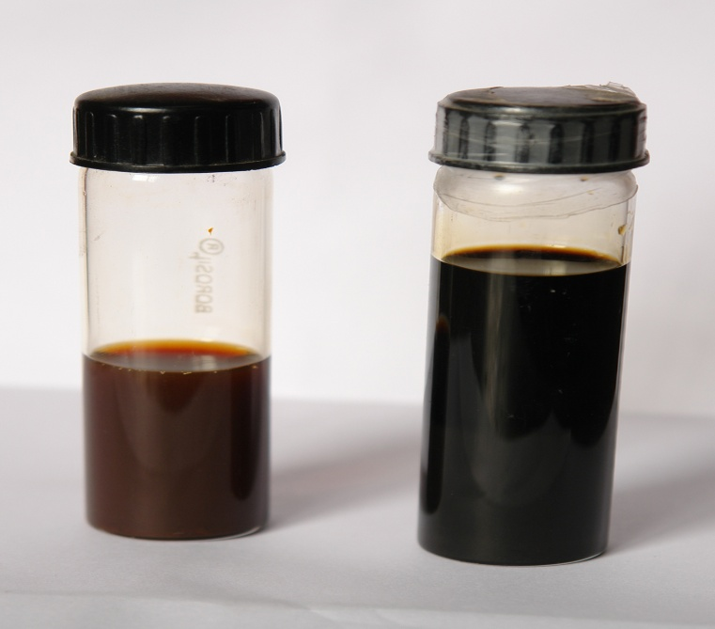
Aqueous Ferrofluids
New CSIR for New India
NML’s BIOMATERIALS GROUP
Magnetite: 0.1- 0.3 % by vol (need to increase)
Size: ≤ 6nm
Dispersant:
biomolecules & water soluble polymers
0.05 – 2.5 % by volume
Water: 97-98% by vol
Solubility in water: Complete
Appearance &odour: Black, no odor
Specific Gravity (at rt)-0.996
Viscosity – 0.982
Boiling Point (°F) - 212° F
Magnetization: 0.23emu/gm
water soluble dried powder-43.34 emu/gm
Colloidal stability:
Zeta Pot: ∼ -15 -18mV
Hydrodynamic diameter: ∼150-175nm
Polydispersity index: 0.1-0.2
Scale of production: one litre
FERROTEC’s EMG series, USA
Magnetite: 0.4-1.1% by vol
Size: 10nm
Dispersant:
not mentioned
0.5–1.5%by vol
Water: 97.4-99.1% by vol
Solubility in Water: Complete
Appearance & Odor: Black Fluid, no odor
Boiling Point (°F) 212° F
Specific Gravity 1.05 to1.07
Vapor Pressure (mm Hg.) 17 @20°C
Percent Volatile by Volume 97.4-99.1%
Vapor Density (AIR = 1) <1
Magnetisation: not mentioned
Colloidal Stability: not mentioned
Scale of production: not mentioned
Hemocompatibility, Cytotoxicity, Initial screening &Sensitivity test, Cell adhesion-both in vitro & in vivo, Carcinogenesis evaluated and qualified
Collaborative work with CCMB & BARC :feasibility studies for MRI & Hyperthermia

Slide 18


